Slide 1
Game's name (TBA)
Level 4/5 Group 15

Slide 2
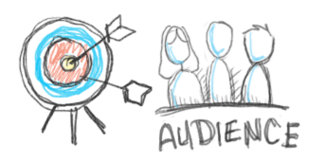
Target Audience
Gender: Male & Female
Age between 16-26
General interests in:
Puzzles
Reading
Narrative driven video games.
Notes:
Callum

Slide 3
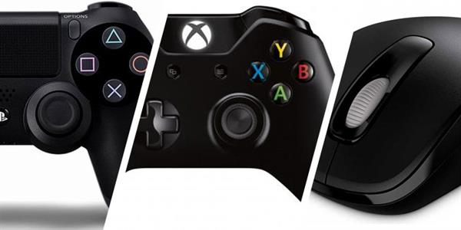
Platform
Our game will be on a PC.
Mac, Linux and Windows.
Selling on average for £5.00
Notes:
Mac(Jake cover)

Slide 4

Logline
The player must endure mundane everyday office tasks and allow their curiosity to take over and reveal the secret of his company.
Notes:
Callum

Slide 5
Liberosis and Monachopsis
Liberosis
•”The desire to care less about things”
Boring tasks
Greyscale, plain office cubicle
Monachopsis
•”The subtle but persistent feeling of being out of place.”
Seeing things that are out of place
More and more incongruous items appear over the course of the game
Notes:
Connor and Jake

Slide 6

The player experience
Over all what we want to try and make the player experience.
Notes:
Callum and Jake

Slide 7

Game mechanics
3D Point and click
Which focuses on a rhythm and repeat matching game.
Notes:
Connor

Slide 8

Structure and rewards.
Player will completes stages
Then the player will be rewarded with hint at the games narrative.
The will repeat this until completions.
Notes:
Callum

Slide 9
Prototype
Notes:
Callum – Video
Connor(Pis/Gifs)

Slide 10
Future plans
Instantiate new files for each level
Add narrative email popups at points throughout the level
Add animation triggers to code
Have new types of folders appear at various points during the level
Notes:
Connor

Slide 11
Any questions?

