Slide 1
Group 8: Presentation 1
James Pyke, Caitlin White, Jack Fuller and George Hutchings

Slide 2
Emotions
Monachopsis - The subtle but persistent feeling of being out of place.
Rückkehrunruhe - The feeling of returning home after an immersive trip only to find it fading rapidly from your awareness.

Slide 3
Target Audience
Predominantly male: 18 – 25
Easy fun – exploration, curiosity & wonder
http://quanticfoundry.com/2015/09/04/game-audience-profiles/

Slide 4
Genre
Metroidvania
Platform Adventure/Puzzle

Slide 5
Gameplay/Level Design

Slide 6
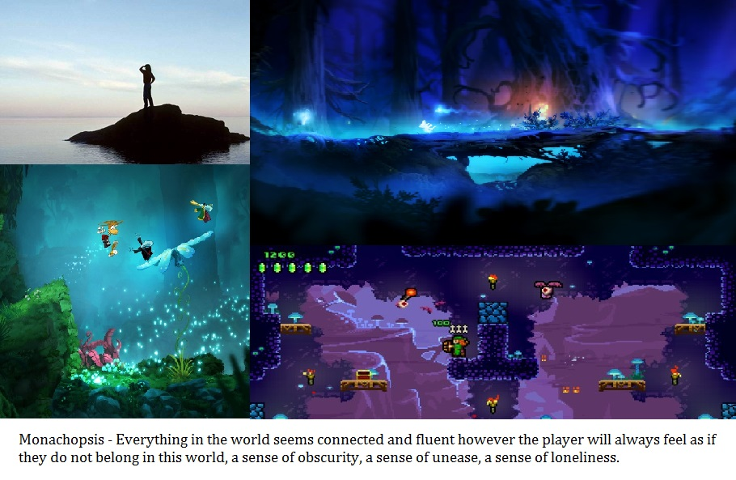

Slide 7
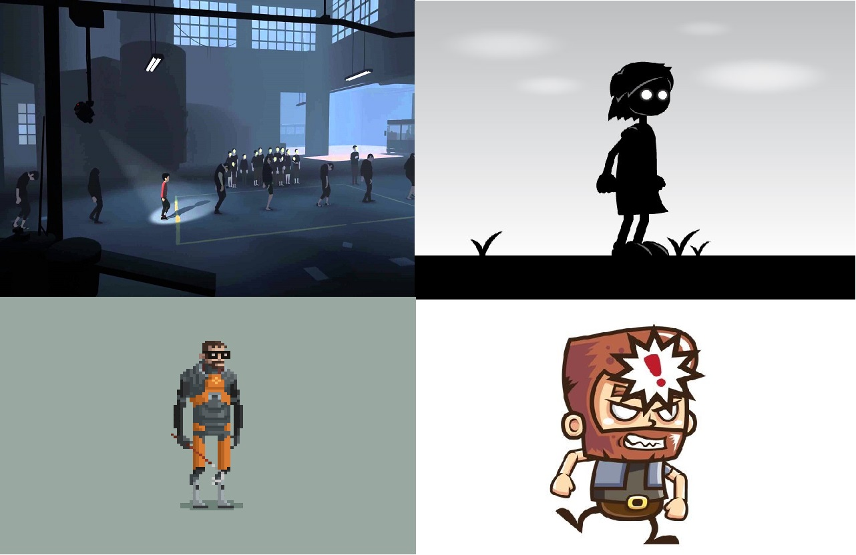

Slide 8
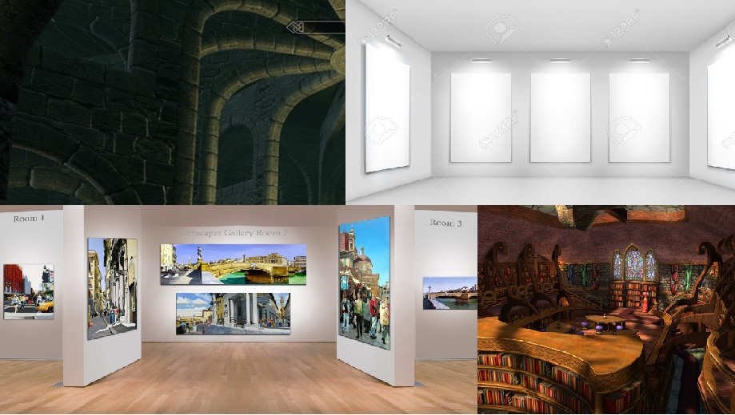

Slide 9
Questions?

