Slide 1
Lvl 4/5 Group Project Group 7
Elliot Page, Michael Curtis, Thomas Barret, Anastazia Hunt

Slide 2
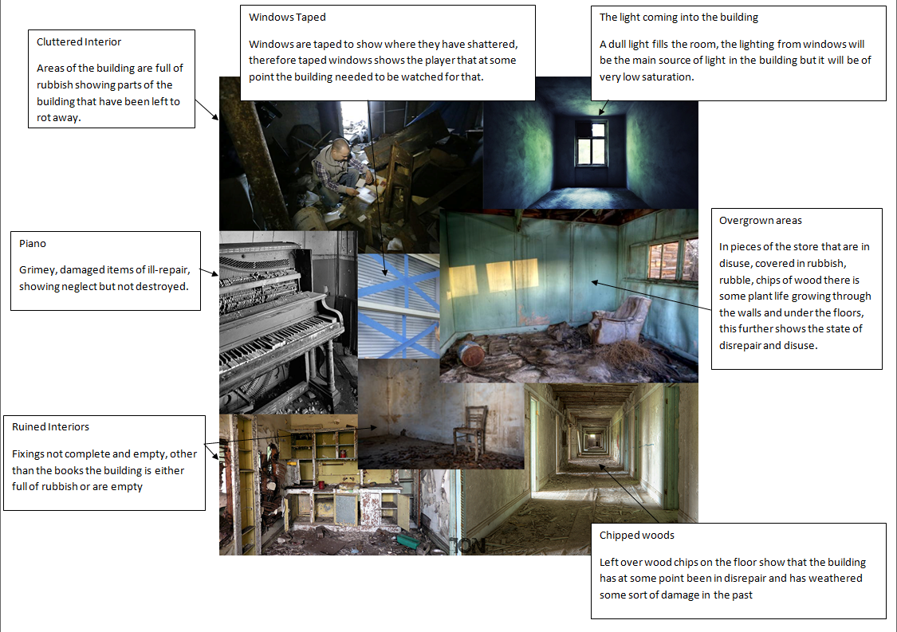
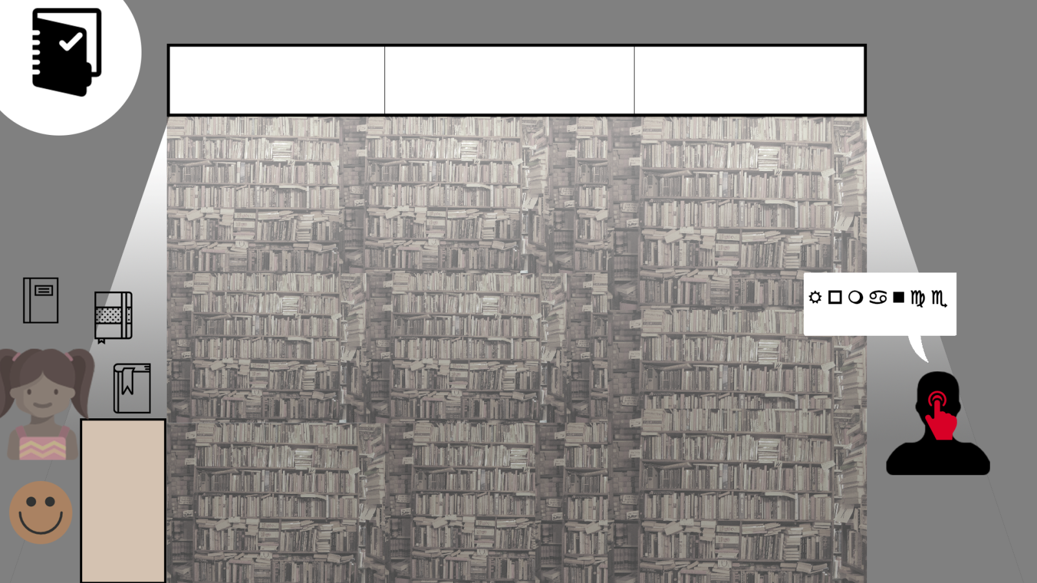
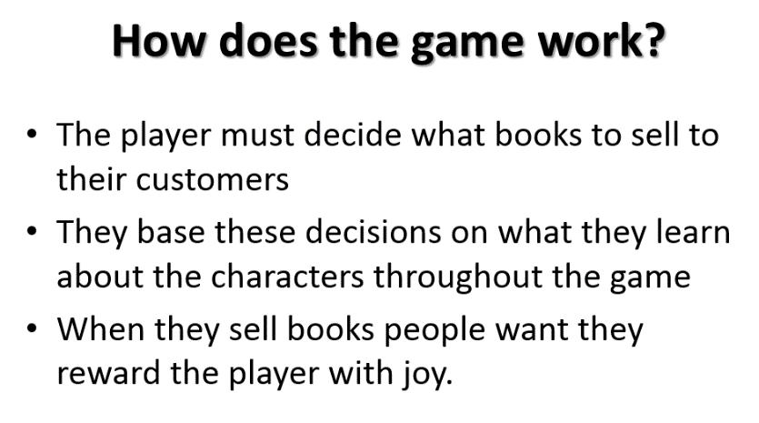
Initial Idea
Vellichor
Adronitis
Player does well when they know the characters
Players don’t do well initially
Frustration

Slide 3
Progress
Prototype here

Slide 4
What’s Next?
Buying Mechanic for books.
Appropriate feedback from customers.
Lasting customer opinion of the Player.
Improving bookshop to reward the player.

Slide 5
Project Management
https://github.com/UoSGamesGroups/first-semester-lvl4-5-group-7/pulse/monthly
Use these graphs before the presentation so they are up to date

Slide 6

Questions?

