Slide 1
Lvl 4/5 Group Project Group 7
Elliot Page, Michael Curtis, Thomas Barrett, Anastazia Hunt

Slide 2
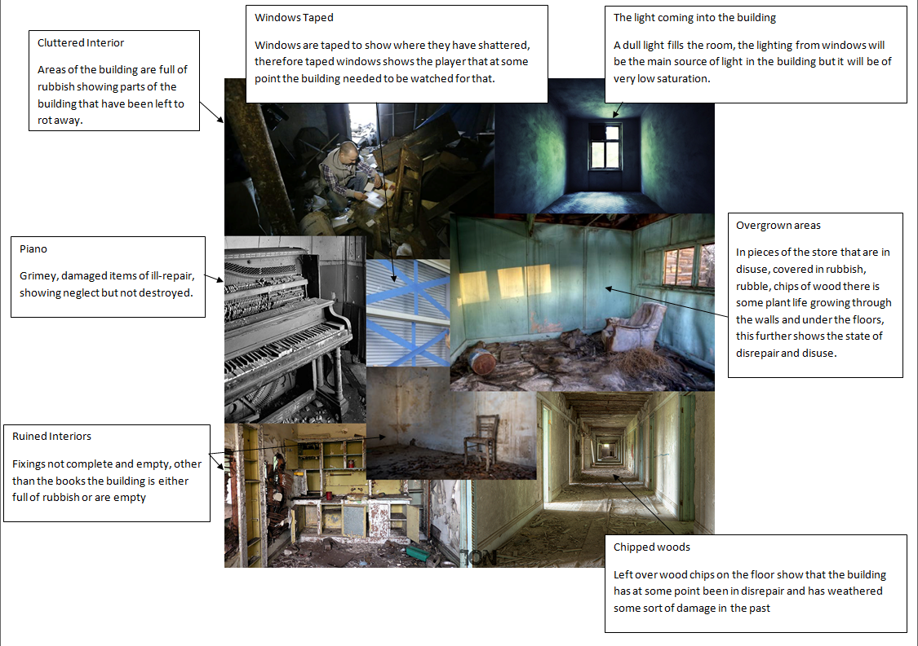
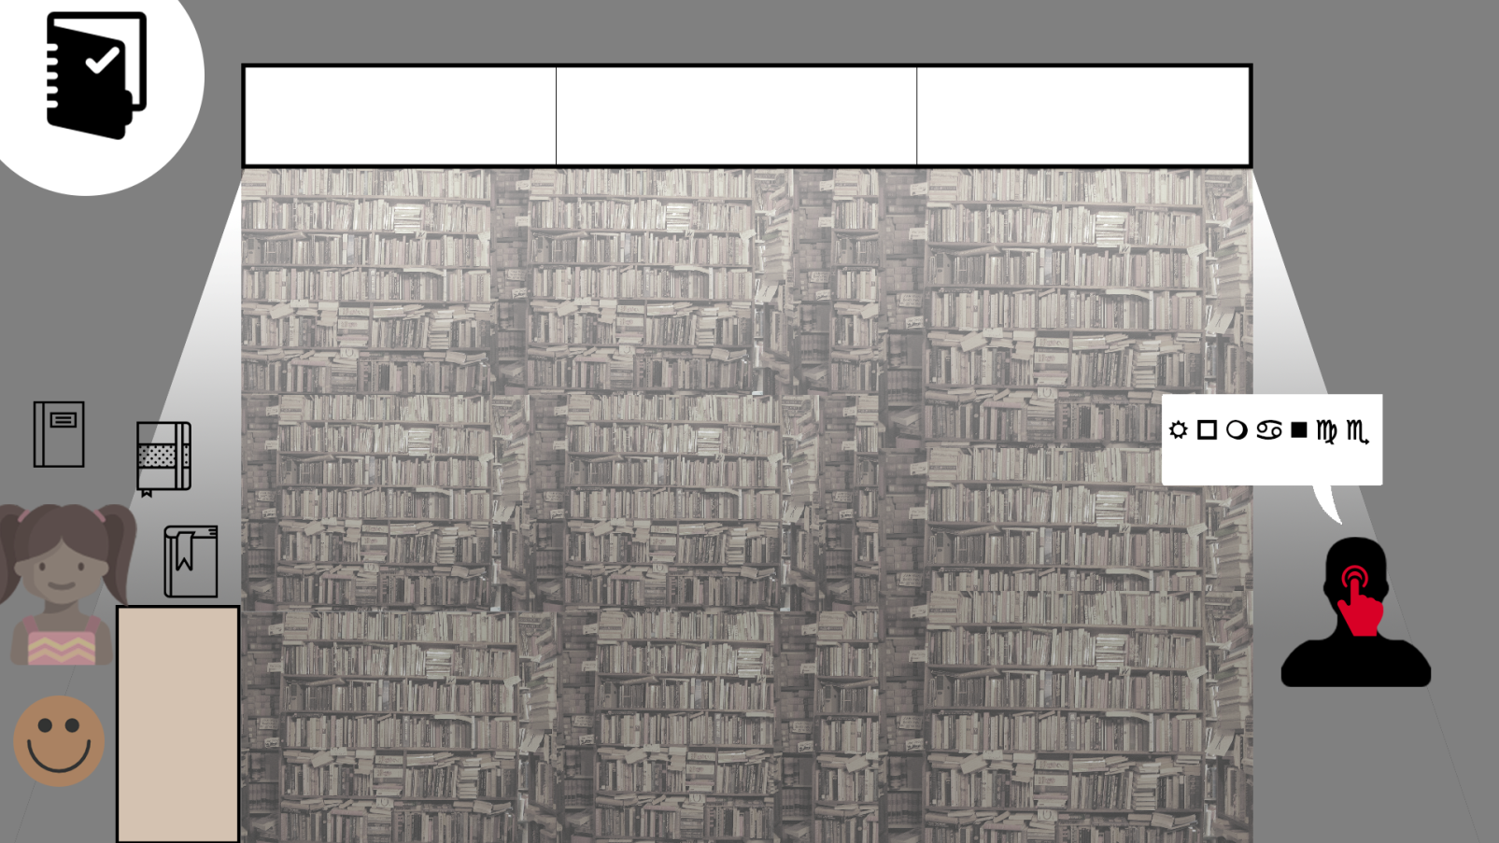
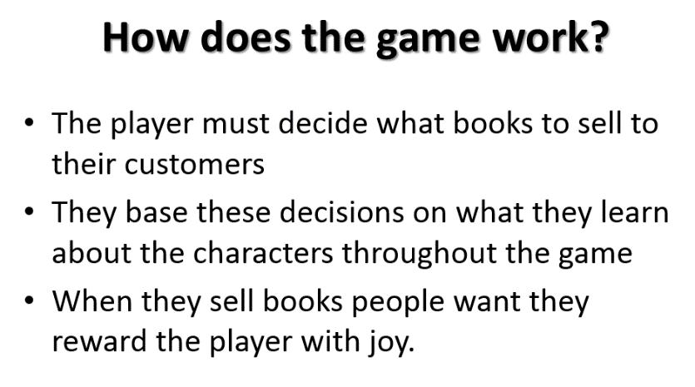
Initial Idea
Vellichor
Adronitis
Player does well when they know the characters
Players don’t do well initially
Frustration

Slide 3
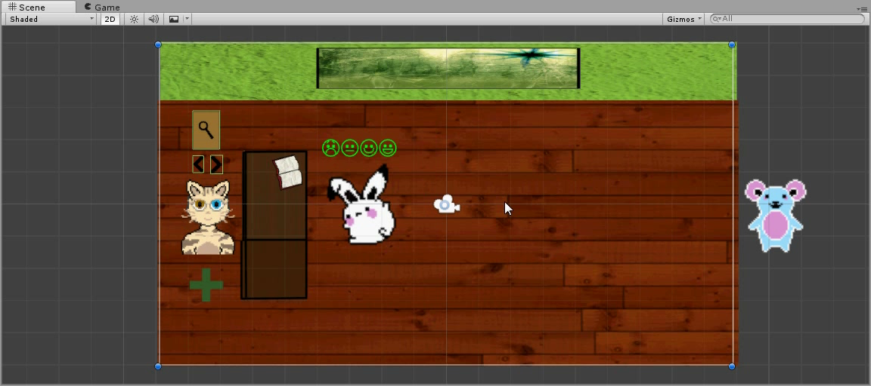
Progress

Slide 4
What’s Next?
Buying Mechanic for books.
Appropriate feedback from customers.
Lasting customer opinion of the Player.
Improving bookshop to reward the player.
Implement additional character sprites.
Implement our music/sounds and our artwork to the scene to promote Vellichor.

Slide 5
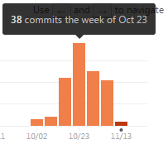
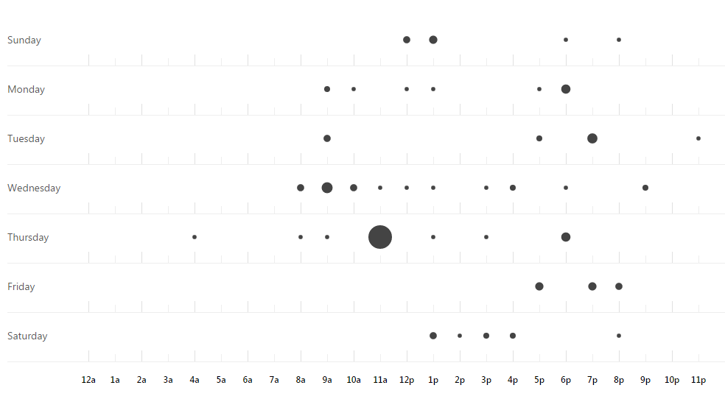
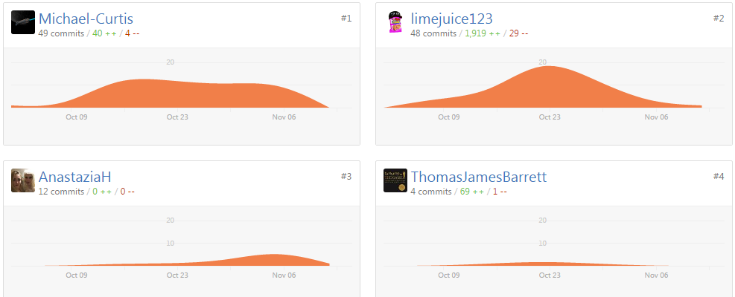
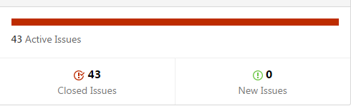
Project Management

Slide 6
Hours
Elliot Page: 23 Hours
Michael Curtis: 17 Hours
Anastazia Hunt: 23 Hours
Thomas Barrett: 20 Hours

Slide 7

Questions?

