Slide 1
Lvl 4/5 Group Project Group 7
Elliot Page, Michael Curtis, Thomas Barret, Anastazia Hunt

Slide 2

Vellichor

Slide 3
Adronitis

Slide 4
Target Audience

Slide 5
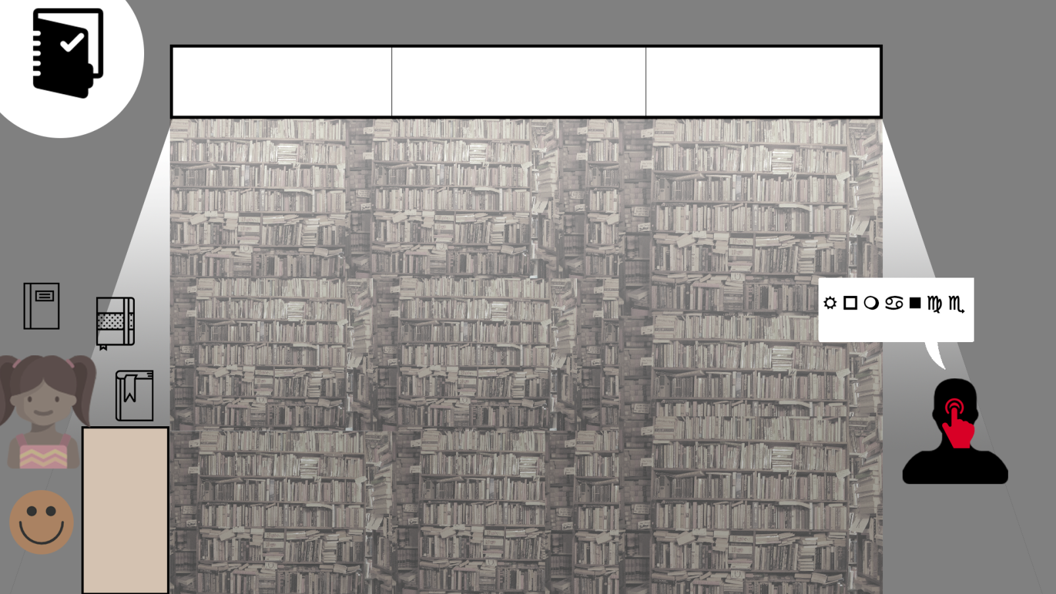
What does the player do?

Slide 6
How does the game work?
The player must decide what books to sell to their customers
They base these decisions on what they learn about the characters throughout the game
When they sell books people want they reward the player with ........

