Slide 1
Of Whom We Hold Dear
Group 1
-Matthew Allum
-Aaron Mulligan
- Lee Hatchman
Notes:
Aaron: 4, 5, 6, 7, 11
Matt: 1, 2, 3, 10
Lee: 8, 9,

Slide 2
Audience/Logline
Take control and experience an ageing MC struggling with anterograde amnesia. Help him discover what he’s lost and find the truth behind his accident.
PC platform – First person perspective
Teens/Young males ~ females
Notes:
Audience/Logline
We will need to discuss who the character will be (example: Gender, age, anything about them unless we’re making it so the player is the character)
Sporadic productivity, will need to have a definition of what it means for the audience for them to have an understanding of what it means.
Could maybe turn the beginning of the logline into a rhetorical question, example: “Ever wonder what really happens to that one person who holds up a game lobby?”
Following it up with: “Come find out by playing as [character] who suffers from sporadic productivity who must complete menial tasks at the expense of others”

Slide 3
Gameplay
[Insert video of gameplay here]

Slide 4
Progression
Sliding puzzle becomes harder (4x4 - 5x5 - 6x6)
Shorter blackout time limit
More areas; more story

Slide 5
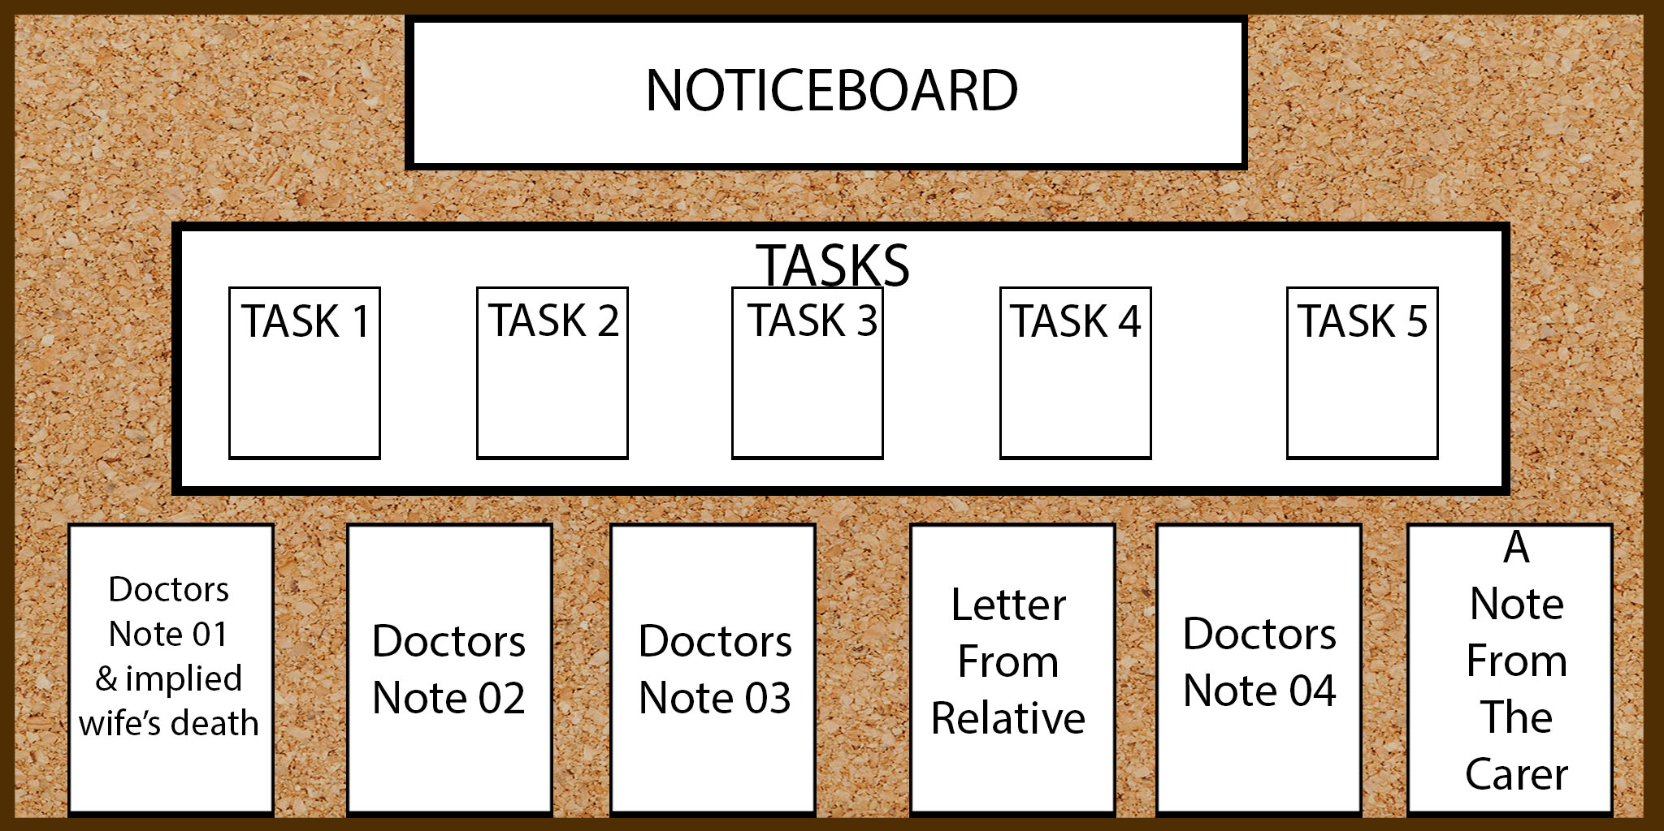
Noticeboard
Central hub for the player to go to
Displays objectives, lore and instructions
Updates as player progresses

Slide 6
The Carer

Slide 7
Relationship between MC and The Carer

Slide 8
Furniture Designs

Slide 9
Puzzle Art

Slide 10
Total Sprint Hours

Slide 11
Future Tasks
Start getting the story in
Complete furniture models
Create and finish The Carer

Slide 12
Questions?

