Slide 1
Of Whom We Hold Dear
Group 1
-Matthew Allum
-Aaron Mulligan
- Lee Hatchman
Notes:
Aaron: 4, 5, 6, 7, 11
Matt: 1, 2, 3, 10
Lee: 8, 9,

Slide 2
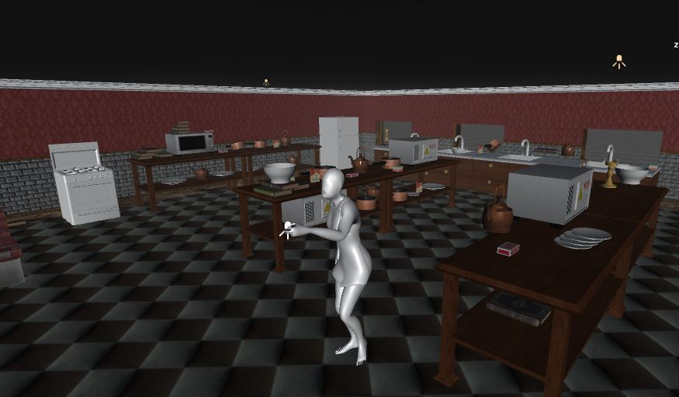
Audience/Logline
Take control and experience an ageing MC struggling with anterograde amnesia. Help him discover what he’s lost and find the truth behind his accident.
PC platform – First person perspective
Teens/young adult males & females
Notes:
Audience/Logline
We will need to discuss who the character will be (example: Gender, age, anything about them unless we’re making it so the player is the character)
Sporadic productivity, will need to have a definition of what it means for the audience for them to have an understanding of what it means.
Could maybe turn the beginning of the logline into a rhetorical question, example: “Ever wonder what really happens to that one person who holds up a game lobby?”
Following it up with: “Come find out by playing as [character] who suffers from sporadic productivity who must complete menial tasks at the expense of others”

Slide 3
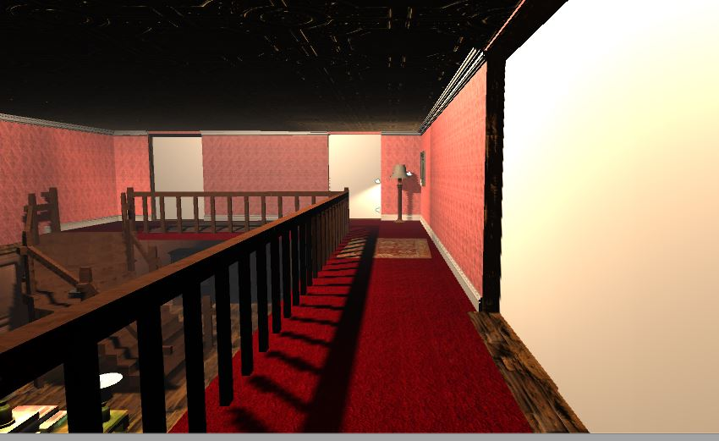
Gameplay

Slide 4
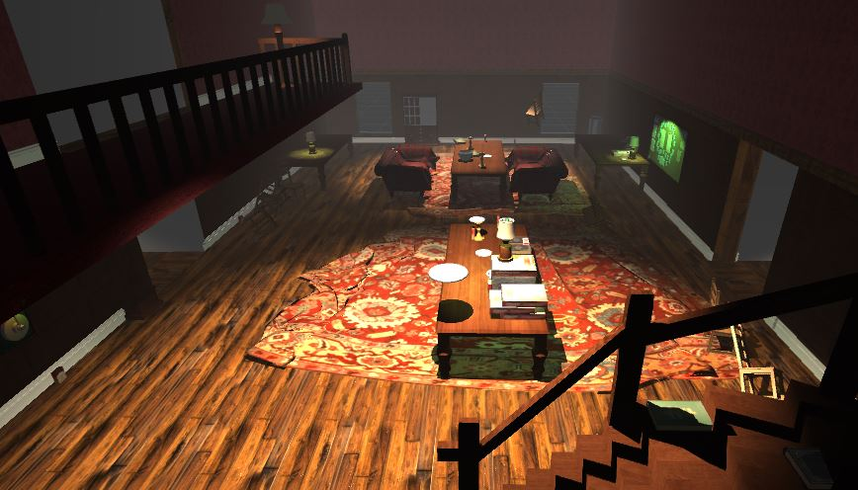
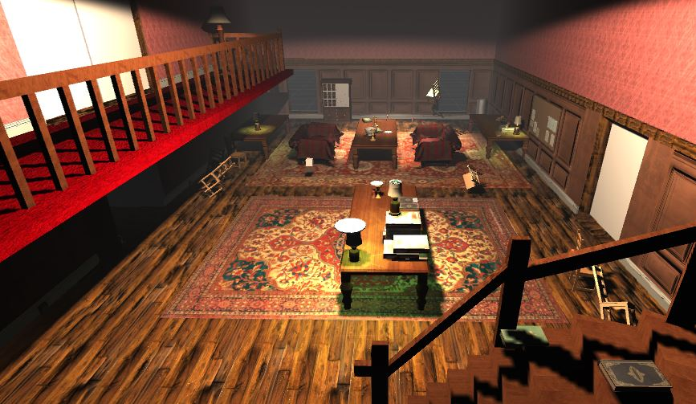
Lighting
Attempt to create more dynamic lighting
Finding problems with how the lighting behaves
Unity 5.6 Lighting Modes – potential solution?

Slide 5
Playtesting Setup
Matt’s laptop and headphones
Cafeteria of Atrium building
Asked students to play test our game
Total 4 play tested for 5-10 minutes each

Slide 6
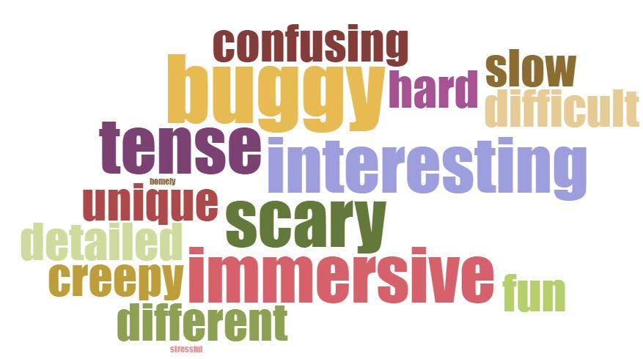
Playtesting Feedback

Slide 7
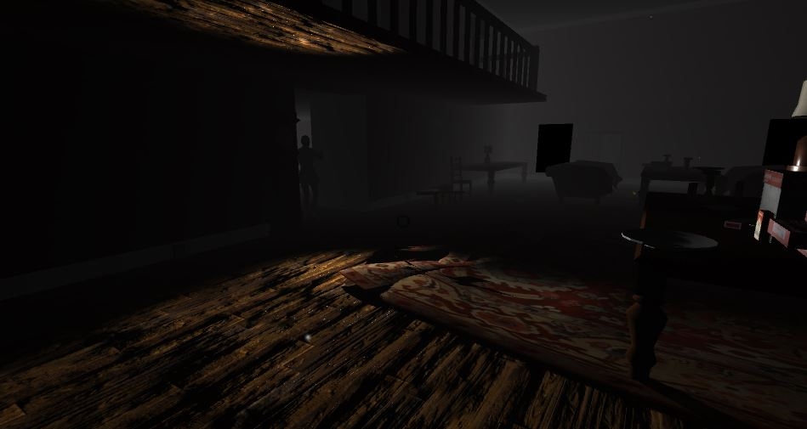
Playtesting Positives
Interesting – game mechanics & game premise
Scary – specifically the carer
Immersive – sound and the house detail

Slide 8
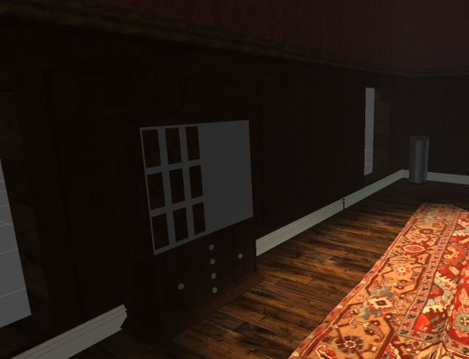
Playtesting Negatives
Buggy – lots of bugs need addressing
Confusing – need more clearer instructions
Slow – player feels too slow, especially when chased

Slide 9
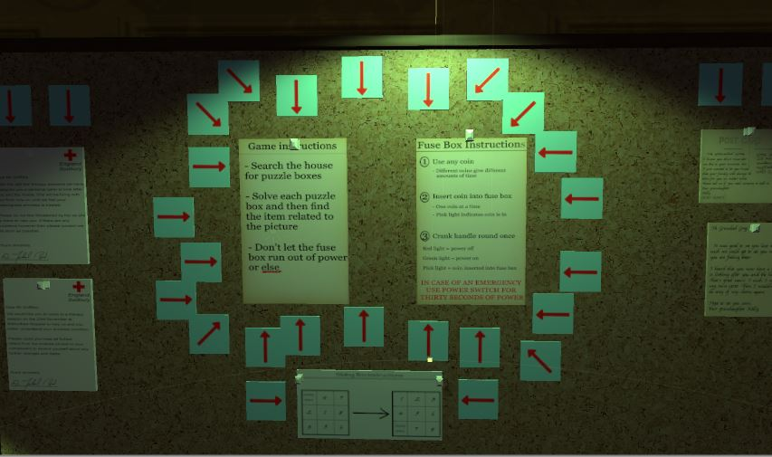
Future tasks
Fix all the bugs
Make in game instructions clearer
More playtesting

Slide 10
Questions?

