Slide 1
Of Whom We Hold Dear
-Matthew Allum
-Aaron Mulligan

Slide 2
Audience/Logline
Take control and experience an ageing MC struggling with anterograde amnesia. Help him discover what he’s lost and find the truth behind his accident.
PC platform – First person perspective
Teens/Young males ~ females
-Most likely to assimilate and relate with the game idea
-Empathy – Paul Ekman’s sixth emotional trigger
Notes:
Audience/Logline
We will need to discuss who the character will be (example: Gender, age, anything about them unless we’re making it so the player is the character)
Sporadic productivity, will need to have a definition of what it means for the audience for them to have an understanding of what it means.
Could maybe turn the beginning of the logline into a rhetorical question, example: “Ever wonder what really happens to that one person who holds up a game lobby?”
Following it up with: “Come find out by playing as [character] who suffers from sporadic productivity who must complete menial tasks at the expense of others”

Slide 3
Mental Disorientation/Panic
Our core emotional responses
We will determine success on our ability to get Disorientation/Panic from our player audience.
Stanley Parable Torpor Layers of Fear
Momento 50 First dates
Notes:
Panic
We need to discuss how to measure ‘Panic’ and ‘Confusion’ in gaming, therefore playtesting will be vital during our game’s development.
We may need to measure ourselves or other people’s reactions to the games below (primary or secondary data research) to see how others react to those games
We could also look into other games as well to look at these emotional responses.

Slide 4
Narrative Structure
Reverse Narrative structure (Christopher Nolan’s Memento)
-Enhance the player's sense of disorientation
MC suffering from anterograde amnesia
- MC is trying to piece together memories of someone they love and what has happened to them
Seven sections of the game
- Player experiences the increasing struggles of the MC

Slide 5
Breakdown Structure
Prologue – Inciting Incident - MC falls down the stairs
Memory 1 – Memory reveals something off in your home
Memory 2 – Realised someone else living with you
Memory 3 – Person with you is closely connected to you
Memory 4 – Revealed to player its your wife
Memory 5 – Find out your wife has passed away
Epilogue – “Inciting Incident” - MC falls down the stairs
Notes:
Breakdown Structure
Players will need to feel engaged and interested in the game to do these tasks, therefore it’s critical that we make these sporadic objectives are different in what you must do (Example: If all is ‘Get this item: …. ‘ this may bore the player)
The timer measure how long the player has to do the task and return to their desk to play (could have multiple tasks for them to do).
We could introduce more elements to put the player under pressure when doing the task (example: avoid the dog whilst getting the water)

Slide 6
Mechanics
Seeking & Puzzle (Jigsaw) – Easy and Hard fun
For each memory, players must find specific items
-A note will display on a noticeboard in the hallway which the player must find.
-Seek out the items on the note in any of the rooms open
The puzzle will be our mental challenge
-Puzzle will be in a form of a jigsaw which players must piece together
-The more players find and solve memories the harder the jigsaw puzzle will become
- Players must also be aware of The Carer and avoid being ‘caught’ doing a puzzle

Slide 7
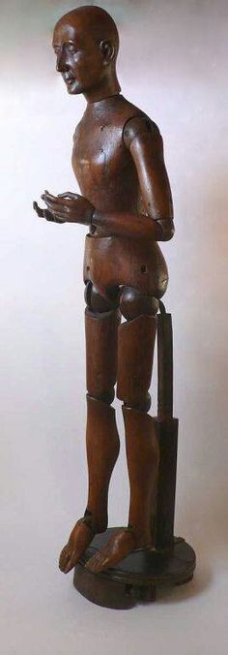
The Carer
Designed to cause panic through perceived threat when players are completing a puzzle
MC is scared of The Carer; The Carer just wants to help
The Carer will take the form of a mannequin to unsettle players, portraying how the MC feels about The Carer

Slide 8
Disorientation
Orientation is knowledge of one's personal identity, location, date, time and present situation
Starting at the end and working to the start: mystery & disorientation.
Using environmental factors, we can alter some of the senses which make up Orientation
-All furniture is moved around the rooms after a length of time
-Clock out of control, no idea of time

Slide 9
Panic from Pressurized Events
The Stakes will be delivered both through the mechanics and narratively
-Narratively anterograde amnesia is portrayed through a timer rearranging the furniture within the rooms.
Further, panic from the mechanics
- Completing puzzles before the reset
- Avoiding The Carer from catching the player during a puzzle

Slide 10
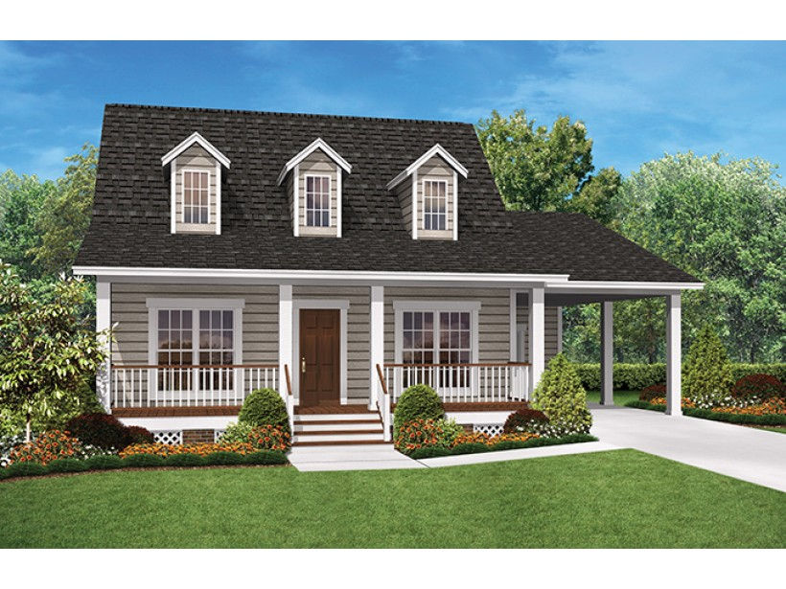
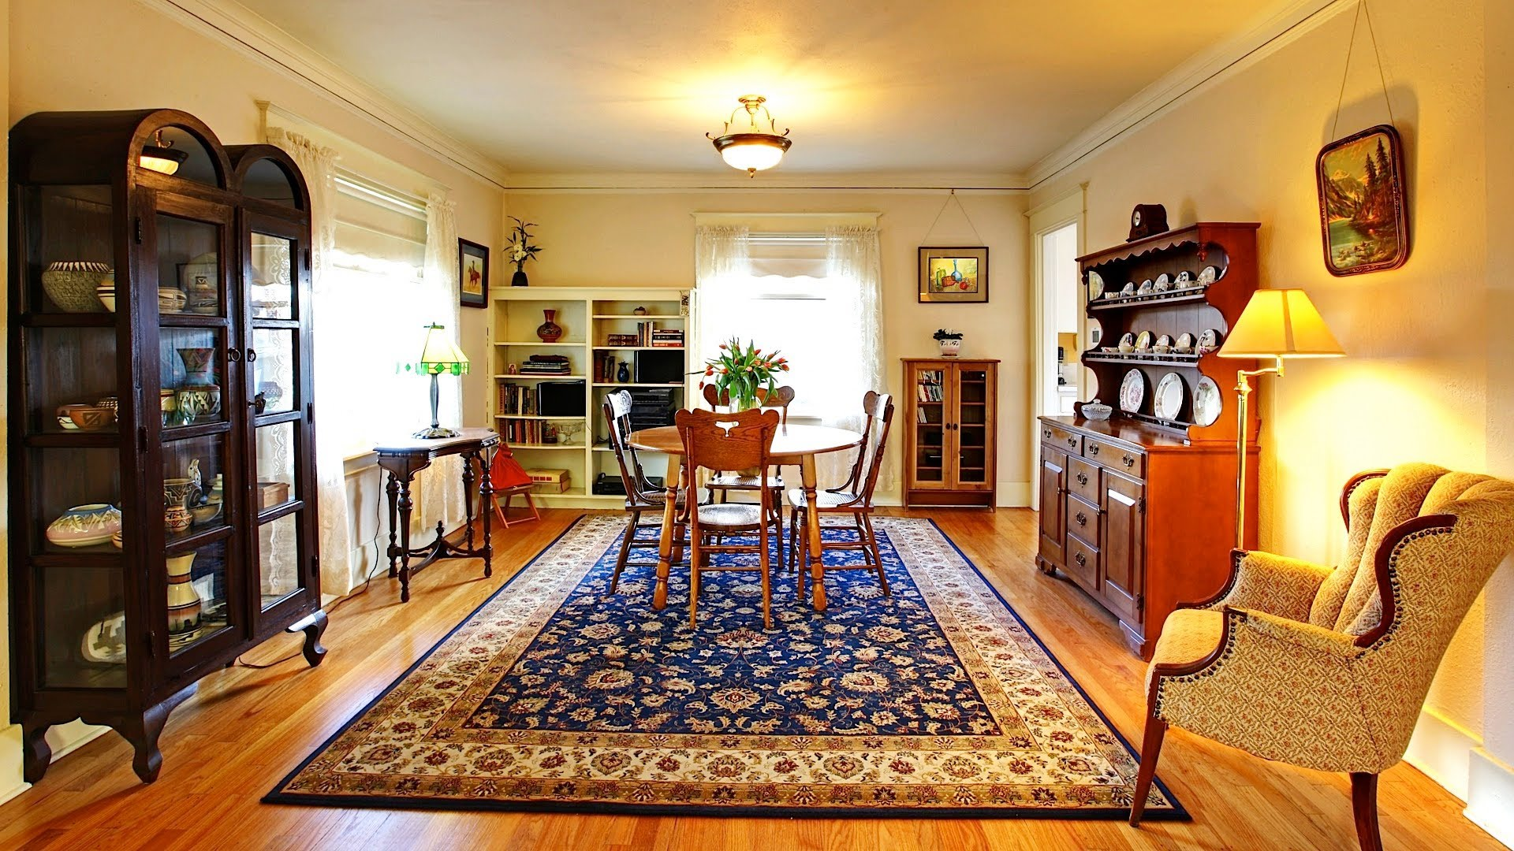
Setting
Location will be in MC’s house in the countryside
Country house interior – wood furniture, wooden flooring, painted and stone walls, old carpets
Old fashioned furniture to reflect MC’s age
Notes:
Setting
- Better to discuss once we have the brief finalised

Slide 11
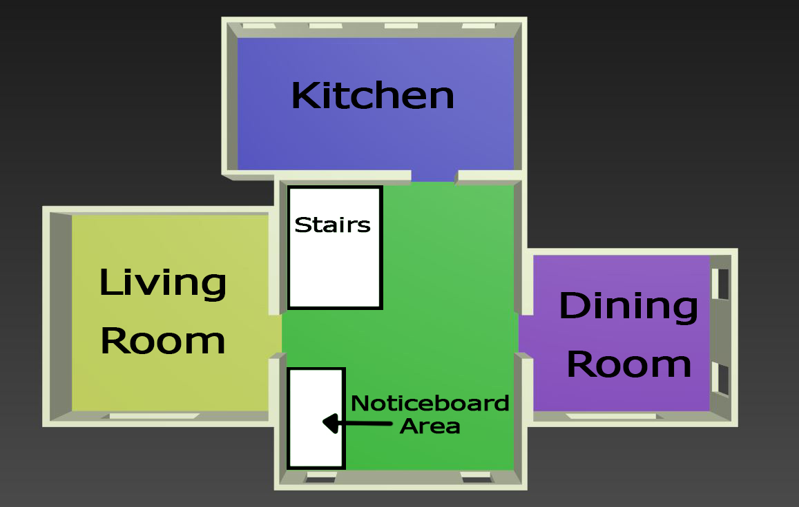
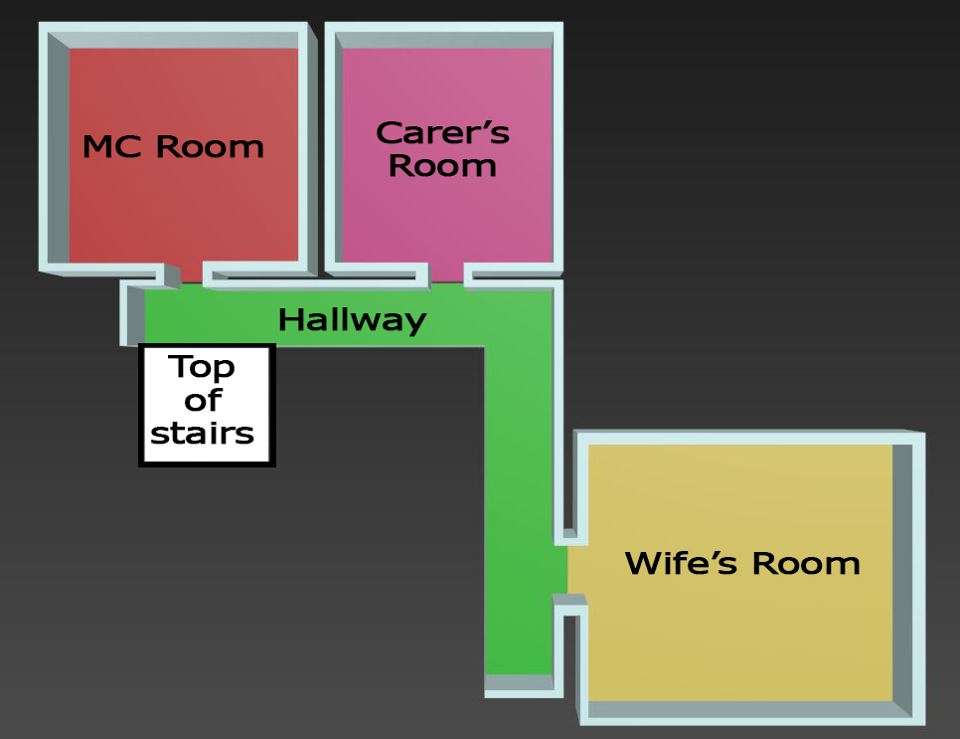
Floor Plan
Bottom Floor
Top Floor

Slide 12
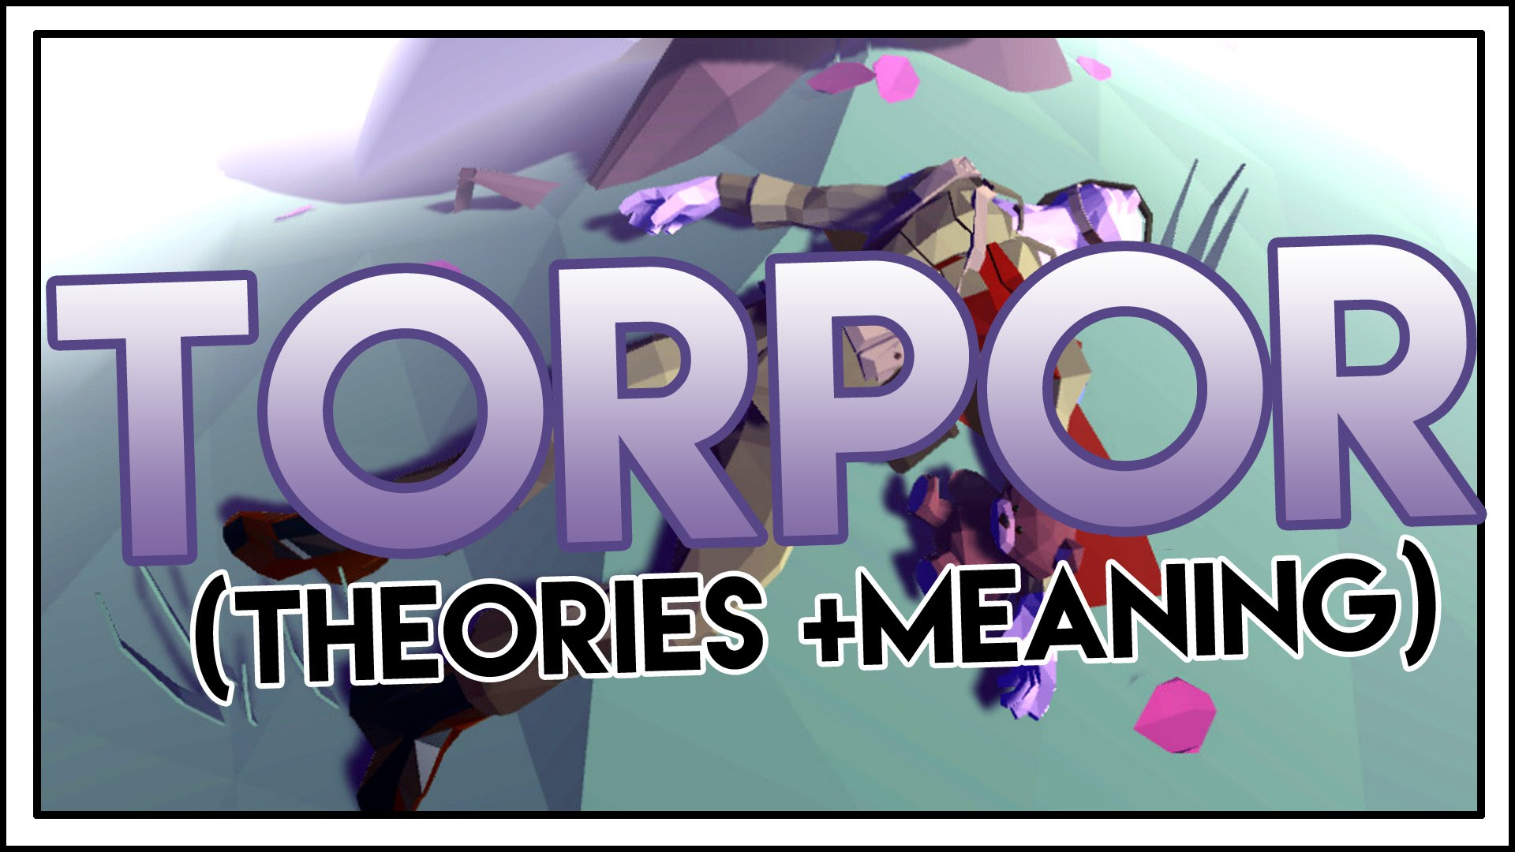
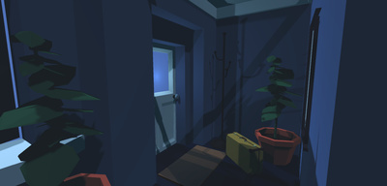
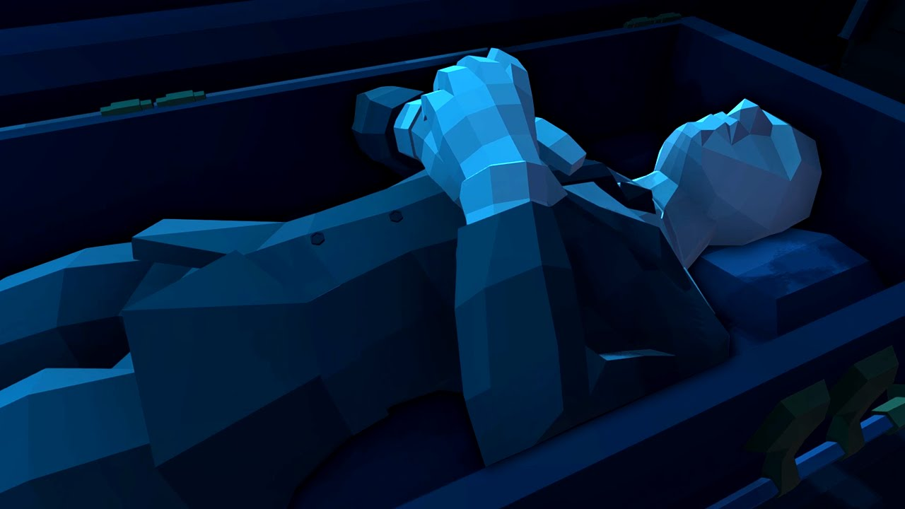
Art Style
Low Poly Angular Assets (Torpor)
Greater control of the visual hierarchy
Allows us to distinguish player objectives better
Realistic for a two man team

Slide 13


Progression and reset
Spec Ops The Line’s uses fade to white/black to subtly emphasise if something is real
Mental instability
Progression: fade to white
Failure to complete memory within timer: fade to black to restart the memory.
Carer reset: Caught in a puzzle

Slide 14

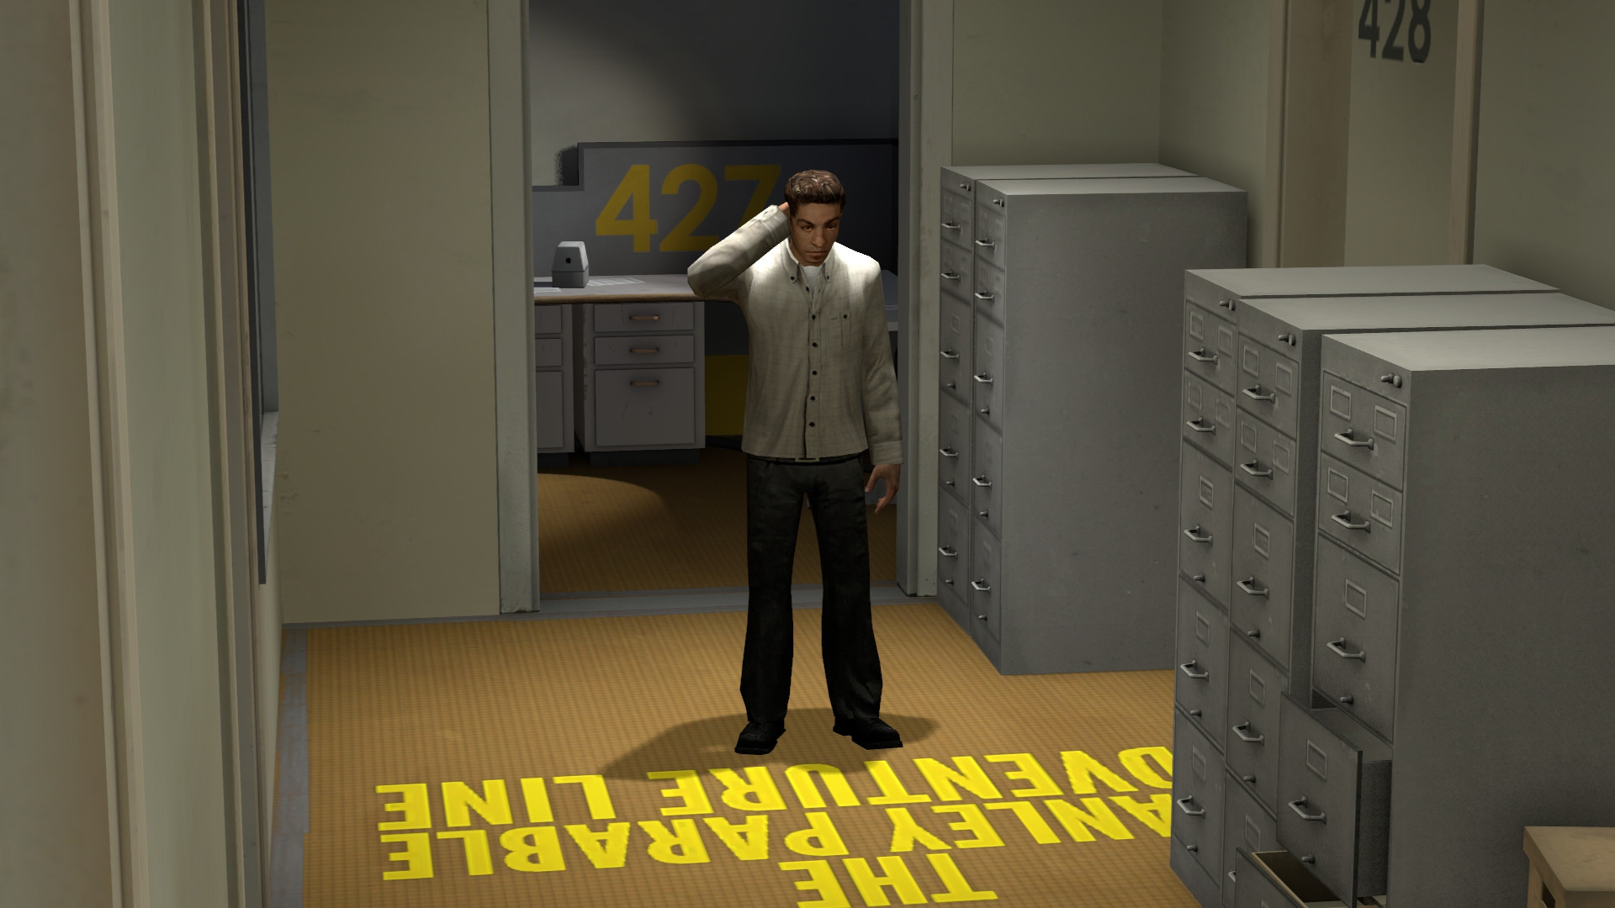
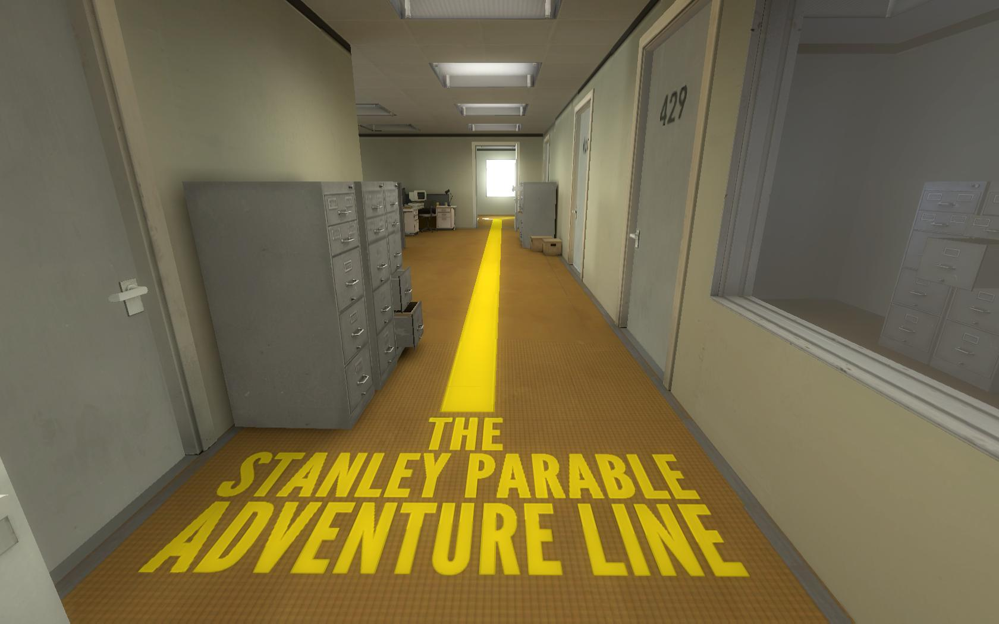
Flow States
Frustration (fiero) is not something we want our audience to experience
Tension and release are more suited
-We want our audience to be panicking/disorientated (Tension)
-Then a degree of uncertainty/curiosity to know if you have progressed (Release)

Slide 15
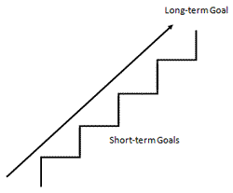
Short/Long Term Goals
Short term: Completing the immediate objective in finding the next memory and completing the puzzle
Long term: Working out what the story means.
Notes:
Short/Long Term Goals
Short term: Players complete the task/objective and then can proceed to the next one.
Long term: Players will build up a streak of successful tasks completed which could unlock something rewarding/achievements/something good for the player, however they also risk losing their streak
Losing results in their streak ending
We could have a way of allowing the player to choose what task/s they wish to carry out, or allowing them to choose a special reward instead of carrying on the streak. The Special Reward could help the player further their next streak attempt by jumping levels, stopping pressures on a certain level, stopping the time, giving time etc.

Slide 16
Questions?

