Slide 1
Group Project Level 6 Group 3 Initial Pitch
Ionut Vericiu
Dragos Dumitru

Slide 2
Genre: Hack-n-Slash with RPG elements
Platform: PC
Target audience: (research link)
*main audience: traditional gamers(16-35years old, tend to buy games, play for more than an hour/day, have past experience with games);
*secondary: 35+ male audience which have past game experience;

Slide 3
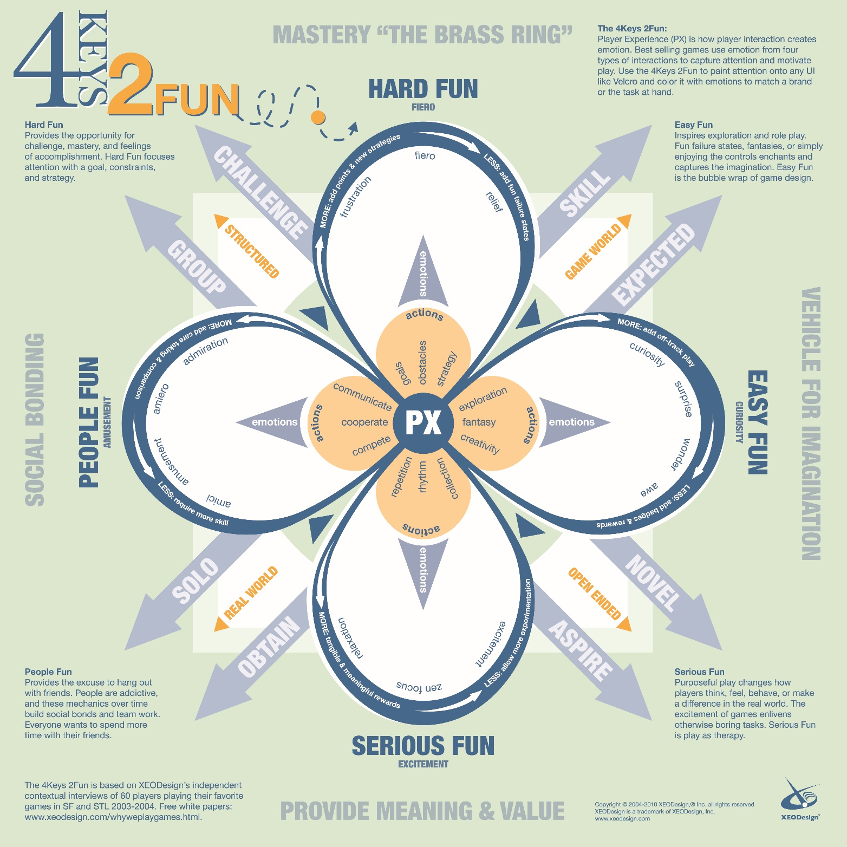

Slide 4
First introductory cutscene in game
Brief history about the main character:
*adventurer;
*always looking for new place to explore;
* loves collecting artefacts;

Slide 5
Second introductory cutscene in game
About the boy who saved his life:
*orphan
*died soon after he met the MC
*”I would do ANYTHING to bring you back”

Slide 6
Last introductory cutscene in game
Inciting incident:
*in the last adventure MC stolen a cube-shape artefact
*a voice in the cube propose to bring the child back to life if the MC returns it

Slide 7
Point of no return
MC goes back to temple guided by the voice in the cube through the temple’s traps;
Shortly after, the voice in the cube tricks the MC and it gets killed by falling into a deep pit.
Cube revives MC.

Slide 8
Equilibrium changes
Now that the MC is reanimated, he is obliged to kill and feed on enemies souls in order to stay alive and accomplish this quest;
He has to give up on humanity;

Slide 9
Middle Confrontation
Most of the gameplay takes part here;
Gather info about the voice in the cube at the beginning;
Gather info about the cube;
Fight your way to the climax;

Slide 10
Climax
Battle the demon who murdered your son and tried to kill you, as well.

Slide 11
Resolution
The MC escapes the temple;
Reached the graveyard but the cube won’t resurrect the child;
The MC propose to give the cube his body so he can freely feed on souls forever;
Cube accepts and boy is revived;
The MC is sacrificed.

Slide 12
Gameplay
5 weapons each having 3 different upgrades;
Level system that grants bonus health points/damage points;
Cube progression that unlocks the weapon upgrades.

Slide 13
The emotions:
Sadness and anger through story;
Accomplishment and progression through gameplay.

Slide 14
What does the player do
Collecting;
Exploration;
Combat;
Driven forward by a linear story;

Slide 15
Art Demo and inspiration
Fable – The Lost Chapter
XIII
Torchlight
Hob

Slide 16
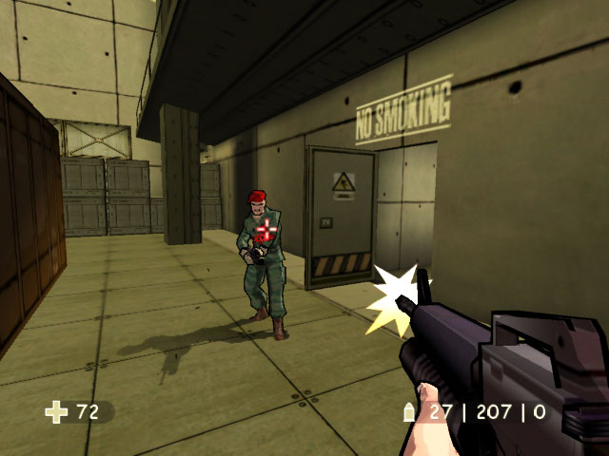
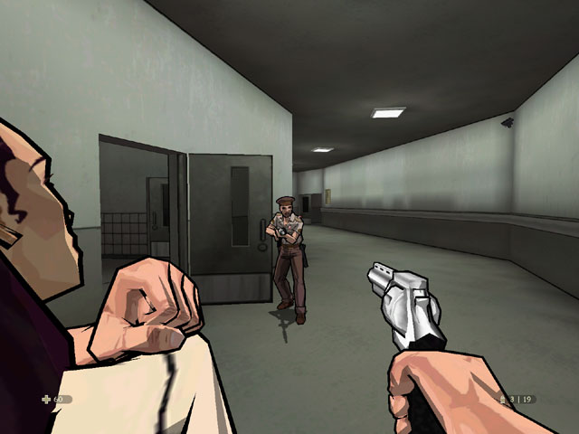
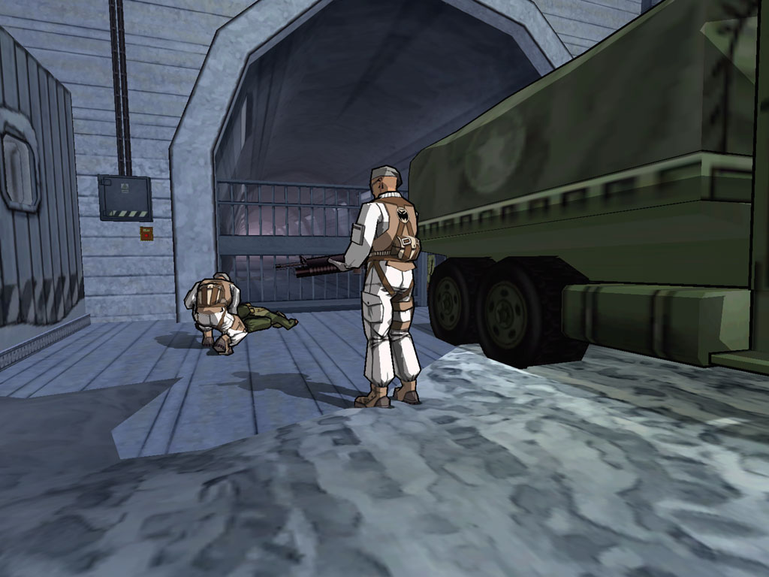
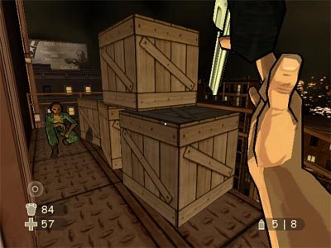

Slide 17
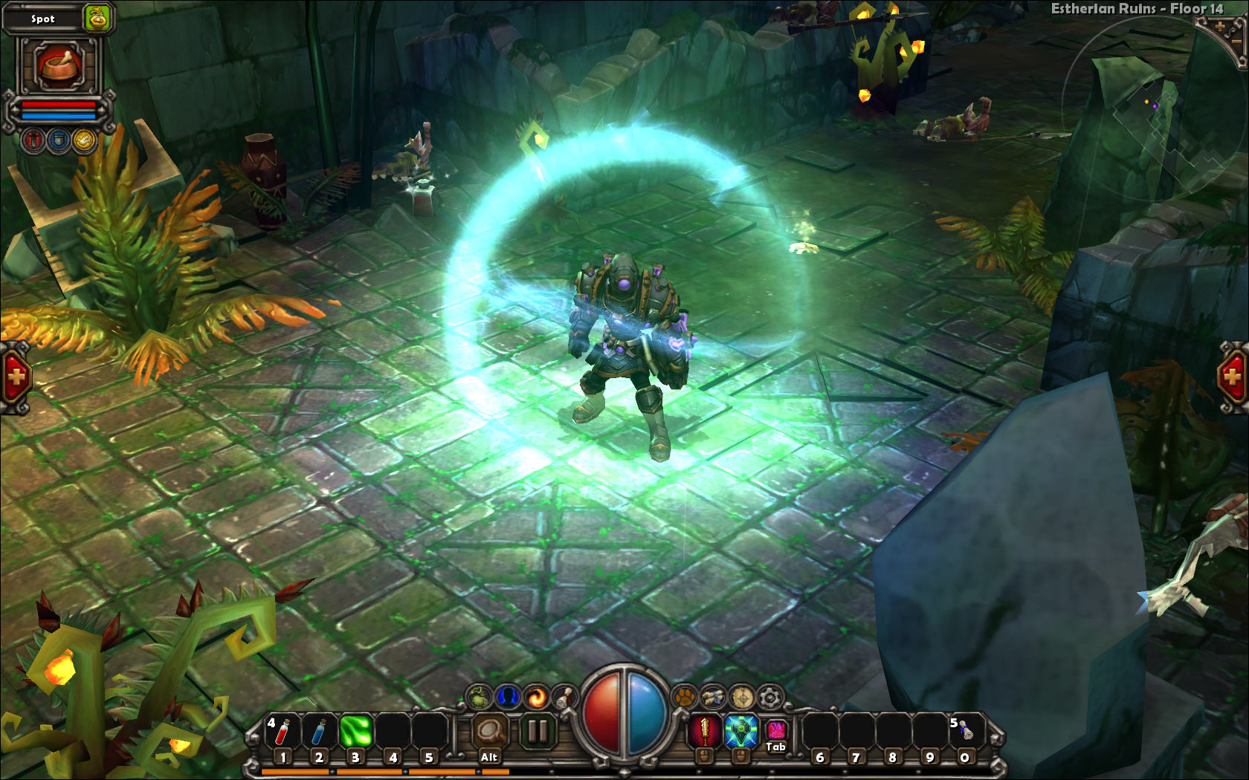
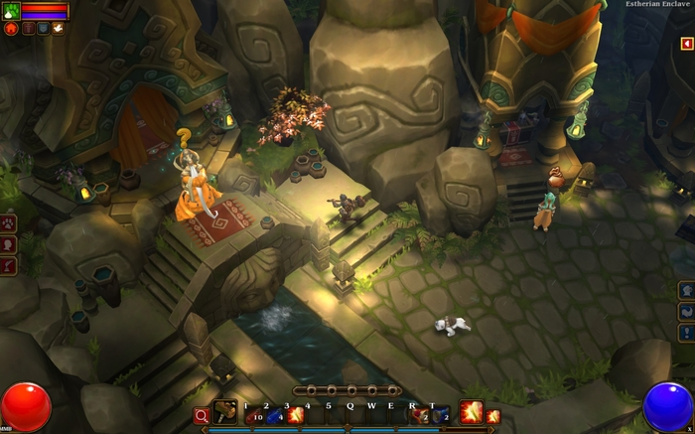
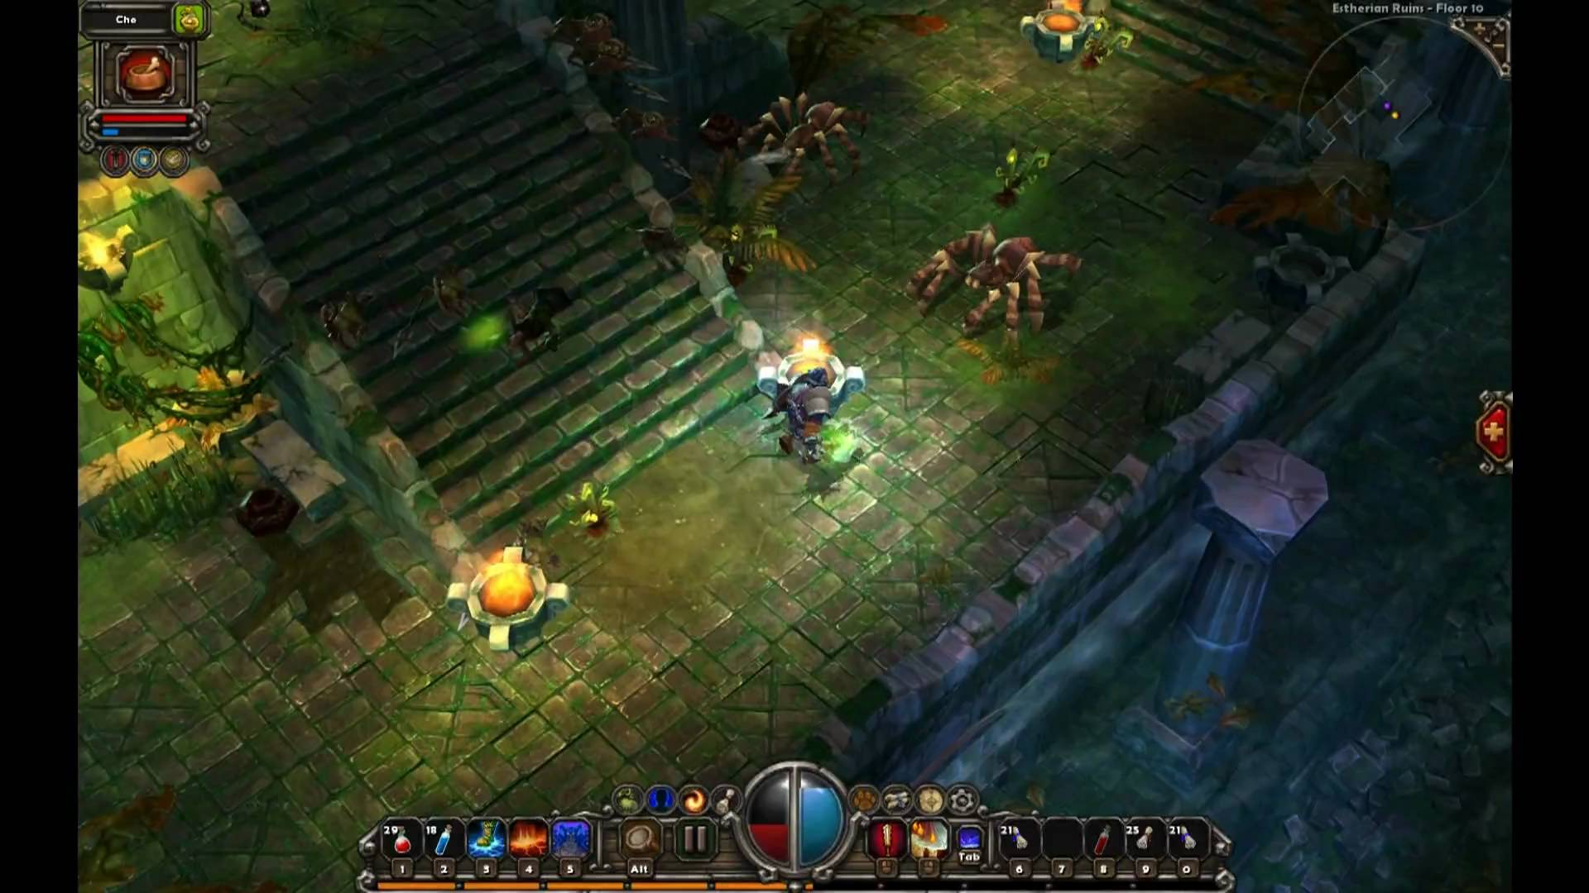

Slide 18
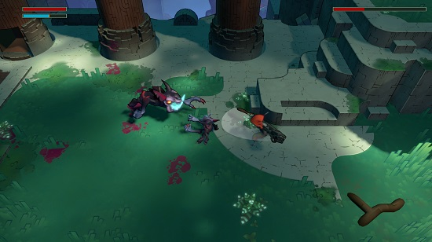
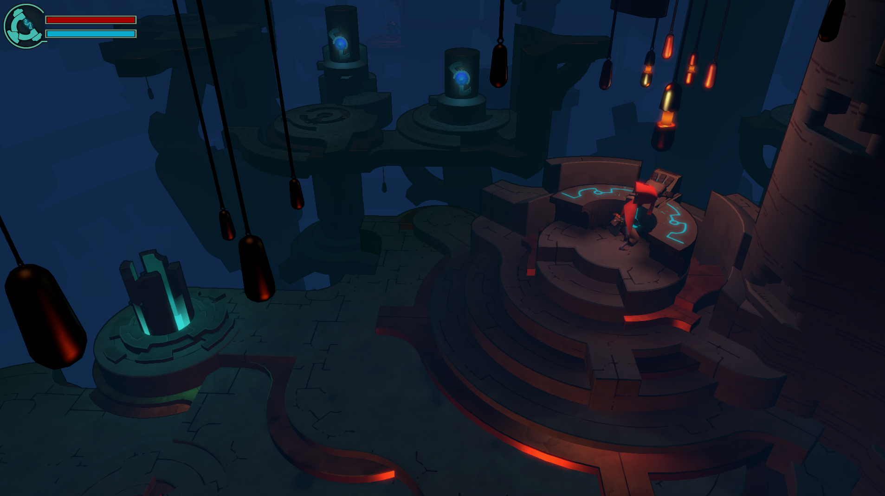

Slide 19
Questions

