Slide 1
L6 Group 8
Tom Smith, George Davis, Shane Stephenson

Slide 2
Logline - Learn Key stage 2 History through Archaeological Excavations
Demographic – 8 to 12
Mobile Game

Slide 3
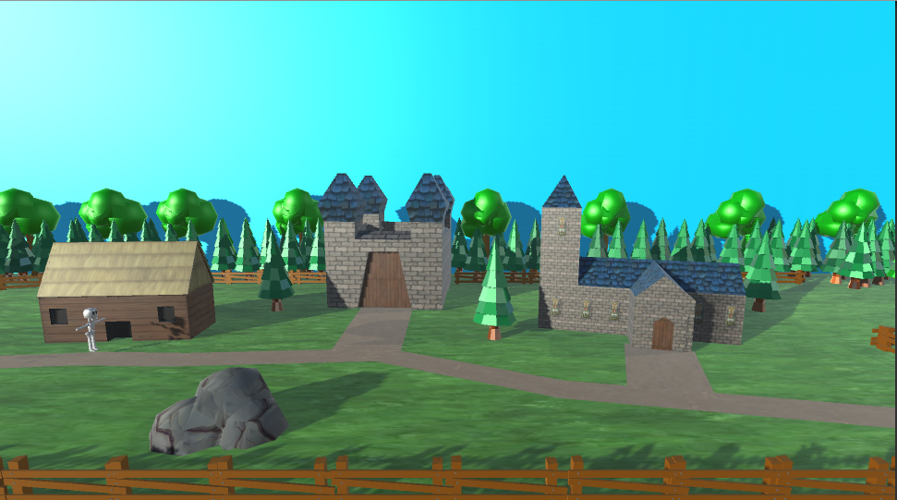
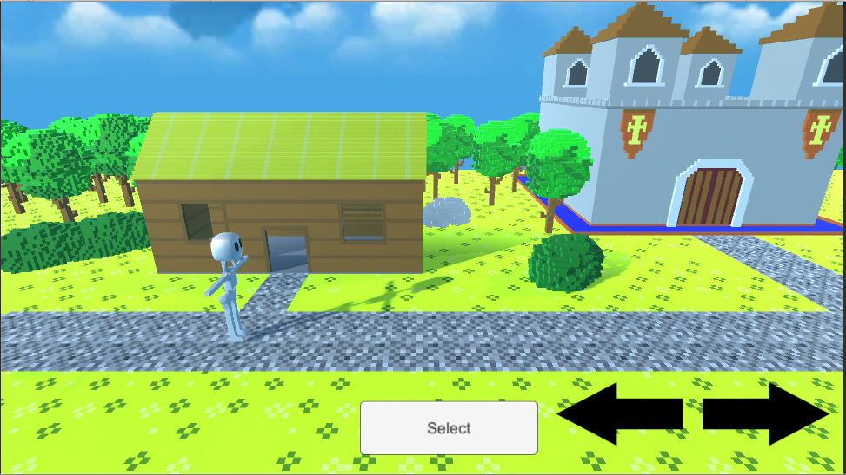
Art Style and Camera Change

Slide 4
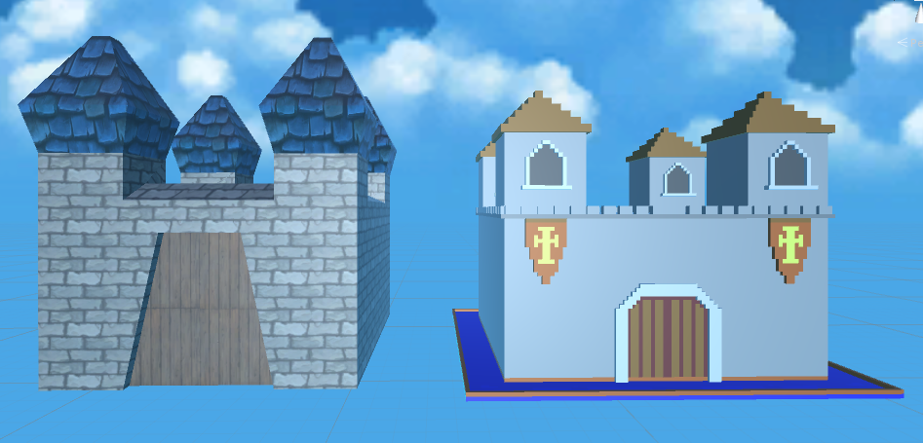
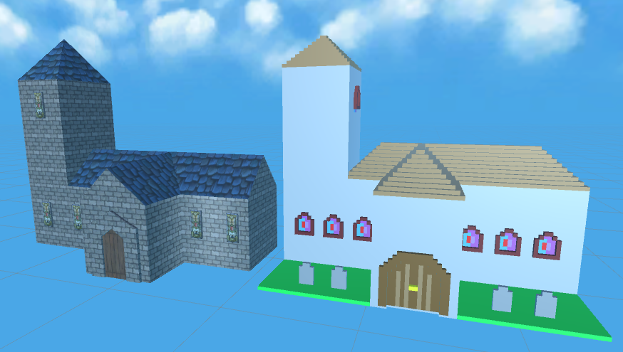
Art Style Comparison

Slide 5
https://www.youtube.com/watch?v=uR3q4TfGRbs

Slide 6
What we will do next
Link all level to correct artifact puzzles
Change artifact image to fit new art style.
Indicators to show what is selected and when a tile is in the correct place.
End of section quiz (Every 8 Artifacts)

Slide 7
Project Management
Tom – 120 Hours
Shane – 118 Hours
George – 122 Hours

Slide 8
Thank You For Listening Any Questions?

