Slide 1
L6 Group 8
Thomas Smith, George Davis, Shane Stephenson

Slide 2
Logline - Learn Key stage 2 History through Archaeological Excavations
Demographic – 8 to 12

Slide 3
Key Stage 2 History Topics
Ancient Greece
Roman Empire
Ancient Egypt
The Americas
Pre Historic (Stonehenge)
Vikings
Middle Ages
Anglo Saxons

Slide 4
Game

Slide 5
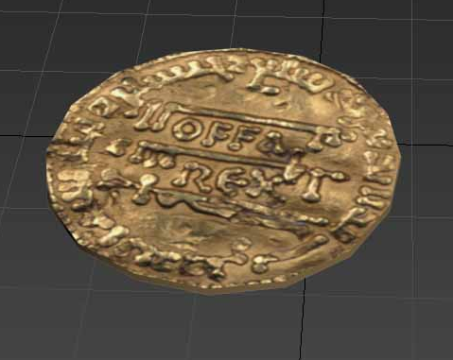
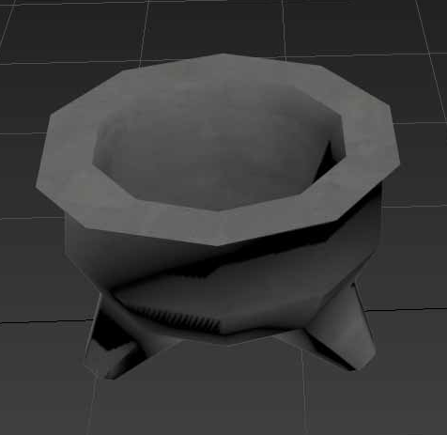
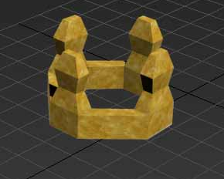
Artifacts

Slide 6
What we are doing next
Fixing and Finishing the match 3 mechanic
Menu Camera Movement / level Information UI
Remaining Environment Models for Anglo Saxon levels
Facts spawn in on the correct level

Slide 7
Tom 40 Hours
George 40.5 Hours

