Slide 1
IMDCGD111 GROUP PROJECT
IMDCGD214 MANAGING GAMES PRODUCTION level 4/5 – group 16
Joseph Barber, Ionut Ciobanu,
Charlie Kinglake, Caitlin White

Slide 2
Target demographic
Age
  15 - 25
Gender
  Males and females
IC

Slide 3
Platform, players, style & duration of gameplay
Platform
  Tablet
Players
  Two
Style
  Simultaneous – Real time
Duration
  Under 5 minute games
CK

Slide 4


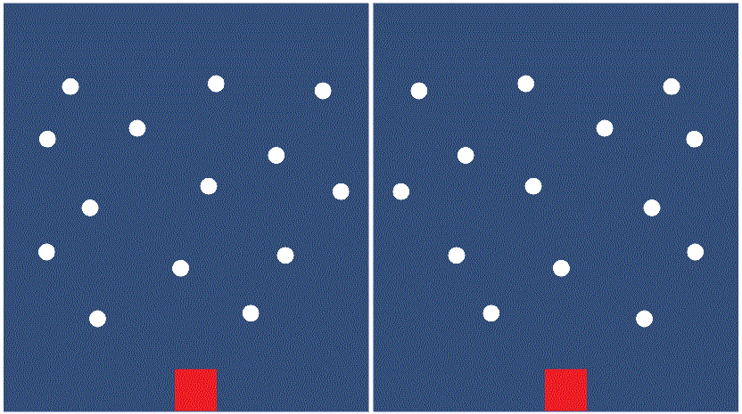
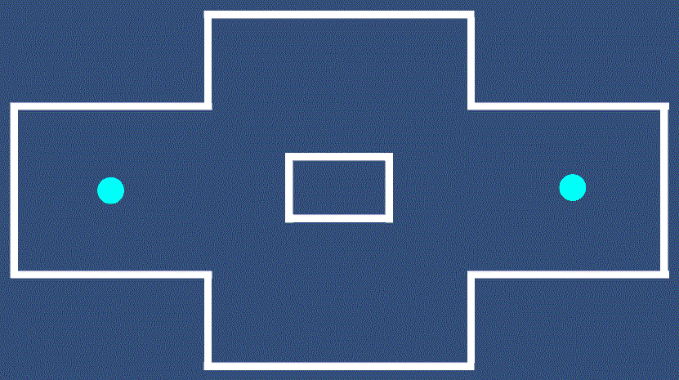
Prototypes
JB

Slide 5
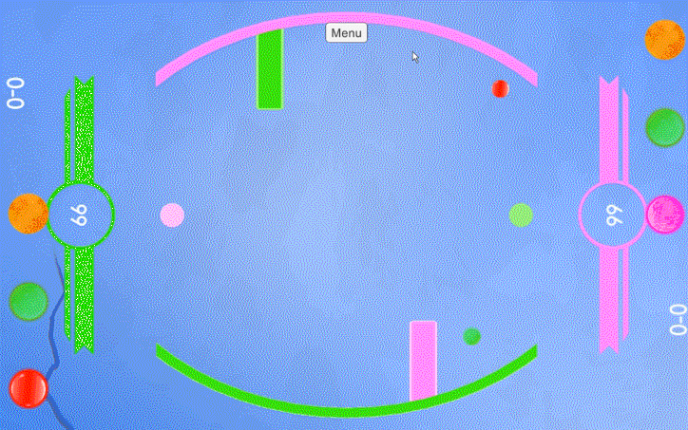
Mechanic
“Fling your balls.”
Bounce them into the opponent.”
“Knock the opponent out to win.”
CK

Slide 6
Win/lose conditions & Player Experience
Knock your opponent out of the arena
  +1 point
After time hits 0, player with the most points wins
Hard fun
  High tension
  Excitement
  Triumph
CK

Slide 7


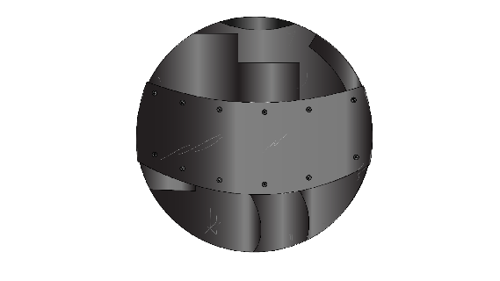
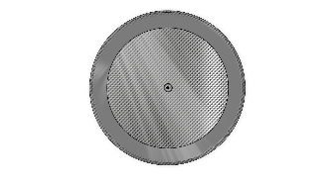


Balls
Six types of balls
  Player can choose three balls per game
IC

Slide 8
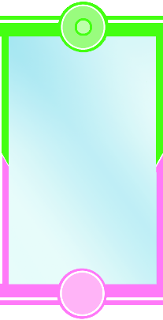
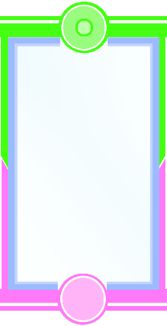
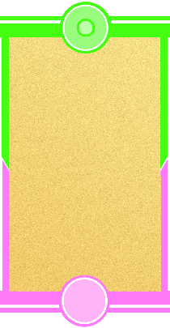
Terrains
Three types of terrain:
CW

Slide 9


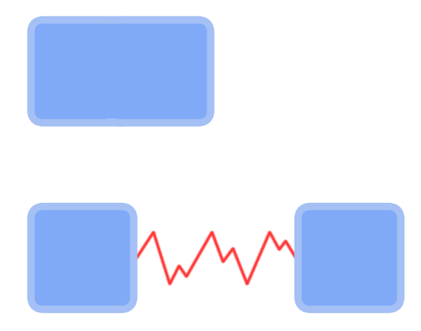

Interactive obstacles
Many physics obstacles:
CW

Slide 10
Unique selling point
Dynamic environment affects physics
Obstacles add an element of randomness to the game
Mixture of strategy, skill and luck
Balls can be used offensively or defensively
JB

Slide 11
Gameplay demonstration
https://www.youtube.com/watch?v=7AnleoJ-JZY&feature=youtu.be
JB

Slide 12
How does our game meet the brief?
2D Environment
Physics: friction
Played simultaneously in real-time
Symmetric gameplay
Terrain and obstacles introduce random element
CW

Slide 13
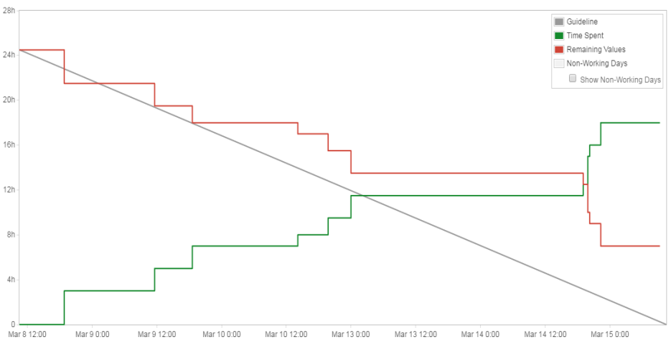
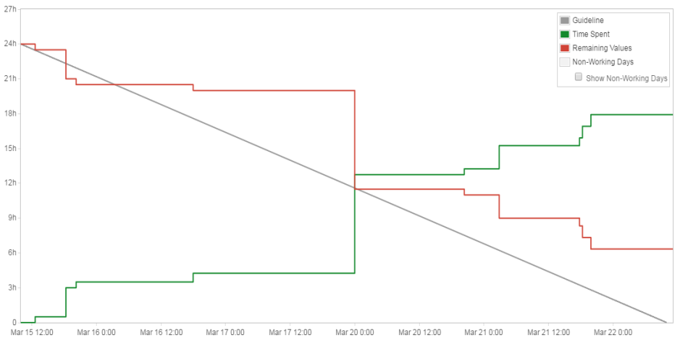
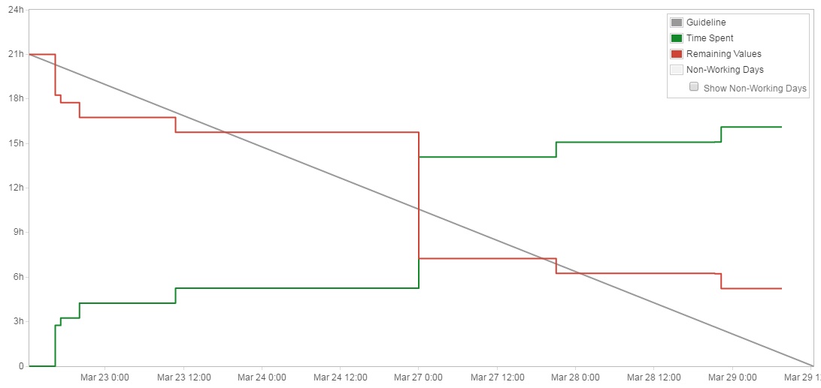
Management
Hours logged:
  Joseph: 51h 30m
  Charlie: 48h 30m
  John: 28h
  Caitlin: 51h 30m
JB

Slide 14
Questions

