Slide 1
IMDCGD111 Group Project IMDCGD214 Managing Games production Level 4/5 Group 16
Joseph Barber, Charlie Kinglake,
Ionut Ciobanu, Caitlin White

Slide 2

Target demographic
Bartle’s taxonomy of Player Types
Killers an Achievers
Age
15 - 25
Gender
Males and females
IO

Slide 3
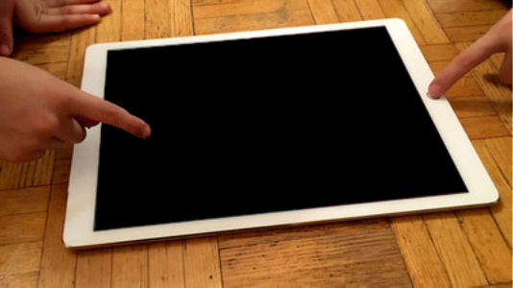
Platform, Players, Style & Duration of gameplay
Platform
Tablet
Players
Two
Style
Simultaneous – Real time
Duration
Under 5 minute games
CW

Slide 4

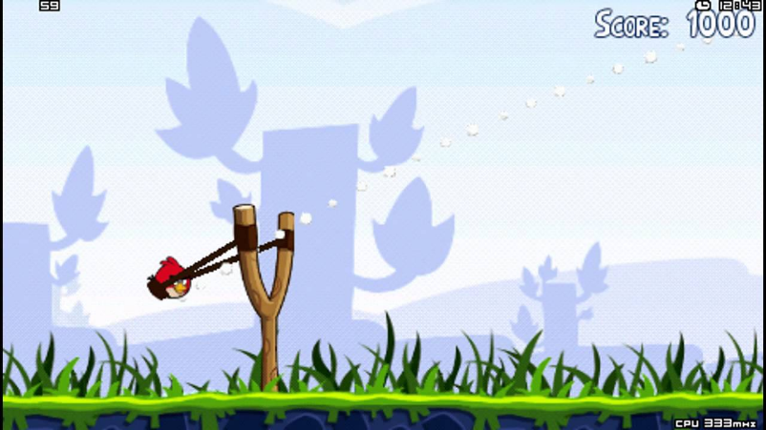
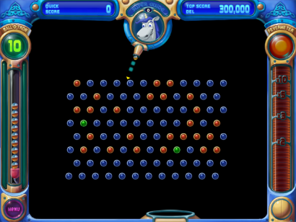
Research material
Olo
Angry birds
Peggle
CK

Slide 5
Prototypes
JB

Slide 6
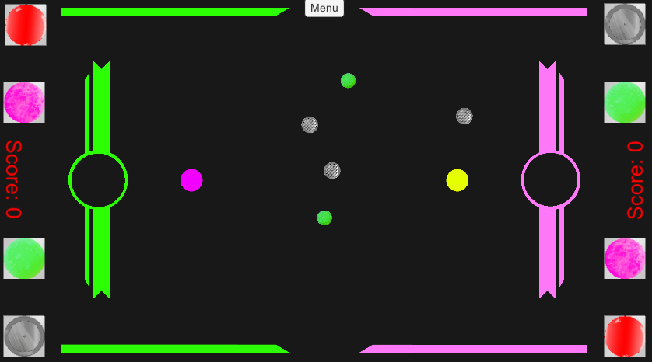
Mechanics, Win/Lose conditions & Player experience
“Fling your balls.”
“Bounce them into the opponent.”
“Knock the opponent out to win.”
Hard fun,
High tension,
Excitement,
Triumph
CK

Slide 7

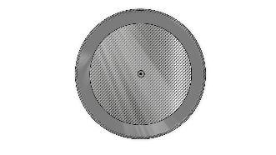


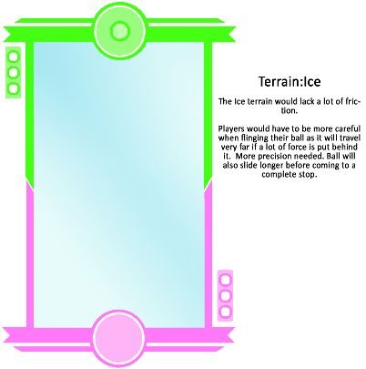
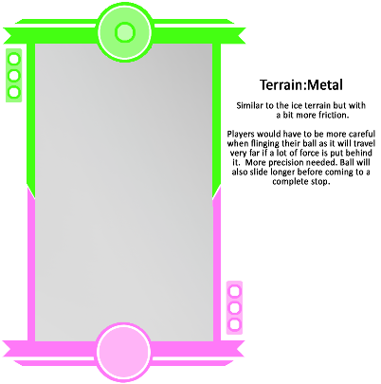
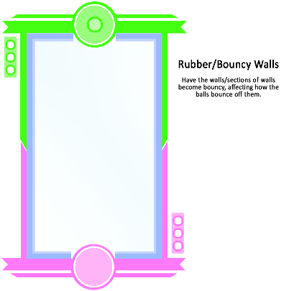
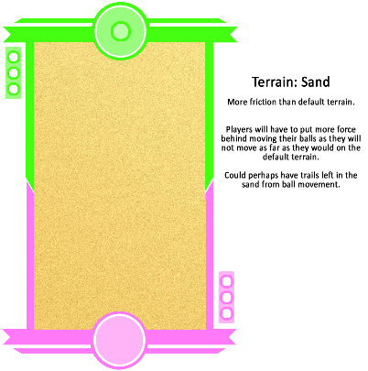
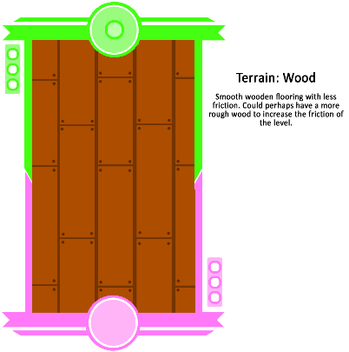
Gameplay
Multiple ball types
Dynamic/Changing terrain
IO & CW

Slide 8

Unique Selling point
Dynamic environment which affects physics
Mechanics can be used offensively or defensively
Mixture of strategy, skill, randomness
JB

Slide 9
Gameplay demonstration

Slide 10
Playtesting feedback
Only a small minority immediately understood the goals
Player likes:
Rebounding physics
Dynamic obstacles
Unpredictability
LPM
Player dislikes:
Lack of obstacles in levels
Players unsure of different balls behaviour
Players want multiple balls in play
.

Slide 11
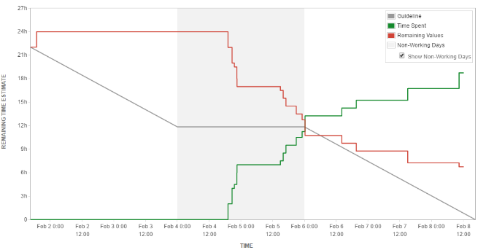
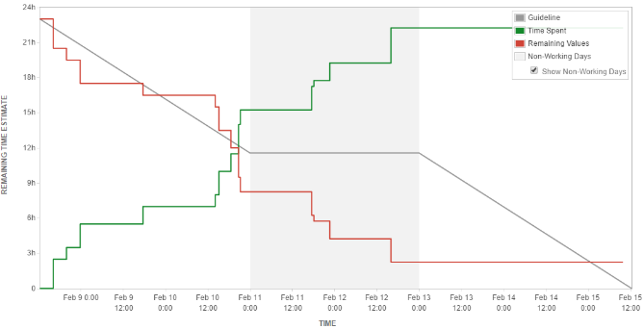
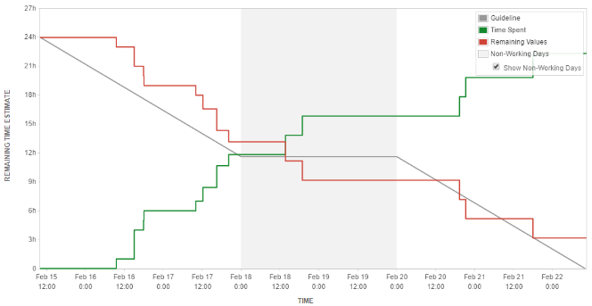
Management
Sprint 1
Sprint 2
Sprint 3
Hours logged
Joseph Barber: 19h 25m
Ionut Ciobanu: 11h
Charlie Kingslake: 22h
Caitlin White: 22h 10m

Slide 12
Questions

