Slide 1
IMDCGD111 GROUP PROJECT IMDCGD214 MANAGING GAMES PRODUCTION level 4/5 – group 16
Joseph Barber, Ionut Ciobanu,
Charlie Kinglake, Caitlin White

Slide 2
Target demographic
Age
15 - 25
Gender
Males and females

Slide 3
Platform, players, style & duration of gameplay
Platform
Tablet
Players
Two
Style
Simultaneous – Real time
Duration
Under 5 minute games

Slide 4
Prototypes

Slide 5
Mechanic
“Fling your balls.”
Bounce them into the opponent.”
“Knock the opponent out to win.”

Slide 6
Win/lose conditions & Player Experience
Knock your opponent out of the arena
+1 point
After time hits 0, player with the most points wins
Hard fun
High tension
Excitement
Triupmph

Slide 7


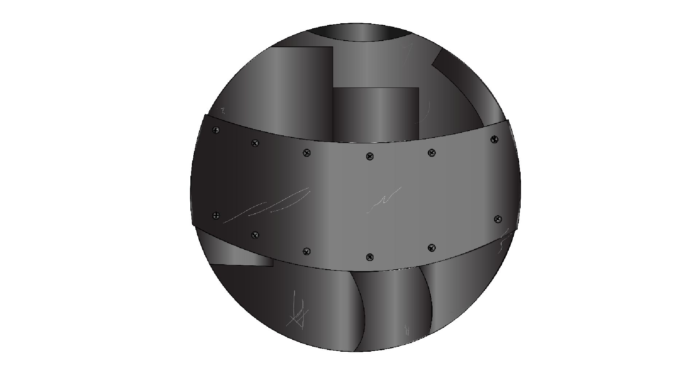
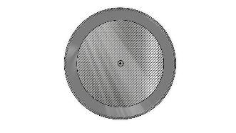


Balls
Six types of balls
Player can choose three balls per game

Slide 8
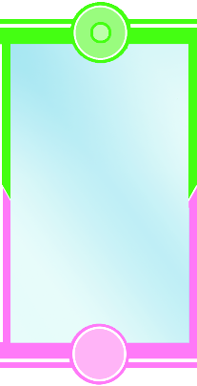
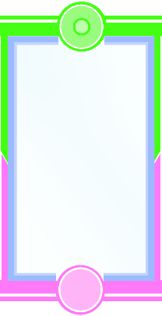
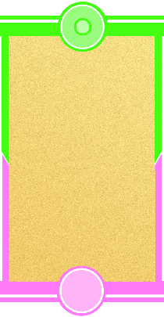
Terrains
Three types of terrain:

Slide 9


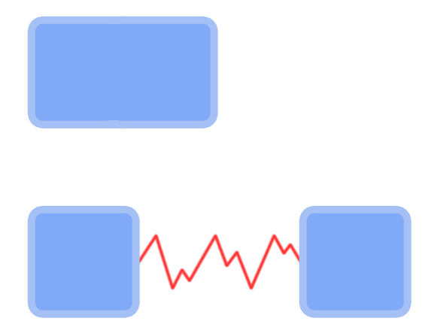

Interactive obstacles
Many physics obstacles:

Slide 10
Unique selling point
Dynamic environment affects physics
Obstacles add an element of randomness to the game
Mixture of strategy, skill and luck
Balls can be used offensively or defensively

Slide 11
Gameplay demonstration
https://www.youtube.com/watch?v=7AnleoJ-JZY&feature=youtu.be

Slide 12
How does our game meet the brief?
2D Environment
Physics: friction
Played simultaneously in real-time
Symmetric gameplay
Terrain and obstacles introduce random element

Slide 13
Management

Slide 14
Questions

