Slide 1
IMDCGD111 Group Project IMDCGD214 Managing Games production Level 4/5 Group 16
Joseph Barber, Charlie Kinglake
Ionut Ciobanu, Caitlin White

Slide 2
Target demographic
Age
15 - 25
Gender
Males and females

Slide 3
Platform, players, style & duration of gameplay
Platform
Tablet
Players
Two
Style
Simultaneous – Real time
Duration
Under 5 minute games

Slide 4
Prototypes

Slide 5
Mechanic
“Fling your balls.”
“Bounce them into the opponent.”
“Knock the opponent out to win.”

Slide 6
Win/Lose conditions & Player Experience
Knock your opponent out to win
Hard fun,
High tension,
Excitement,
Triumph

Slide 7


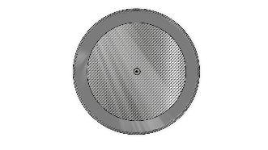

Balls
Four types of balls:

Slide 8
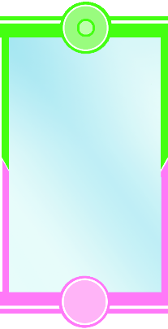
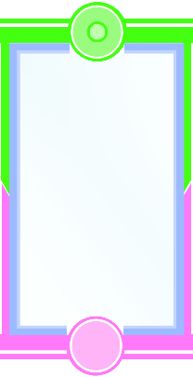
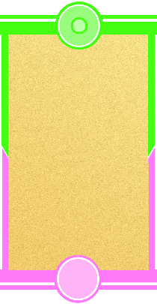
Terrains
Three types of terrain:

Slide 9


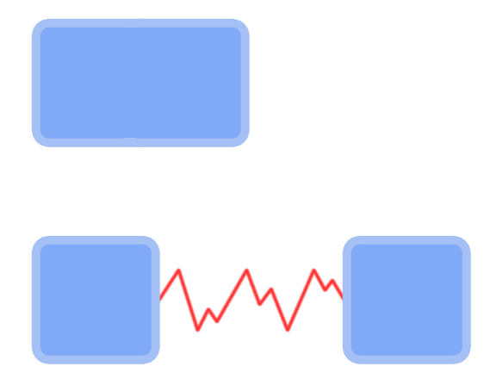

Interactive obstacles:
Many physics obstacles:

Slide 10
Unique selling point
Dynamic environment affects physics
Obstacles add an element of randomness to the game
Mixture of strategy, skill and luck
Balls can be used offensively or defensively

Slide 11
Playtesting demonstration
[Video]

Slide 12
Playtesting feedback
[What did our playtesters say?]

Slide 13
What will we deliver?
(list here) – to be filled in together
Example from Rob:
(Fully operating UI)
(Single complete playing area)
(Game has had user playtesting)

Slide 14
How does our game meet the brief?
2D Environment
Physics: friction
Played simultaneously in real-time
Symmetric gameplay
Terrain and obstacles introduce random element

Slide 15
Management
[Sprints]
[Hours logged]

Slide 16
Questions

