Slide 1
Level 4/5 Group 16
Joseph Barber, Ionut Ciobanu,
Charlie Kinglake, Caitlin White

Slide 2
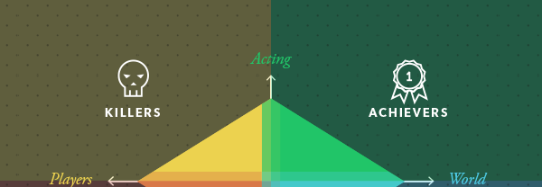
Target Demographic
Bartle’s taxonomy of Player Types:
Killers and Achievers
Age:
15 - 25
Gender:
Males and females
IC

Slide 3
Platform, Players, Style & Duration of gameplay
Platform
Tablet
Players
Two
Style
Simultaneous – Real time
Duration
Under 5 minute games
CW

Slide 4
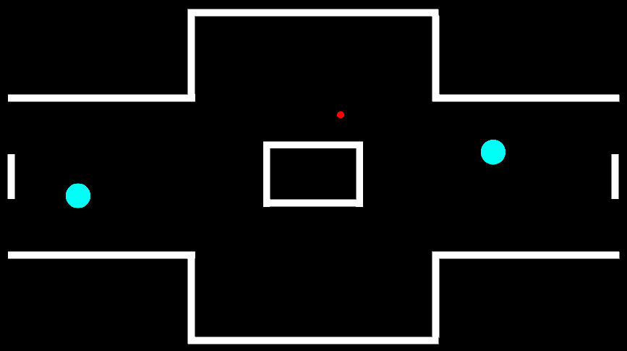
Mechanics, Win/Lose conditions & Player experience
“Fling your balls.”
“Bounce them into the opponent.”
“Knock the opponent out to win.”
Hard Fun,
High tension, Excitement, Triumph
CK

Slide 5

Gameplay
Changing environment
Multiple balls to choose from
Balls affect either player
JB

Slide 6

Unique Selling Point
Dynamic environment which effects physics
Mechanic can be used offensive or defensively
Mixture of strategy and skill
IC

Slide 7
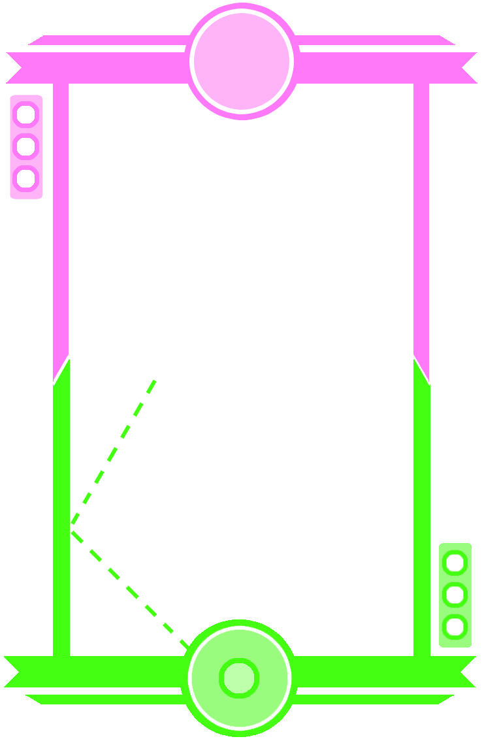
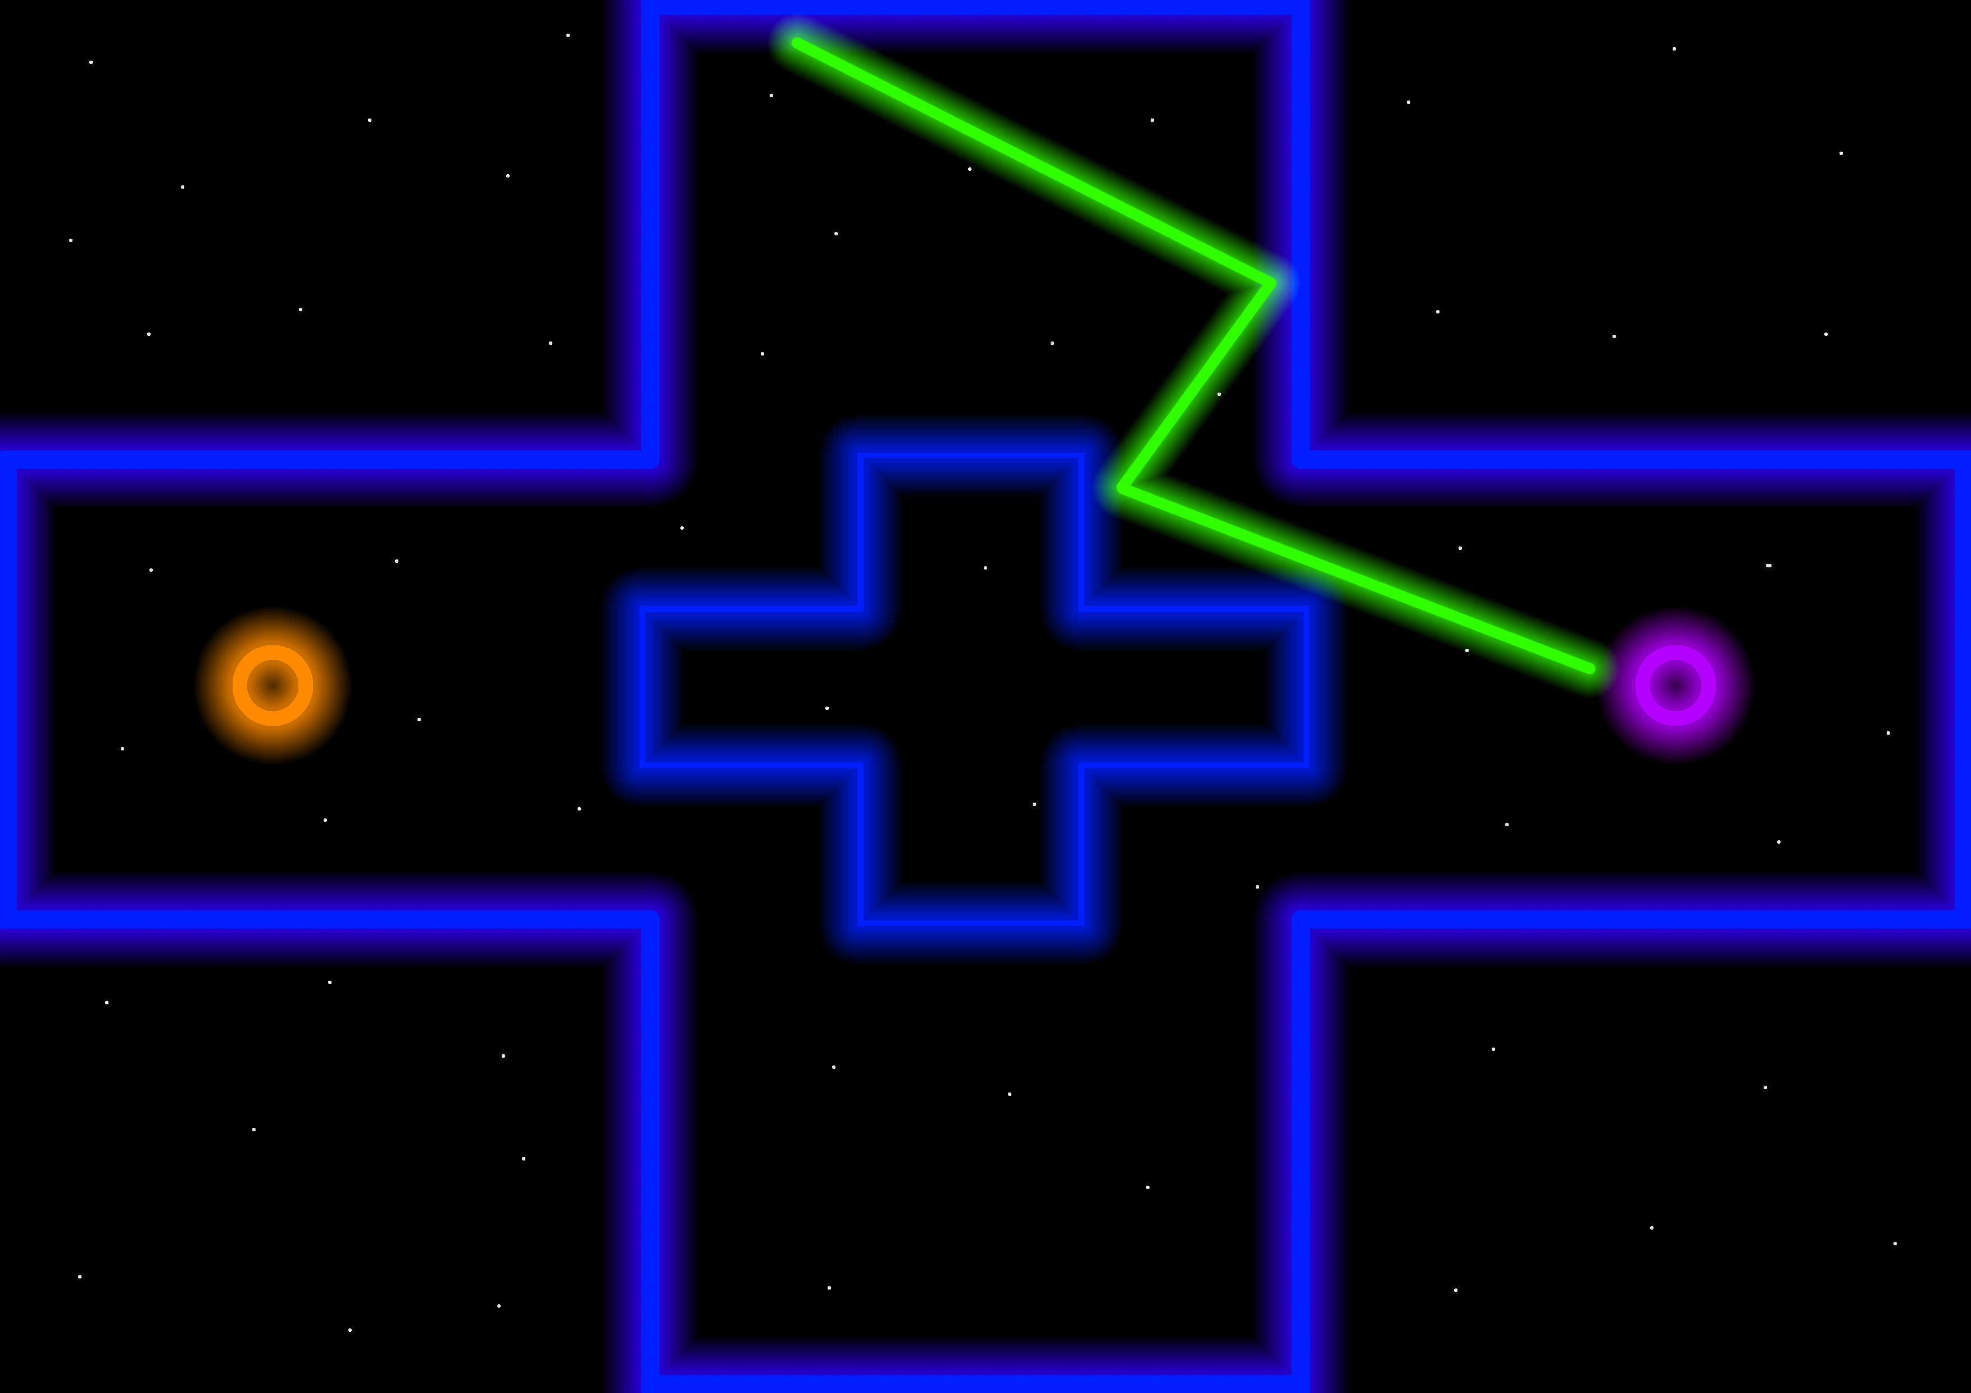
Art style
CK & CW

Slide 8
Questions?

