Slide 1
Project Name(TBA)
Computer Game Design Level 5/4 Group 17:
Callum Walsh, Dan Beales and Quwaine Dantes

Slide 2
Log line
Racers control a wil-o-wisp to survive the longest against gravity, by pressing a key to upkeep their anti-gravity.

Slide 3

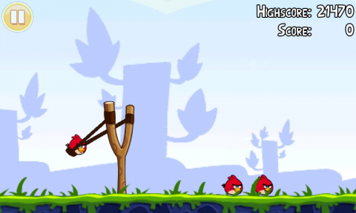
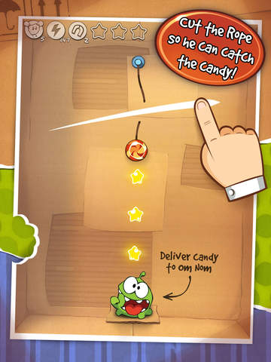
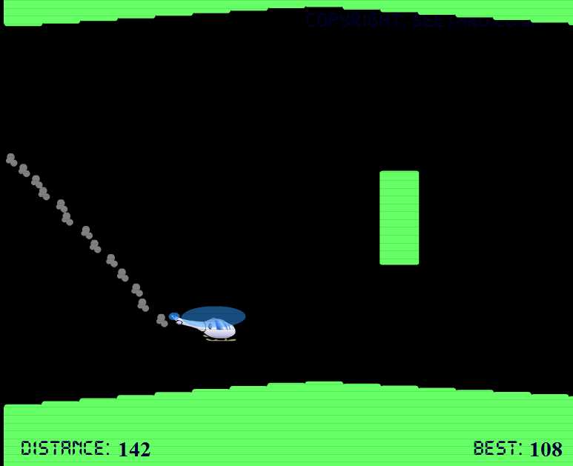
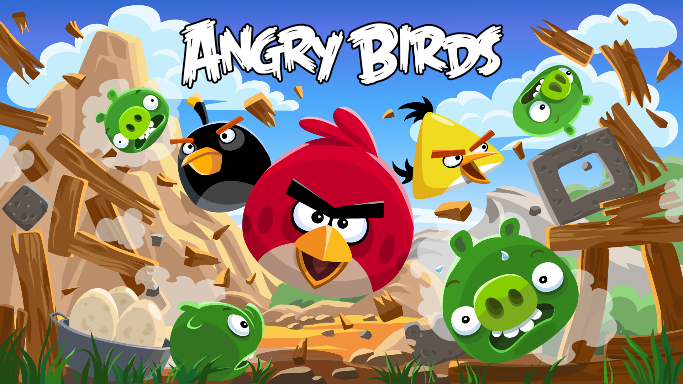
Research

Slide 4
Target Audience
Core audience
Age’s between 8-12
Male and female.
Casual gamers.
Sub audience
Age’s between 13-18
Male and female.
Casual gamers.

Slide 5
Platform
Primarily for PC
Would like to test for smart phones.
Would like to test for tablets

Slide 6
Mechanics
Character Movement
Anti-gravity
Collision
Floating obstacles
Environmental obstacle
Rebound
Hitting another player off course or into perils.

Slide 7
Concept art

Slide 8
Prototype(Version One)

Slide 9
Future plans
Decide on a art style.
Play test mechanics, find a balance.
Come up with functional prototypes.
To test concepts of possible mechanics.

Slide 10
Any Questions?

