Slide 1
L4/5 Group 4
Game Name
Connor Wilby
Sam Clack
Henry Smith
Heather Bishop

Slide 2
Demographics
10 years old +
Males and Females.
Socialisers and Killers

Slide 3
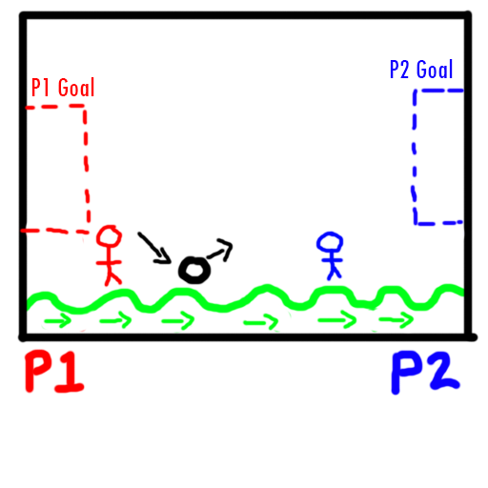
Concept One Outline
Two players must get a single ball into the opponents goal.
The physics comes from the bounciness of the ball, offset with the ground which is mimicking a waves behaviour.
Each goal changes the direction of the wave to benefit the goal scorer.
Pickups will be collectable to affect the ball size/weight and the wave speed/oscillation (height of the peaks and troughs).

Slide 4
Concept One Outline
Main mechanic is the wave generation, how fast its frequency is and how high its oscillation is.
Aimed towards evoking Hard fun. There will be challenge, but carefully tuned as to allow for a more casual and easy-going competitive experience. Laughter is a key experience for this concepts.

Slide 5
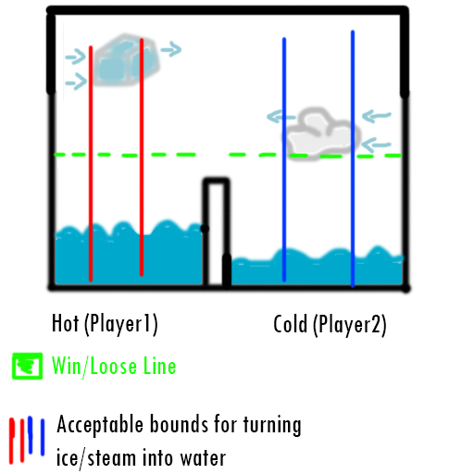
Concept Two Outline
A simultaneous adversarial multiplayer game in which two players must correctly turn ice/steam to water in order to fill their tank first.
The main mechanic is altering the states of matter into water.

Slide 6
Concept Two Outline
Aims to evoke Hard fun. There will be challenge, but it will also be tuned to allow for a casual and easy-going competitive experience. Laughter is also an key experience for this concepts.

Slide 7
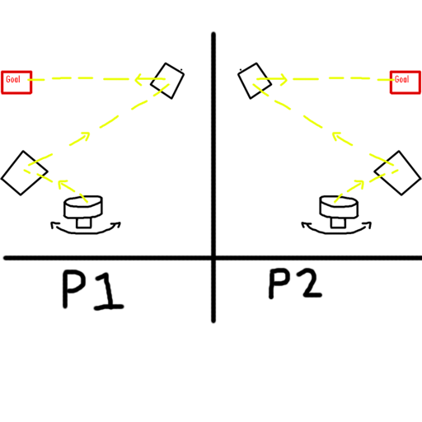
Concept Three Outline
A race to the finish multiplayer game in which players must use beams of light to solve puzzles.
Key mechanic is refracting/reflecting the light precisely.

Slide 8
Concept Three Outline
Focuses on serious fun, encouraging utter concentration to solve puzzles whilst being under pressure of a ticking clock.

Slide 9
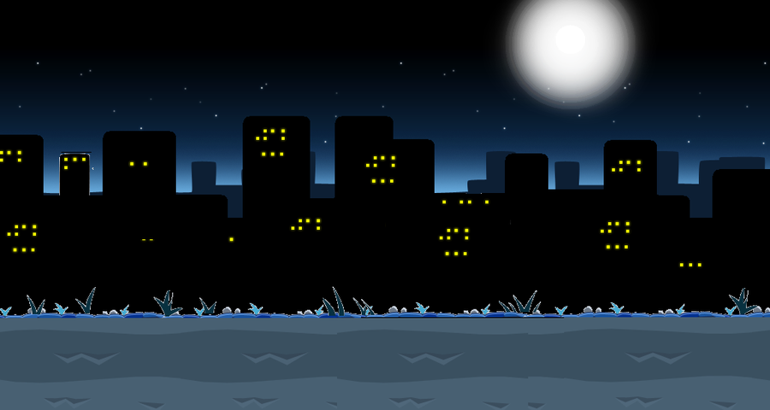
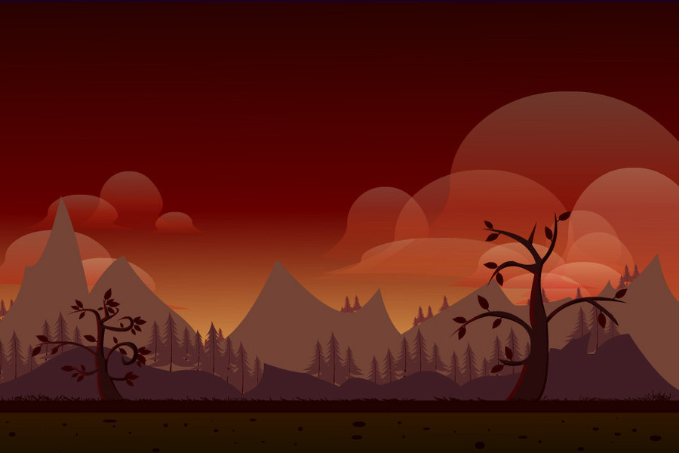
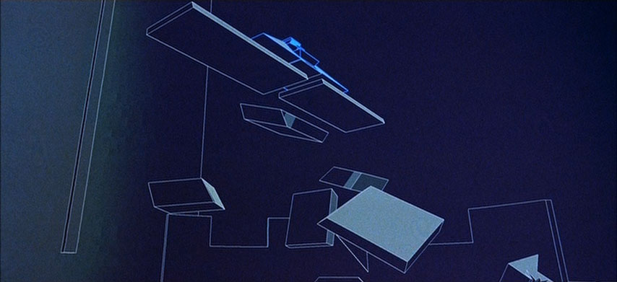
Aesthetics
Minimalistic design for faster asset creation and to keep from the visuals distracting from the experience.

Slide 10
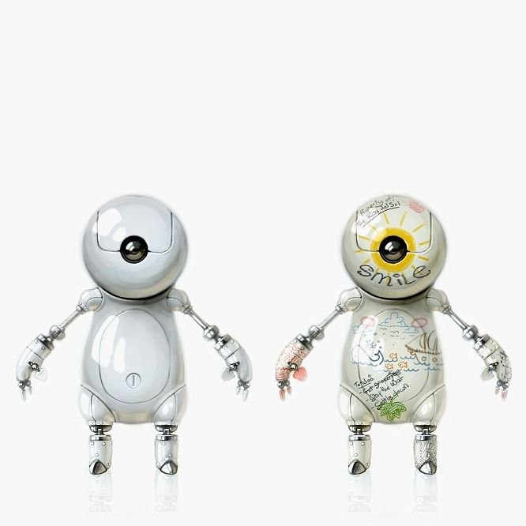
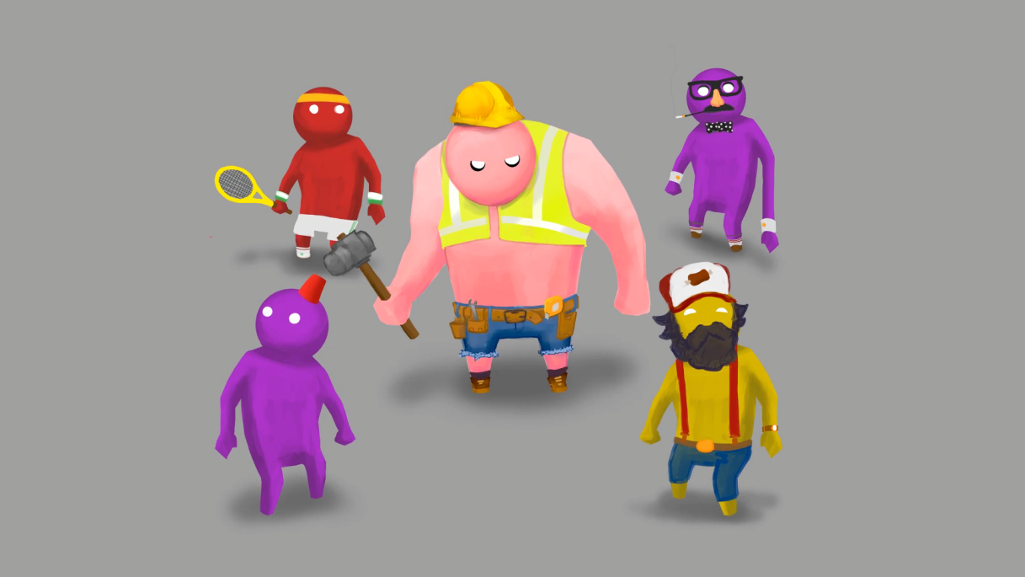
Aesthetics
Characters using rounded design to promote friendly and harmless impressions, and to steer away from intense competition between players.

Slide 11
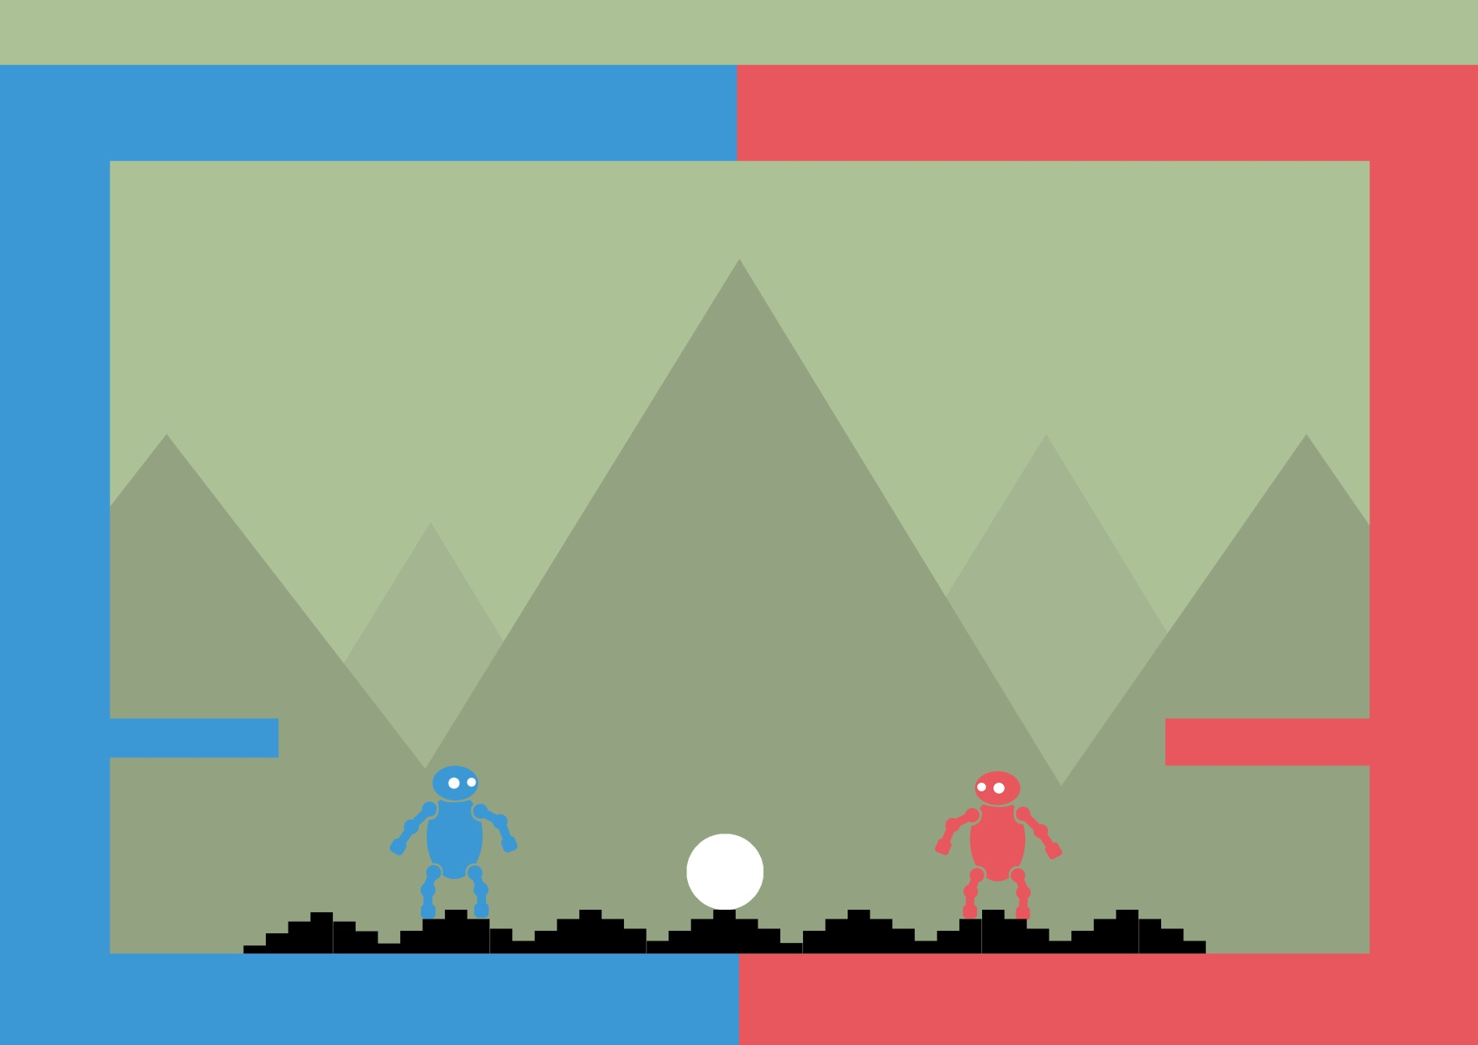
Initial Mockup

Slide 12
Sprint Information
Hours Logged
Connor:
Henry:
Sam:
Heather:
Emails Sent
Connor:
Henry:
Sam:
Heather:

