Slide 1
L4/5 Group 4
Game Name
Connor Wilby
Sam Clack
Henry Smith
Heather Bishop

Slide 2
Demographics
10 years old +
Males and Females.
Socialisers and Killers

Slide 3
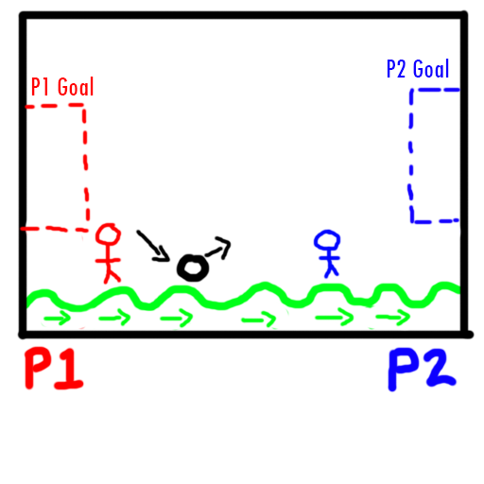
Concept One Outline
A simultaneous adversarial multiplayer game in which two players must get a single ball into the opponents goal.
The physics comes from the bounciness of the ball, offset with the ground which is mimicking a waves behaviour.
Each goal changes the direction of the wave to benefit the goal scorer.
Pickups will be collectable to affect the ball size/weight and the wave speed/oscillation (height of the peaks and troughs).

Slide 4
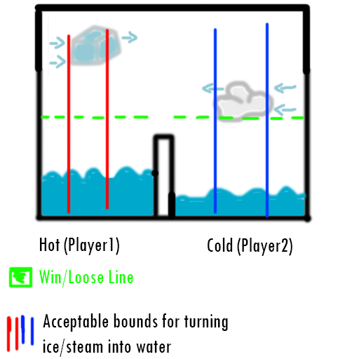
Concept Two Outline
A simultaneous adversarial multiplayer game in which two players must correctly turn ice/steam to water in order to fill their tank first.

Slide 5
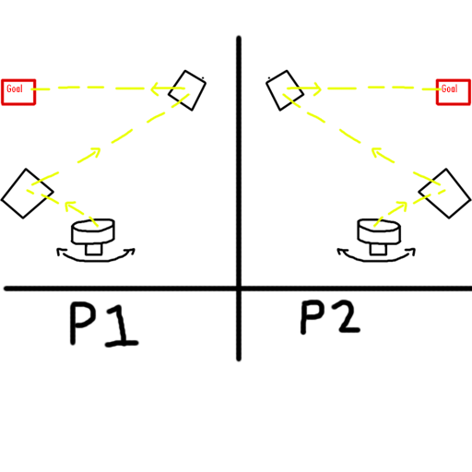
Concept Three Outline
A race to the finish multiplayer game in which players must use beams of light to solve puzzles.

Slide 6
Mechanics
Concept Ones key mechanic is the wave generation, how fast its frequency is and how high its oscillation is.
Concept Twos key mechanic is altering the states of matter into water.
Concept Threes key mechanic is refracting/reflecting the light precisely.
Notes:
Integrate into actual slides

Slide 7
Aesthetics
Concept 1 & 3 will be aimed towards evoking Hard fun. There will be challenge, but carefully tuned as to allow for a more casual and easy-going competitive experience. Laughter is a key experience for these concepts.
Concept 1 focuses more on serious fun, encouraging utter concentration to solve puzzles whilst being under pressure of a ticking clock.
Notes:
Integrate into actual slides

Slide 8
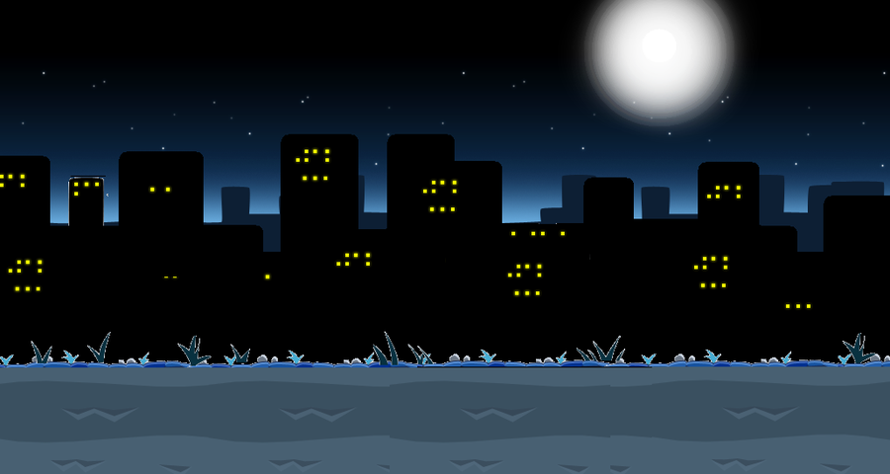
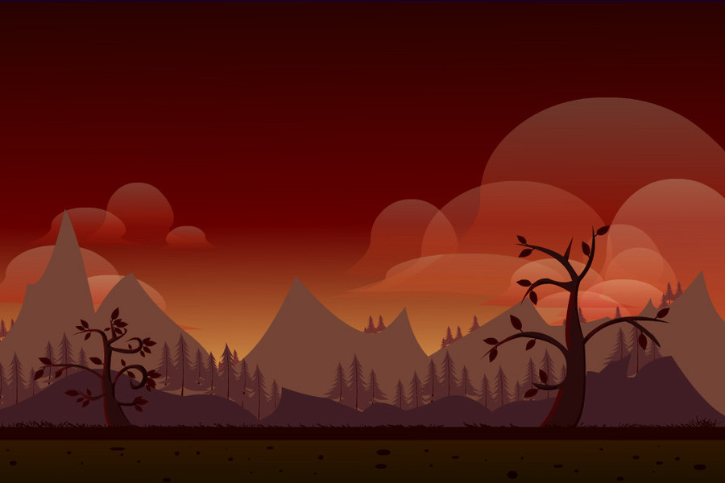
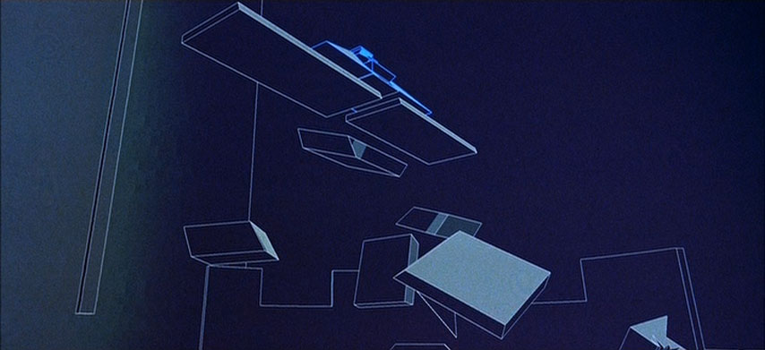
Aesthetics
Minimalistic design for faster asset creation and to keep from the visuals distracting from the experience.

Slide 9
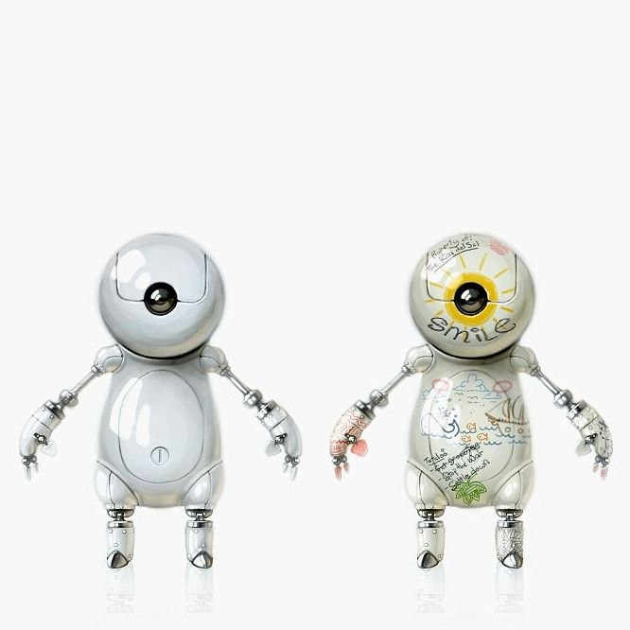
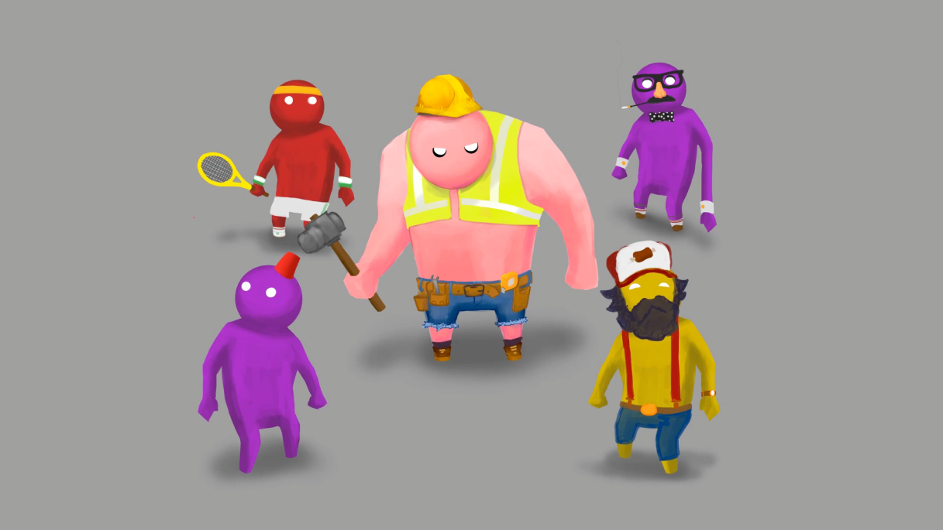
Aesthetics
Characters using rounded design to promote friendly and harmless impressions, and to steer away from intense competition between players.

Slide 10
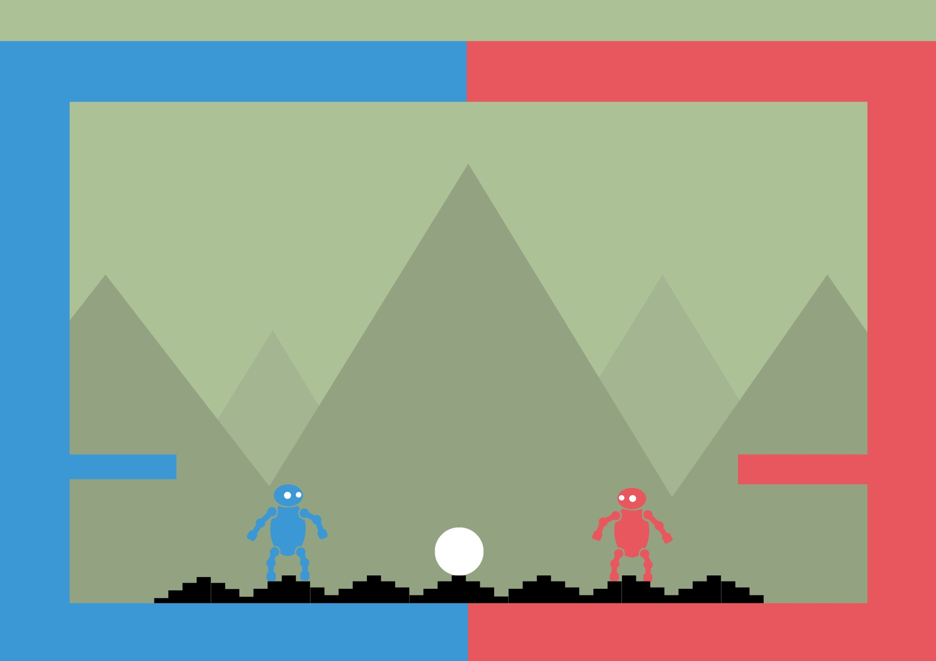
Initial Mockup

Slide 11
Sprint Information
Hours Logged
Connor:
Henry:
Sam:
Heather:
Emails Sent
Connor:
Henry:
Sam:
Heather:

Slide 12
Burndown Chart

