Slide 1
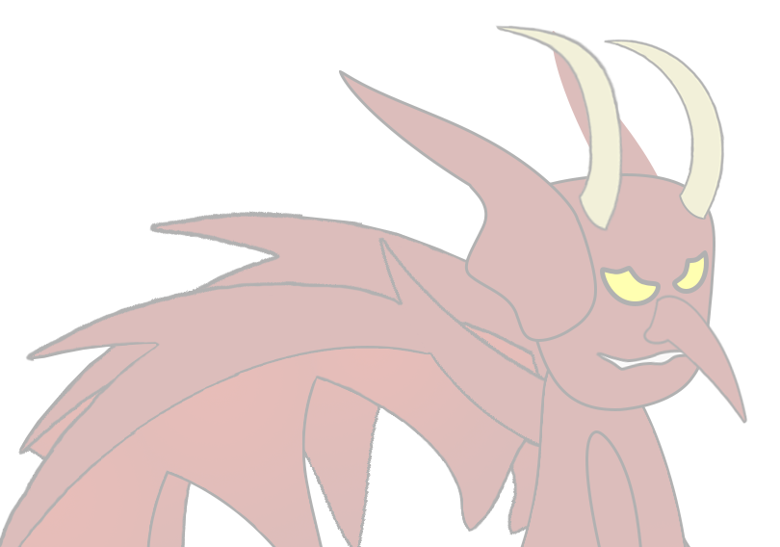
Level 4/5 Group 19
Ogheneochuko Ideh, Thomas Barrett & Samuel Ormondroyd

Slide 2

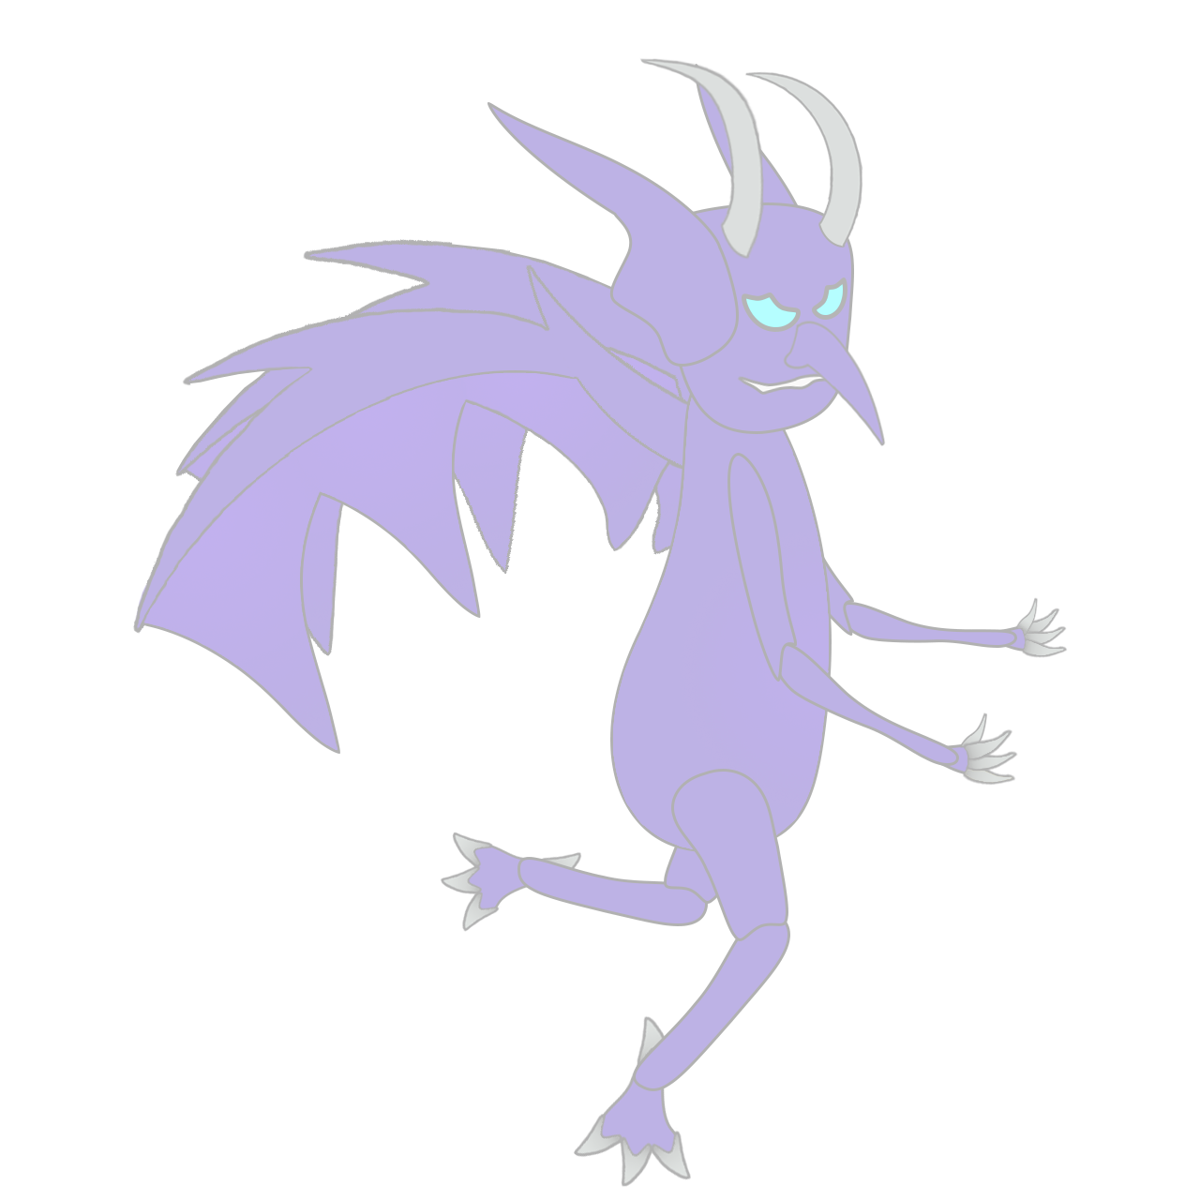
Presented to:
Stakeholders & Ubisoft Bucharest
3RD May 2017

Slide 3
Business First
Group Members: | Emails:
Ogheneochuko Ideh:
Thomas Barrett:
Samuel Ormondroyd:
Group Members: | Hours Logged:
Ogheneochuko Ideh:
Thomas Barrett:
Samuel Ormondroyd:

Slide 4
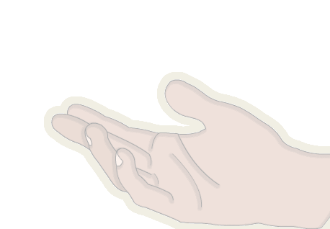
Brief and recap
2 player adversarial physics game.
Symmetric gameplay.
Clear player affordances
Logline
Launch demons as far as physically possible whilst calling down lightning to strike them even further.

Slide 5
Brief and recap
Projected Demographic | Unisex audience. Primarily target from ages 7-14. Appropriate for children (and adults) ages seven and up.
Genre: | The Triple A: Action, Arcade & Adversary.
Platform Specs: | Windows. Unity Executable.

Slide 6

Game
Players launch demons.
Players spawn lightning to propel demons further.
Demons may bounce of terrain propelling them in random directions.

Slide 7
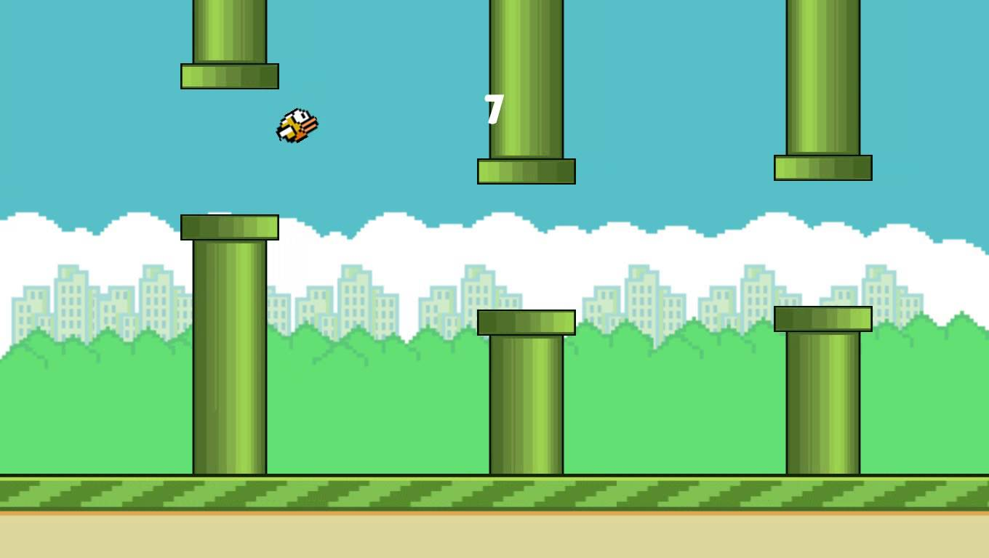
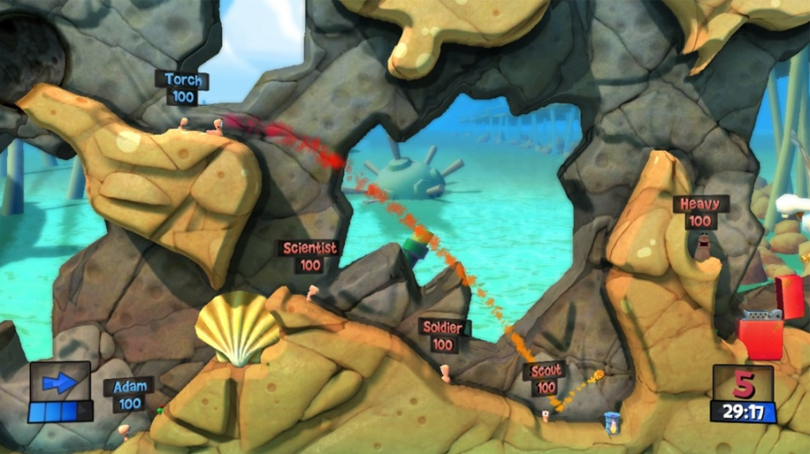
How we targeted our audience
Researched into the art style and tone of games with similar demographics:
Flappy Bird
Worms
We deducted that these games featured cartoon – like playable characters and diegesis.
Emulating the motifs and tones of television shows and other forms of media they digest.

Slide 8
BaRTLE’S Taxonomy
According to Bartle’s taxonomy the player types we aim to target are killers and achievers.
By allowing players to strike down the projecting demons we are adhering to the killer player archetypes from Bartle’s players taxonomy (1)
This states that players are acting upon the world of the game.

Slide 9
BaRTLE’S Taxonomy
The adversary tone of the game allows us to adhere to the achiever archetype.
The players will have one main goal during the duration of the game and will be working towards defeating their opponent.

Slide 10
How our mechanics encourage adversarial game play.
By choosing simultaneous play over a turn based play style we allow for a more competitive tone where players can directly gauge the progression of their opponents.

Slide 11
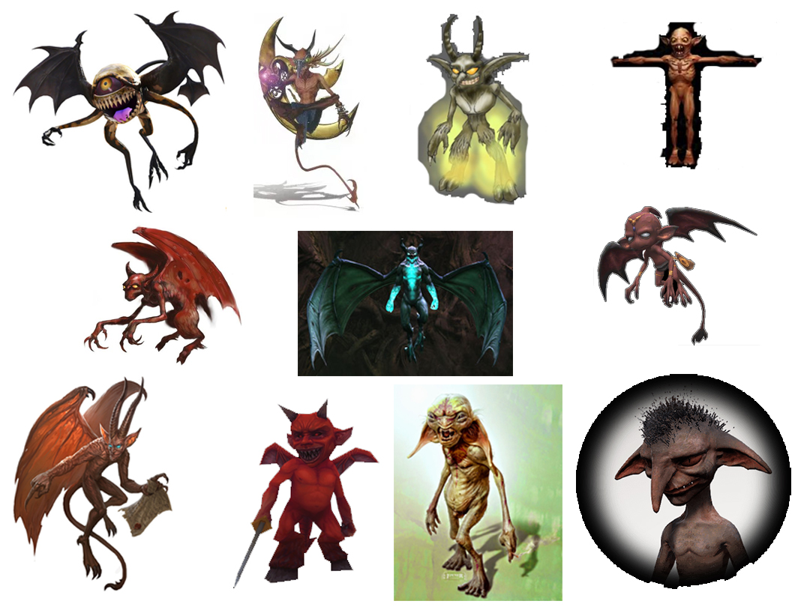
Concepts

Slide 12
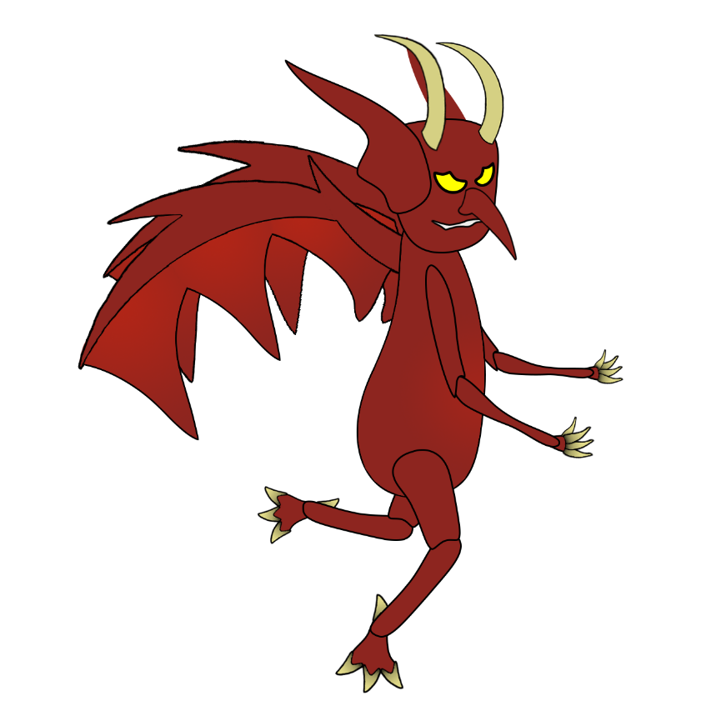
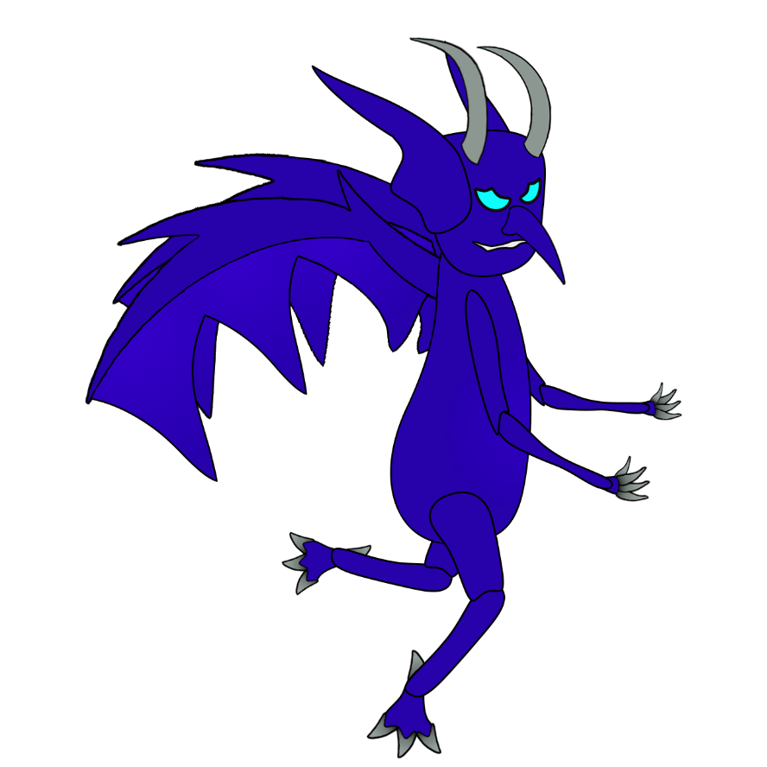
Demons

Slide 13



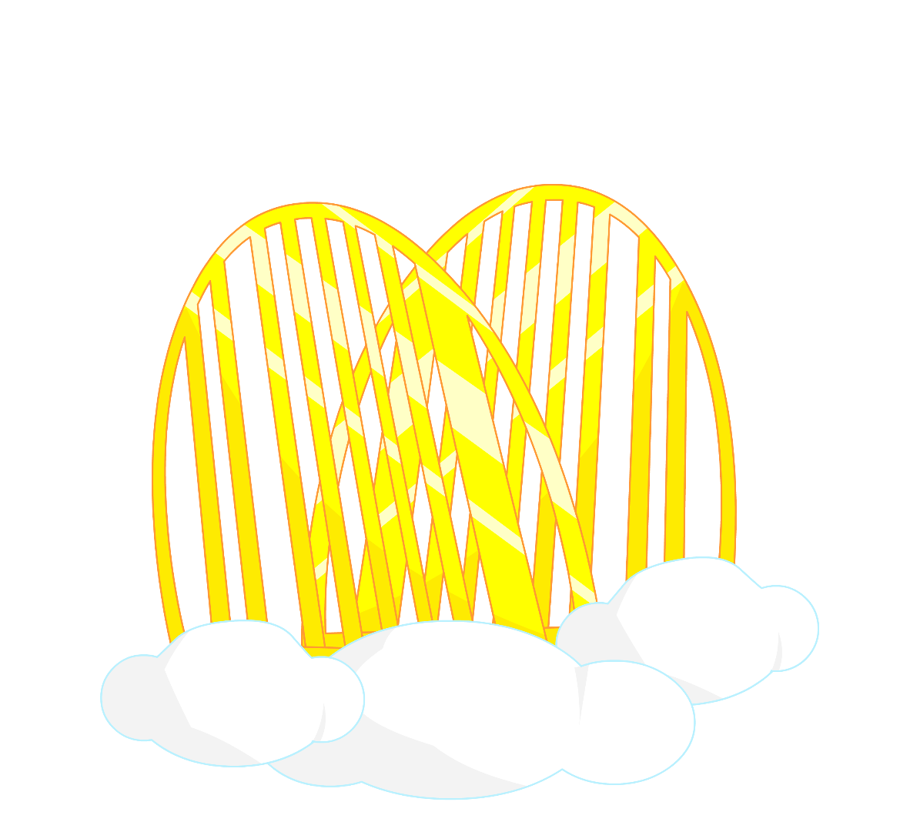
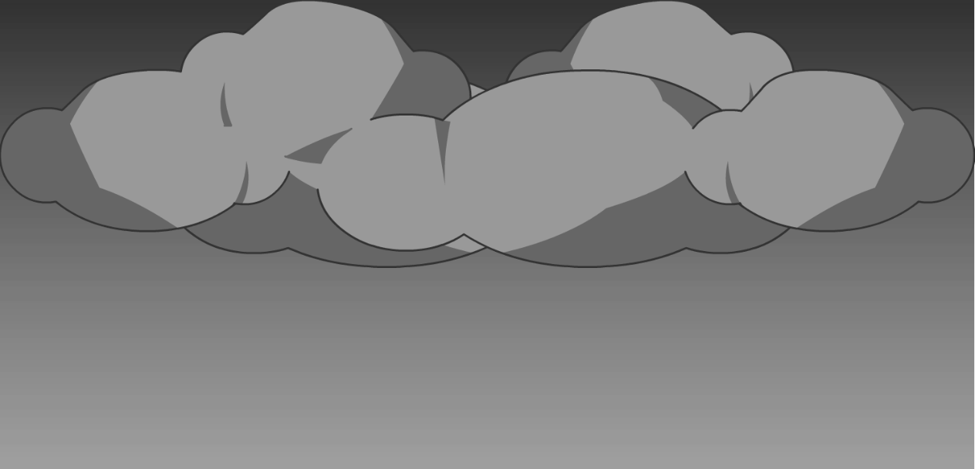
Environment

Slide 14
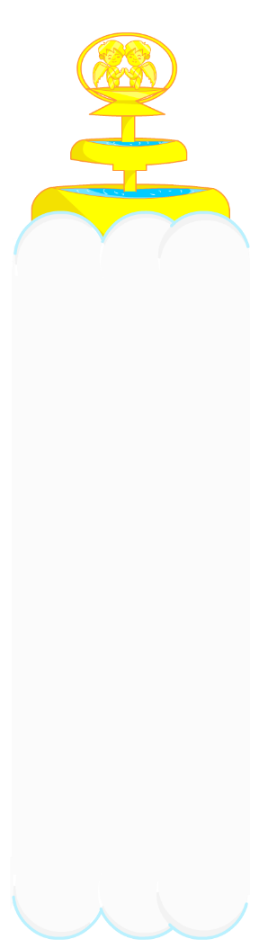

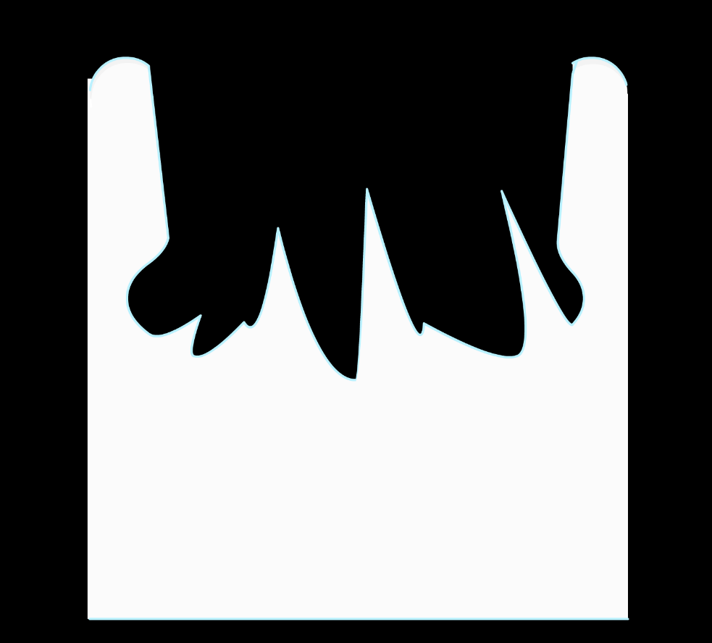

Modular Tile sET

Slide 15


Modular Tile sET

Slide 16

Modular Tile sET

Slide 17
Current Build

Slide 18
Our game meets the brief because:
The physics in our game is drawn from the momentum and trajectory applied to the demons at launch as well as the lightning that strikes them further.
The physics continues through the demons recoiling off terrain.
Our gameplay is symmetric because the same affordance are given to players as well as having a symmetric playing field.
Playtesting was conducted to reach the final variables inducted in our game.

Slide 19
Our game meets the brief because:
Key research was carried into informed conventions for targeting our demographic.
Art
Match – duration

Slide 20
Our game meets the brief because:
Clear player affordances.
Title and main menu screens.
Implemented sounds.

Slide 21
Bibliography
Kyatric. (2013). Bartle's Taxonomy of Player Types (And Why It Doesn't Apply to Everything). Available: https://gamedevelopment.tutsplus.com/articles/bartles-taxonomy-of-player-types-and-why-it-doesnt-apply-to-everything--gamedev-4173. Last accessed 02/05/2017.

Slide 22
Questions?

