Slide 1
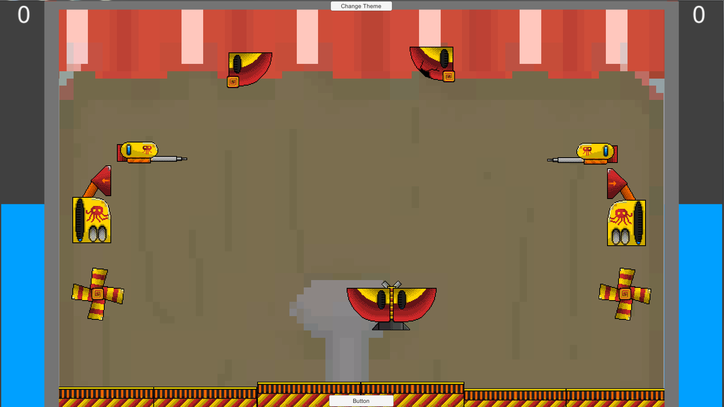

L 4/5 Group 12
River Chick, Douglas Simpson and Elliot Chester

Slide 2


The Game
Players cannon
Originality – What you miss gives your opponent more strength
(Water quantities which is the score)
Two players – Opposite each-other
Simultaneous – NO turn taking
Spinners – Provide unusual scoring system
The symmetrical layout can be seen below (designs may differ on level)

Slide 3
Physics
Water – uncalculatable
Bursts of fun – Due to other spinners
[INPUT VIDEO LINK]

Slide 4
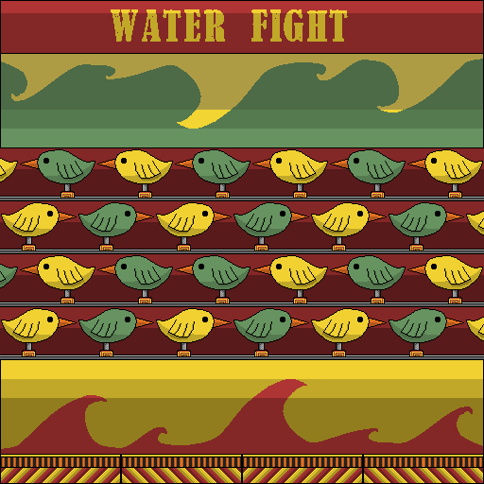



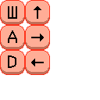
Theme
Carnival
Inspires crazy fun
Gives more joyful / happier feel to the game (compared to others we tried)
Clarity. It’s obvious what belongs to who.
Iterated – Desaturated
UI / Spinners

Slide 5




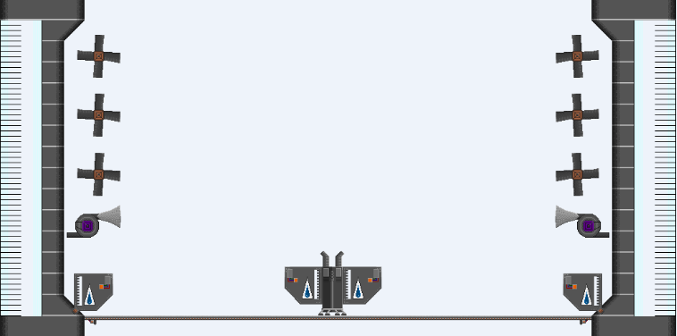
Themes Comparison
Spinners for the scene to the right
Not fully implemented
Too sterile
Boring

Slide 6
“Current Build”

Slide 7
Hours
River – 39 Hours
Doug – 38 Hours
Elliot – 52 Hours
(Joe Sawyer no longer involved)

Slide 8
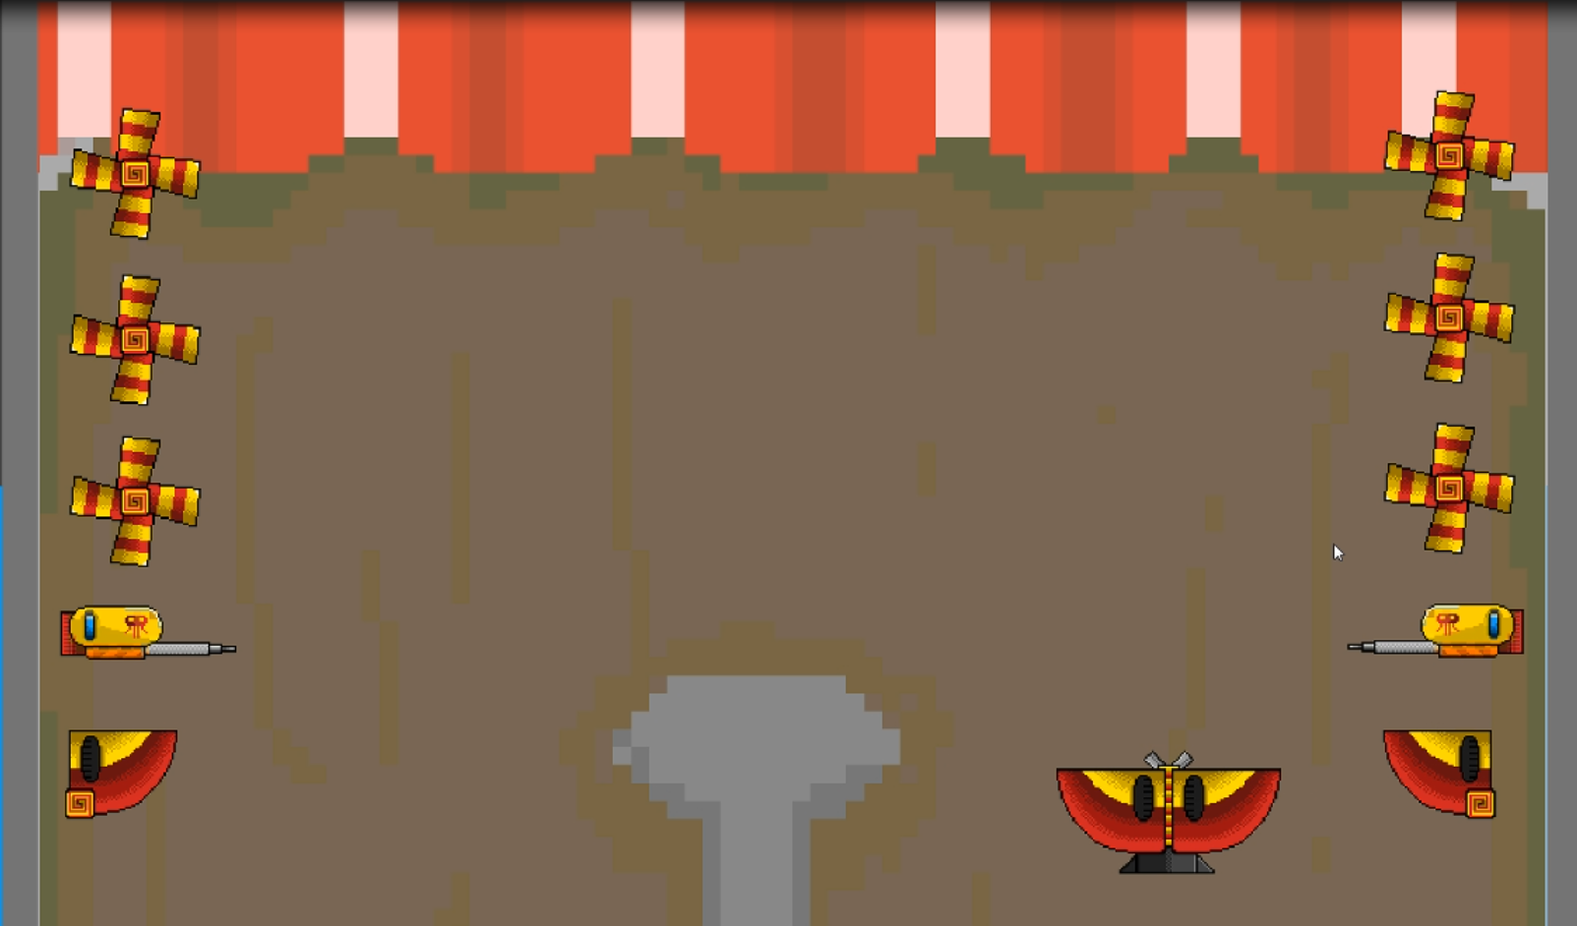
Questions Slide
Thanks for watching.

