Slide 1
L4/5 Group 7
Physics Game
Oliver Chamberlain, Thomas Simmons, George Hutchings and Amy Potter

Slide 2
The Brief
Create a 2D physics game
Adversarial and symmetrical gameplay
Played on a single device
Must contain simple and easy to learn rules and mechanics

Slide 3

Target Audience
Teenaged boys
Aged 13-17
http://www.pewinternet.org/2015/08/06/chapter-3-video-games-are-key-elements-in-friendships-for-many-boys/
http://www.theesa.com/wp-content/uploads/2015/04/ESA-Essential-Facts-2015.pdf
Notes:
Boys are more likely than girls to play games in the same room - 11% more likely to play every day and 20% more likely to play weekly
Boys are also more attracted to games with violence of some kind whereas girls are more attracted to nurturing or methodical games

Slide 4
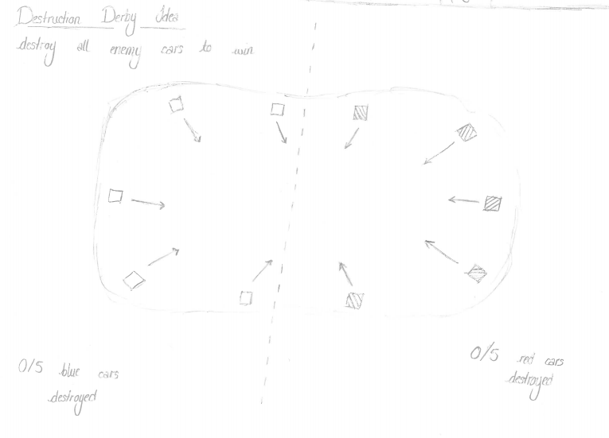
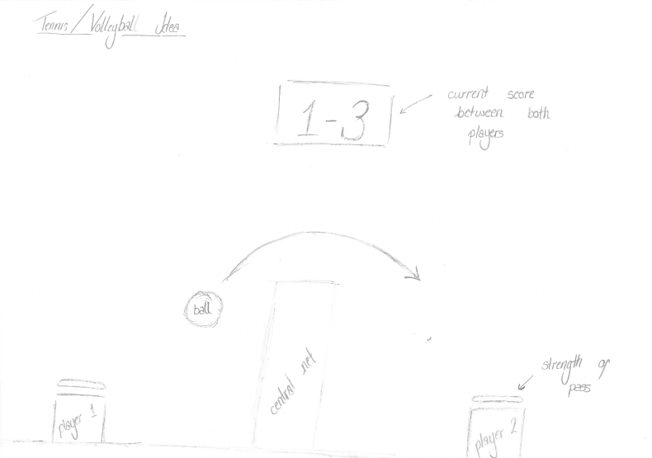

Research and Initial Ideas
Water buoyancy
Gravity
Ragdolls
Forces
Space and time
Light
Schrödingers Cat
Notes:
Moodboards of other games, physics etc
Prototypes and mockups of other ideas

Slide 5
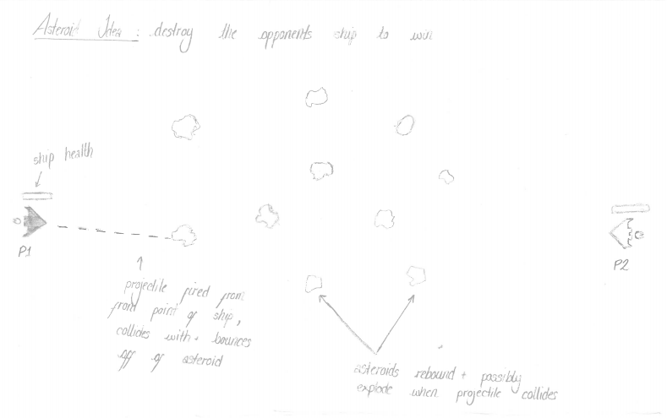
Game Idea - Asteroid game
Two player game
Target game platform: PC
Use blast waves from rockets to knock asteroids into opponent's ship
Standard arrow key controls for movement
Notes:
/*Discuss choice of physics, show mockup screen
Possible moodboard of similar games or colour palettes etc
What the player does*/
WASD and L-ALT for player 1’s controls, Arrow keys and R-CTRL for player 2’s controls
/*Should add something about duration of gameplay*/

Slide 6

Prototype

Slide 7
Alternate game idea - Destruction derby
Two player game
Target platform: IOS/ Windows tablets
Players each have 5 cars
All cars start in a circle around the arena
Players take turns to use an Angry Birds style system to launch cars forwards in order to destroy their opponent’s cars

Slide 8
Alternate game idea - Volleyball
2 player
Target platform : PC
Players use arrow keys to move to move to intercept a ball, hit into the air by their opponent and hit it back over the net
The player who manages to make the ball touch the floor first will get a point
The first to 5 points will be the victor

Slide 9
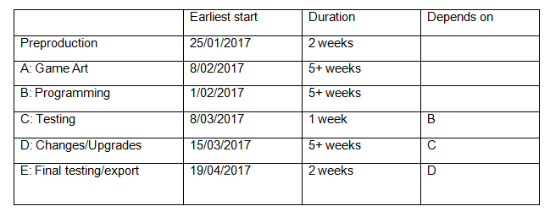
Timescale

Slide 10
Questions

