Slide 1
Group 2
Courtney, Tom, Lewis, Heather.

Slide 2
Brief
To achieve psychological flow for players.
To work within the theme of “Light vs Darkness”.
Developed for PC.
Appeals to Easy Fun(exploration, curiosity).
Appeals to Hard Fun (challenge, mastery).
Appeals to Serious Fun (repetition, zen focus).

Slide 3
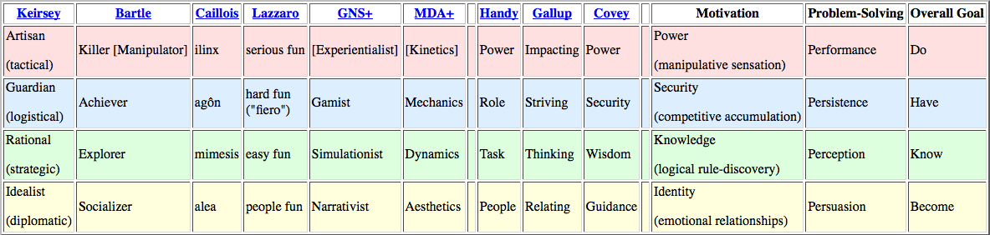
Demographics
Action/Adventure game.
13+ males and females.
Using Bart Stewarts Unified Model it seems natural to appeal to Achiever/Explorer’s.

Slide 4
First Pass - Flow
Concrete goals with manageable rules
Goals that fit player capabilities.
Clear and timely feedback.
Eliminate distractions

Slide 5
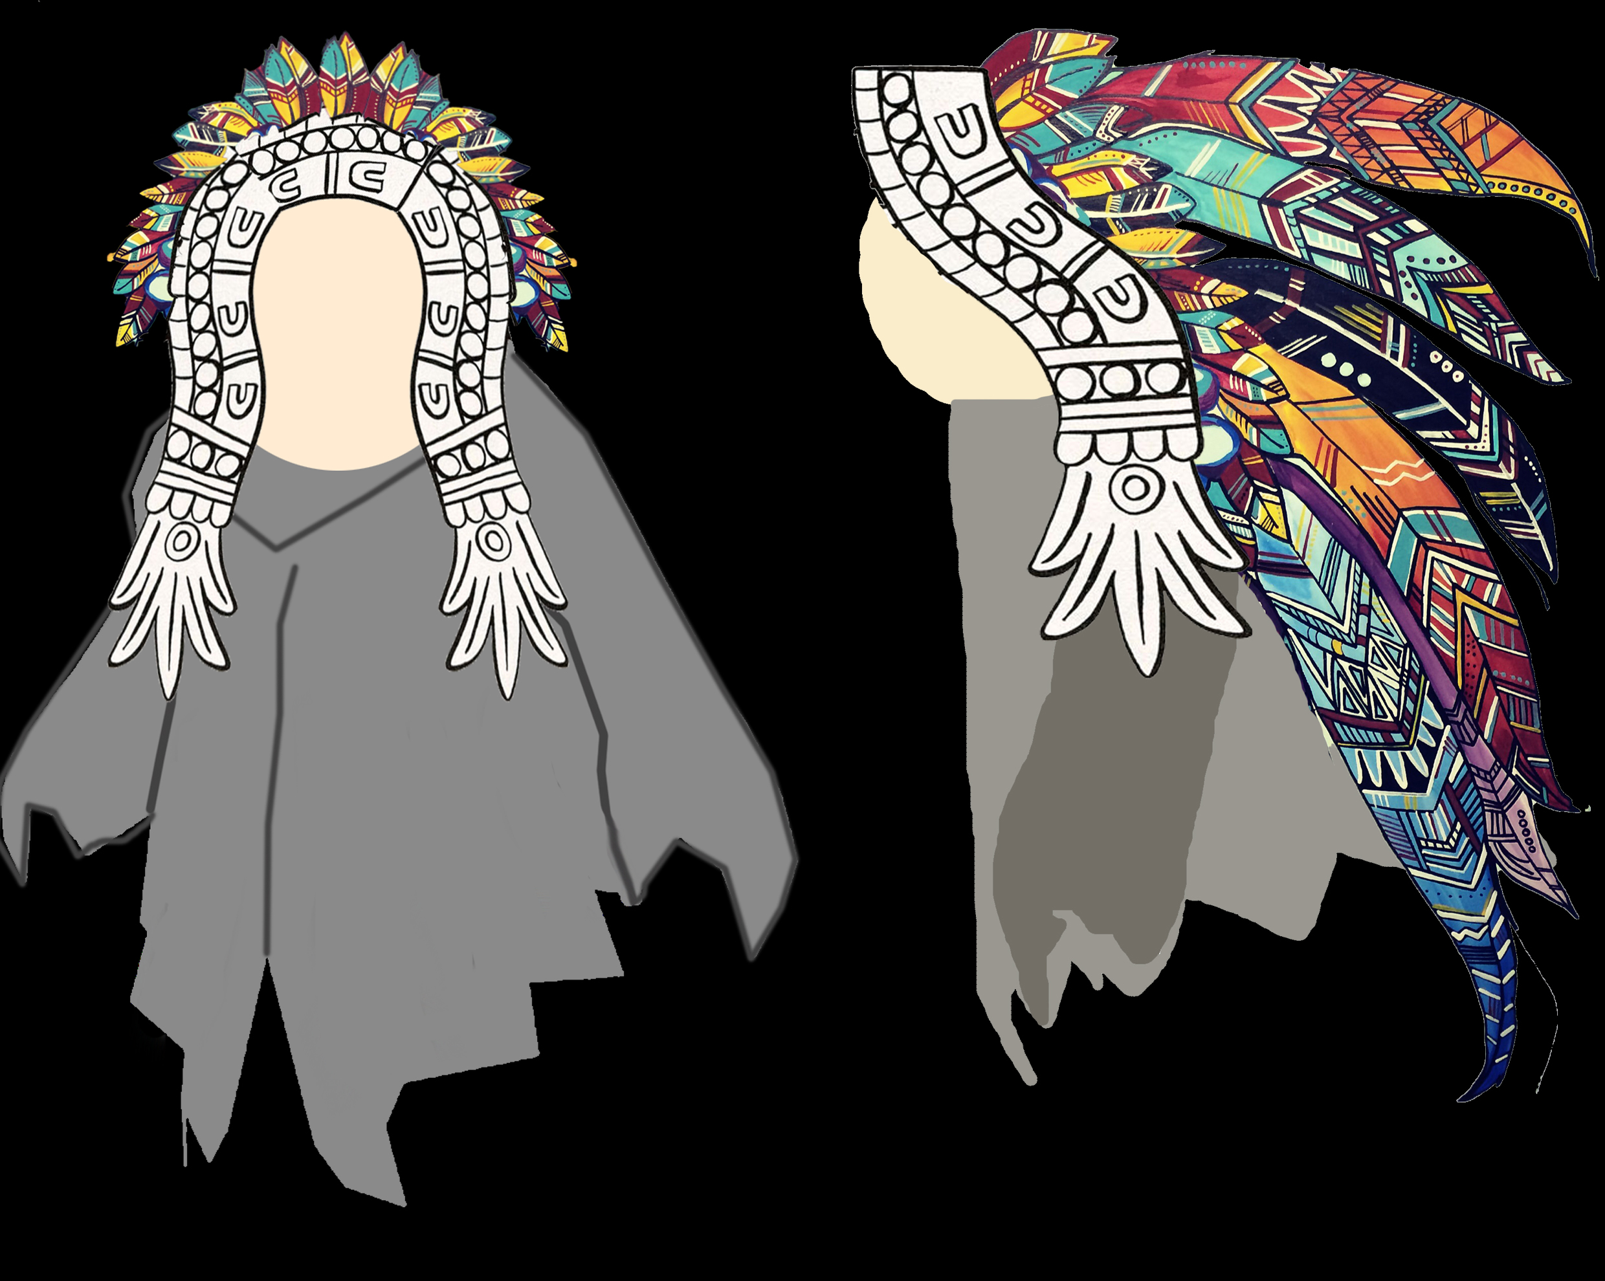
The Player
Play as a Aztec preist whose ritual to feed the sun god fails, causing the end of the world. The last fire had not been coaxed into life, and the player must journey to coax it into life. This last fire is the lamp the player carries throughout the game, they must take it to the god of fire who will use the fire to start the new world cycle by ensuring the successful renewal of the sun.

Slide 6
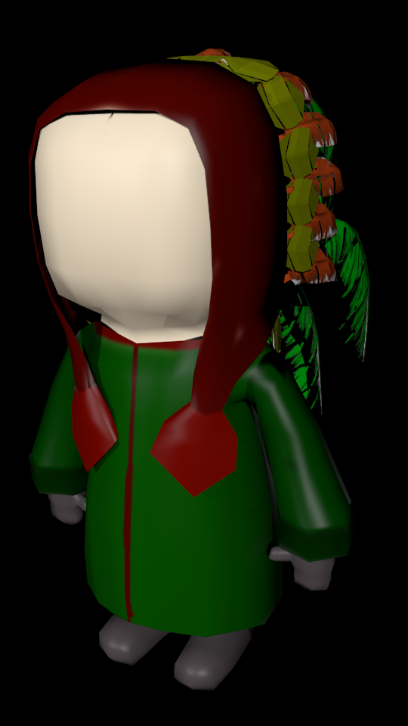
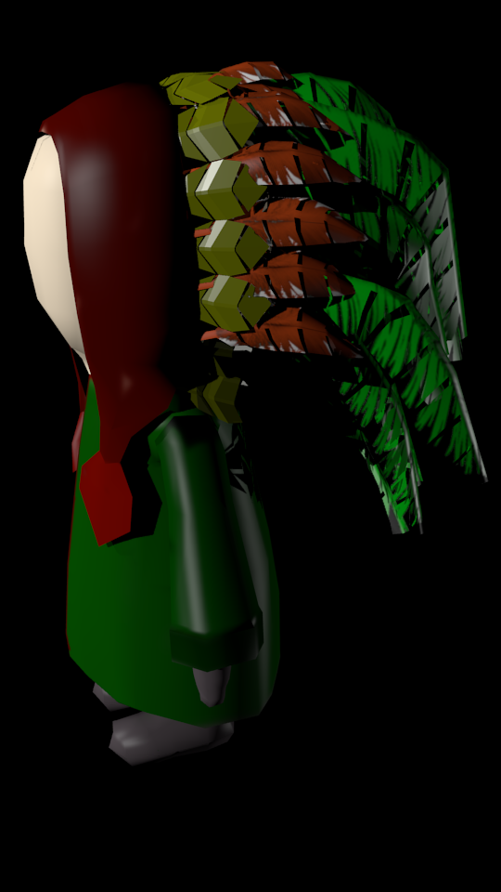
The Narrative
The narrative follows the theme of dark vs light, with the player experiencing two worlds.
The light world is the “real” world, where the player is a child going through an organ donation. They are donating the organ to their older sibling, and due to their age don’t fully understand what is happening and why. The game, and dark world, is the child processing and dealing with the trauma and fear.
The dark world is the childs dream, where their fears and confusion of the situation are manifested. The childs journey as an Aztec Preist is about them overcoming their fear. The bosses and enemies are manifestations of people the child knows.

Slide 7
Core Mechanic
The environment is dark and foggy, with the player character travelling with a light to illuminate their way.
Light mechanic that serves as a “weapon”, light source and interacts with objects in the environment to progress through puzzles.
The light decreases over time, and when used.
Light is the health bar of the player, when empty the player must travel in darkness.
Still deciding if the darkness should kill the player, or if they can continue but will die from one hit from an enemy.
Enemies will attack to steal your light.

Slide 8
Core Game Loop
Combat
Reward
Puzzle
Reward

Slide 9
Combat
Each attack costs Light per use.
The player has three attacks – light, heavy and dodge.
Through exploration and combat the player will receive new oils to change the colour of the light, and the attack they are using.
Oils are one time use. Either automatically activated or player presses a button to activate.
 | Red Enemy | Blue Enemy | Green Enemy
Red Light | Stuns for 6 seconds | Stuns for 3 seconds. | Stuns for 3 seconds.
Blue Light | Stuns for 3 seconds. | Stuns for 6 seconds. | Stuns for 3 seconds.
Green Light | Stuns for 3 seconds. | Stuns for 3 seconds. | Stuns for 6 seconds.
White Light (Default) | Stuns for 2 seconds | Stuns for 2 seconds | Stuns for 2 seconds

Slide 10
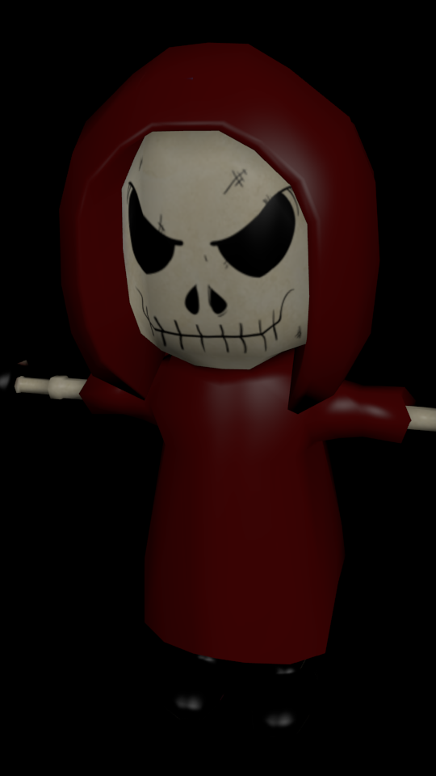
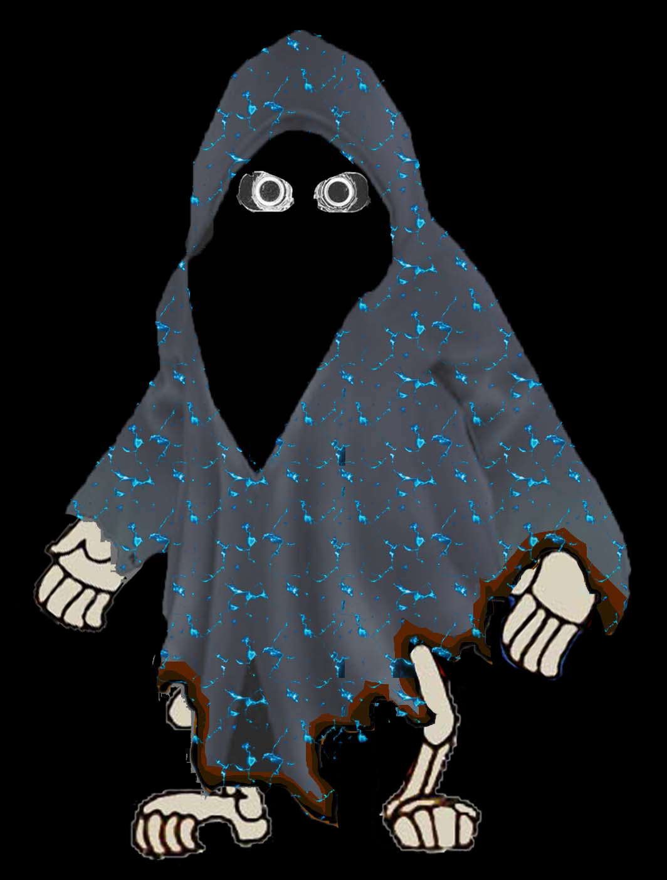
Combat
Three types of enemies:
Patrolling enemies. These enemies traverse between set waypoints. They can be avoided without combat if the player is cautious.

Slide 11
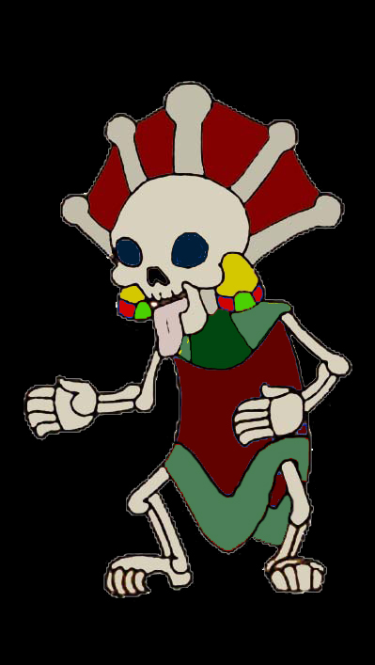
Combat
Guarding enemies. These enemies are static until the player enters a certain radius, then they will chase the player until the player leaves a set radius. Guarding oils, Light refills and shortcuts.

Slide 12
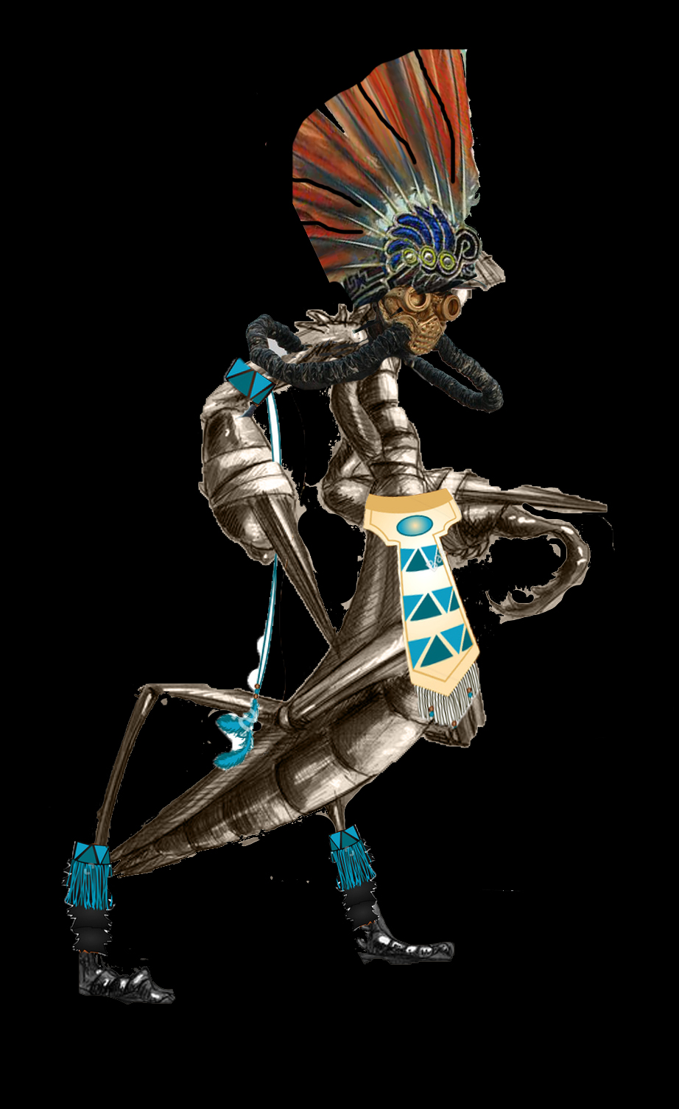
Combat
Bosses. These enemies are for a player to demonstrate their mastery of the mechanics. They have three phases:
Boss Attacks Player, the player must avoid the boss’s attacks.
Player Attacks Boss to stun him long enough to..
Player uses puzzle to defeat the boss via the enviroment.

Slide 13
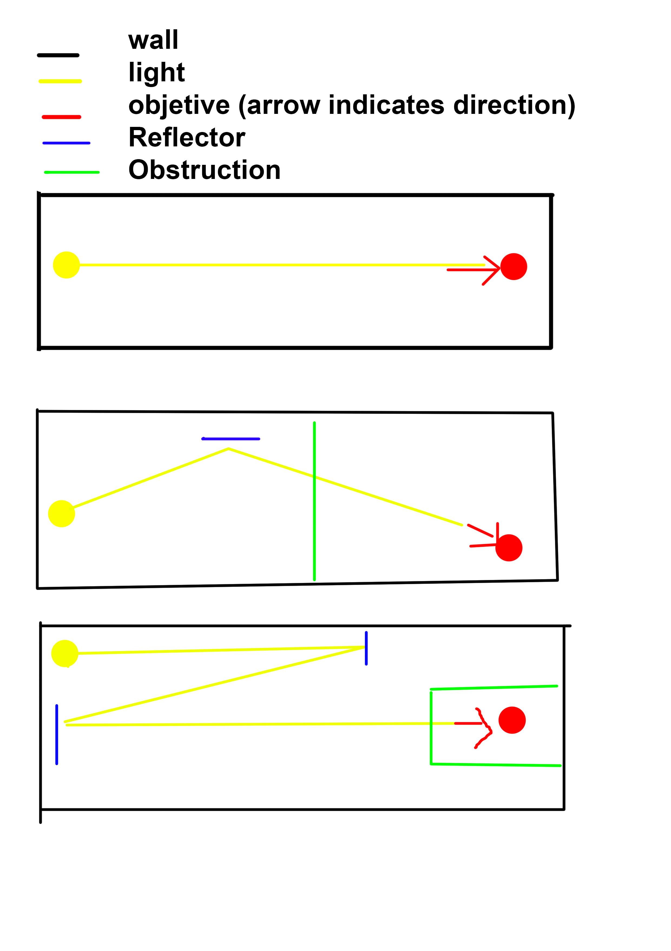
Puzzle
Gating technique to slow progression.
Players will use spatial reasoning to refract a beam of light to a specific object in order to open a door and progress.
Will gradually increase in complexity, but always remain simple enough that players can work out a solution in their head.
The player will place their light on a pedastool in order to complete the puzzle. When successful their light will be refilled and the locked door will open.

Slide 14
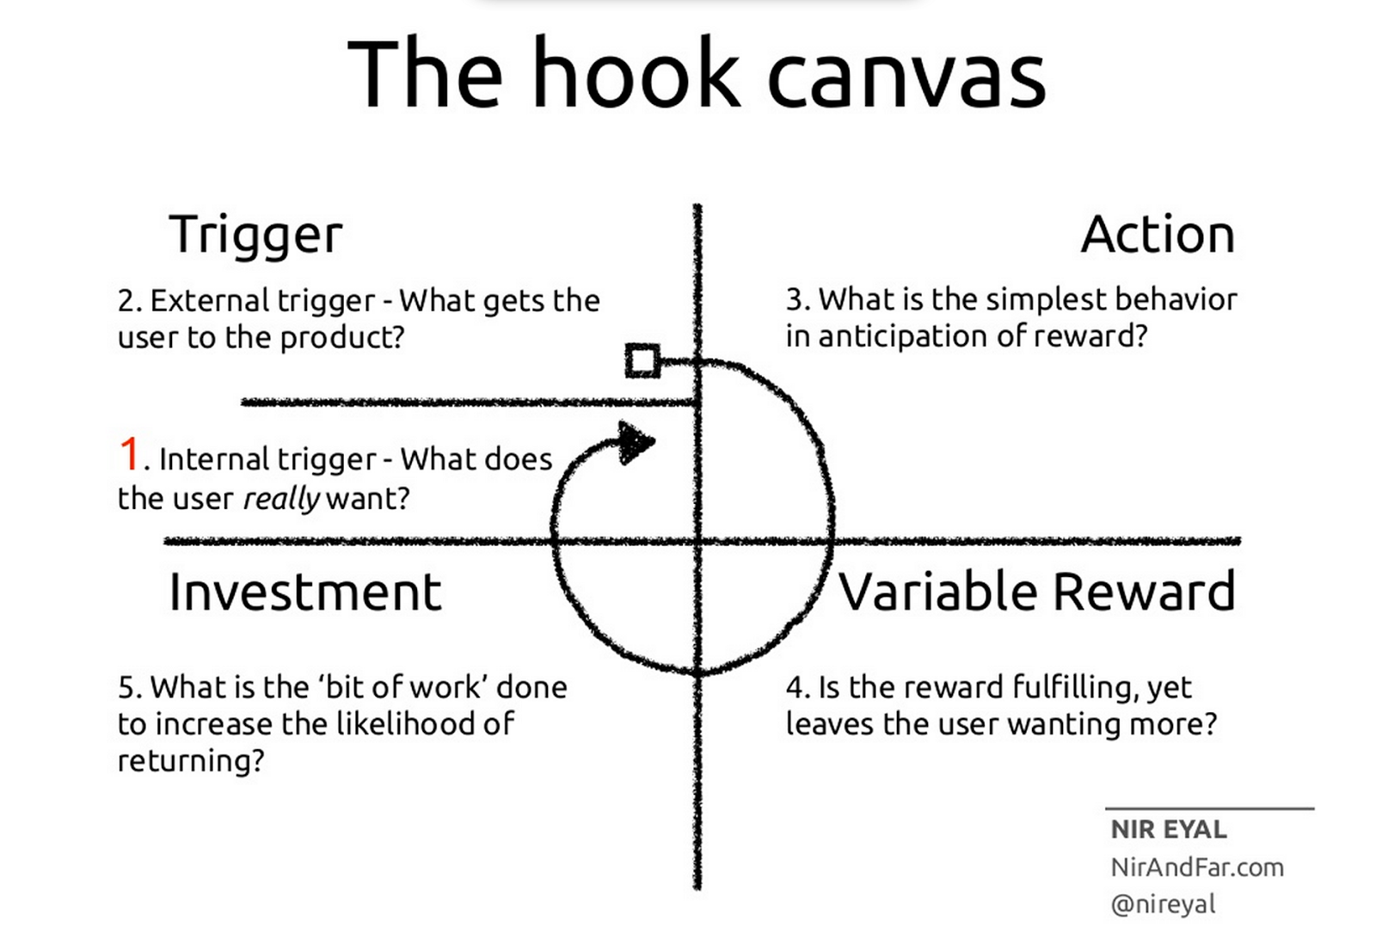
Keeping Players Playing
Trigger: Interesting core mechanic, action/adventure genre, dark theme with relatively light and cute style.
Action: Core gameplay loop.
Variable Reward: The player is rewarded after each action, rewards are a mix of intrinsic and extrinsic.
Investment: Progression through levels, increase of challenge, time.

Slide 15
Rewards
Reward | Exploration | Combat | Puzzle
Oils (One use) | Rare | Common | Rare
Light refill | Common | Rare | Common
Intrinsic | Curiosity, progression, collecting, discovery. | Flow, mastery of mechanics. | Flow, mastery of mechanics.

Slide 16
Prototype

Slide 17
Questions?

