Slide 1



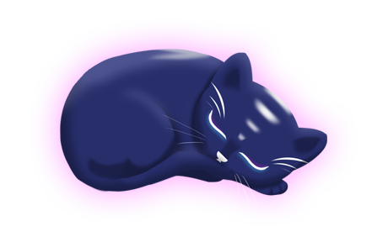
Aurora
Group 6
Charlie Crewe, George Flude, Alex Polley and Callum Walsh.

Slide 2
Our Brief
Create a casual game that uses minimal inputs

Slide 3
Psychograph
Name: Maarii
Age: 48
Occupation: Admin/Sales
Marital Status: Married
Likes:
Sweet pastries
Chocolates
Toffees
Biscuits
Apple Pie
Green Tea
Earl Grey
v
Animals
Cats
Dogs
Horse
Music
Country Rock
80’s Pop
Fears/Dislikes
Insects
Large Dogs
Scaled creatures
Heights

Slide 4

Game Loop
Tap
Reward
Colour

Slide 5
Platform
Tablet
Screen size suitable for psychographic
Mobile Devices
Provides the means to play on-the-go

Slide 6
Platform test

Slide 7
Usability Testing
Paint Strokes felt too repetitive
(Needs playtesting feedback)

Slide 8

Playtest

Slide 9
Strengths and Weaknesses
Strengths
Weaknesses

Slide 10
What needs to be done
Modular construction of scenery
Customisation
Refinement of colour loop
Playtest

