Slide 1



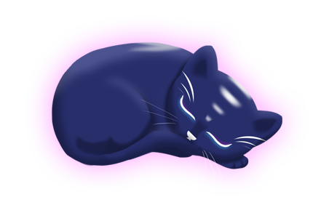
Aurora
Group 6
Charlie Crewe, George Flude, Alex Polley and Callum Walsh.

Slide 2
Our Brief
Create a casual game that uses minimal inputs

Slide 3
Psychograph
Name: Maarii
Age: 48
Occupation: Admin/Sales
Marital Status: Married
Likes:
Sweet pastries
Chocolates
Toffees
Biscuits
Apple Pie
Green Tea
Earl Grey
v
Animals
Cats
Dogs
Horse
Music
Country Rock
80’s Pop
Fears/Dislikes
Insects
Large Dogs
Scaled creatures
Heights

Slide 4

Game Loop
Tap
Reward
Colour

Slide 5
Alpha Gameplay
https://www.youtube.com/watch?v=g4hOc1QpEwQ&feature=youtu.be

Slide 6
Usability Testing
Positive feedback
Art was pleasing to the eye.
Being able to interact with the environment.
Being able to colour of your choice.
Being able to interact with the cat as a menu.

Slide 7
Usability Testing
Constructive feedback
Lack of instructions, a lot of guessing work
Would like to be able to colour more then just environmental objects
More visual feedback as a reward.

Slide 8
Platform
Tablet
Screen size suitable for psychographic
Mobile Devices
Provides the means to play on-the-go

Slide 9
Platform test

Slide 10
What needs to be done
Polish
Zoom Coding
Fix colouring values
Visual feedback
Cat progression
Level Design
Building more scenes
Camera Panning to different islands

Slide 11
Any questions?

