Slide 1

Introductions
Daniel Beales
Willoughby Axtell
Kyle Bodin
James Macleanan

Slide 2
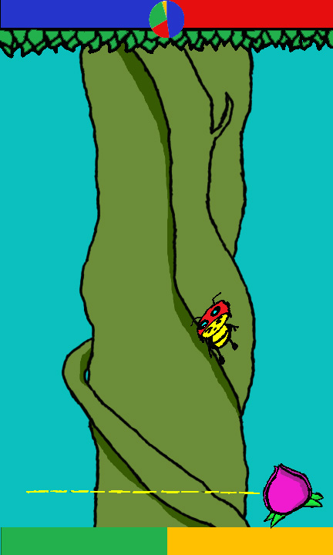



Buzz Blast Battle
3
1

Slide 3

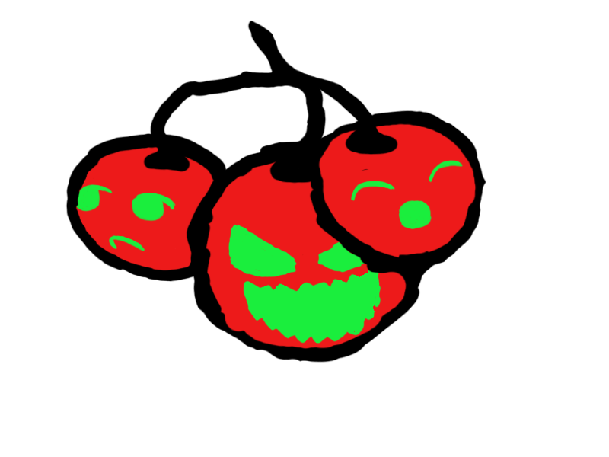
Prototype

Slide 4

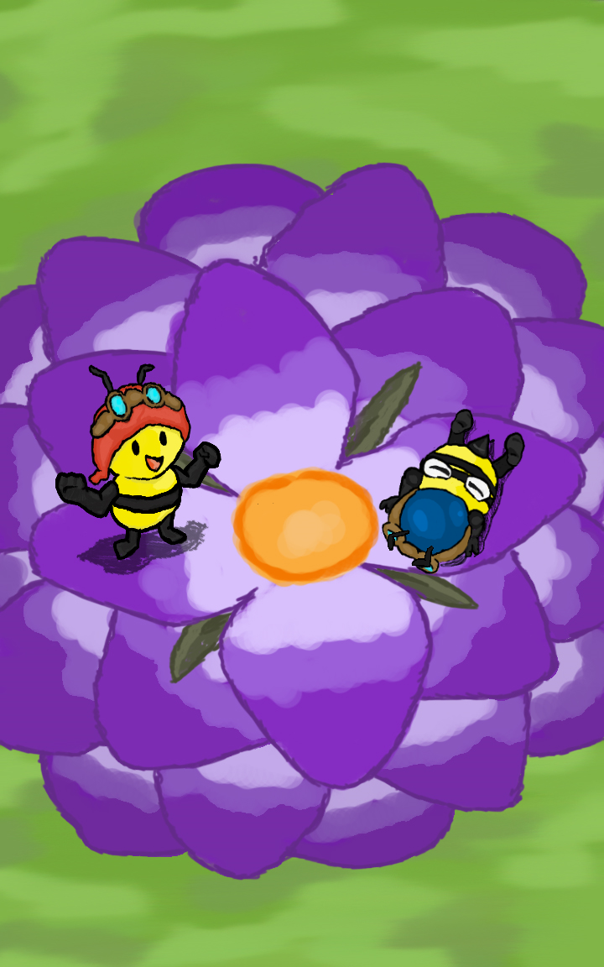
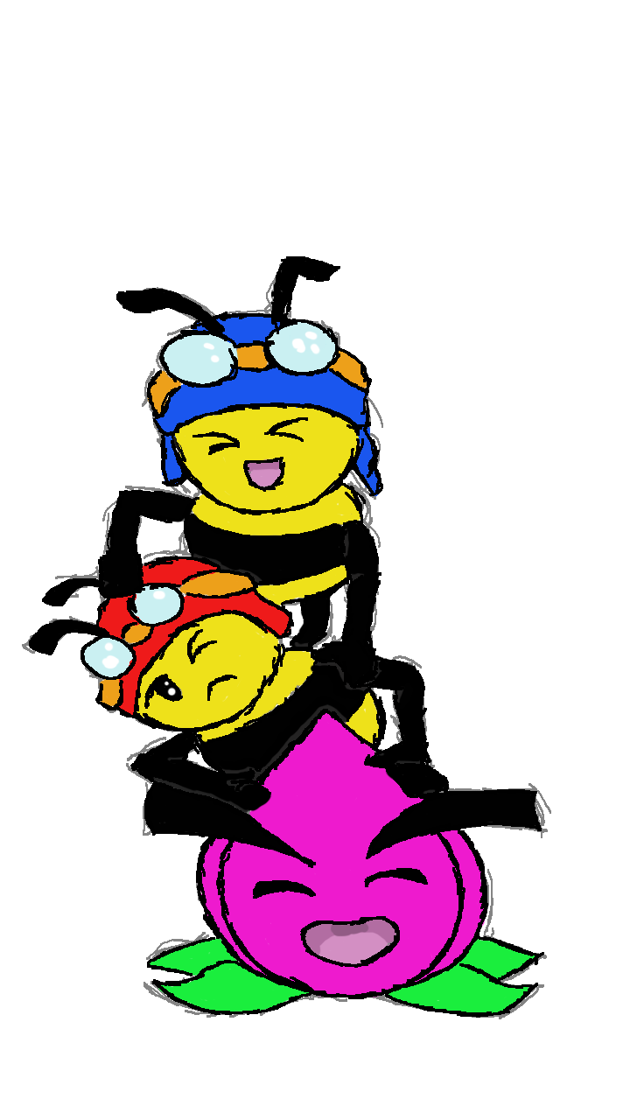
Design
 | Victory Background

Slide 5
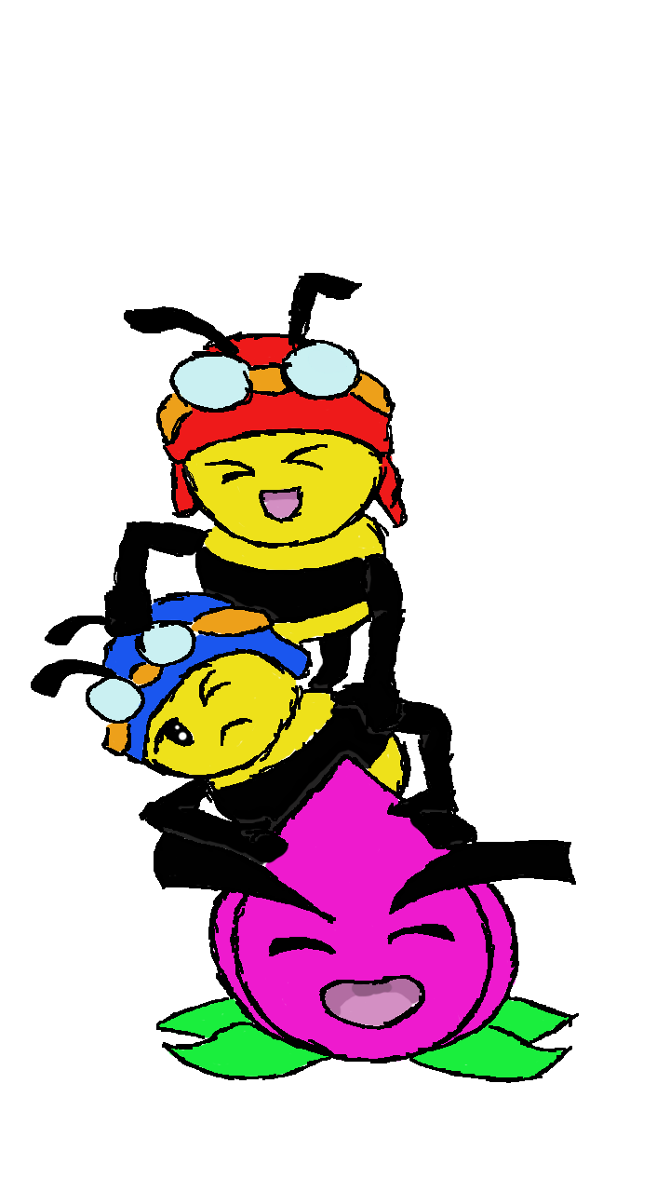
Our Plan
Sort through the key bugs
Playtest to smooth out any remaining issues
Polish the game art
Add Animations

Slide 6

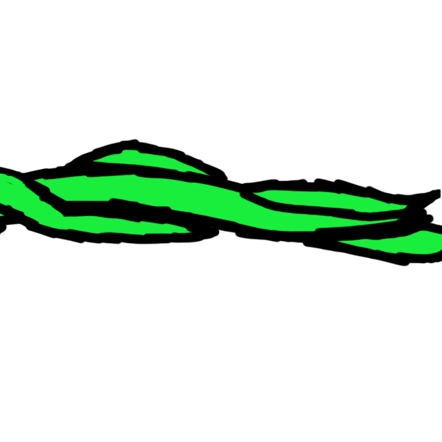
Any Questions?

