Slide 1
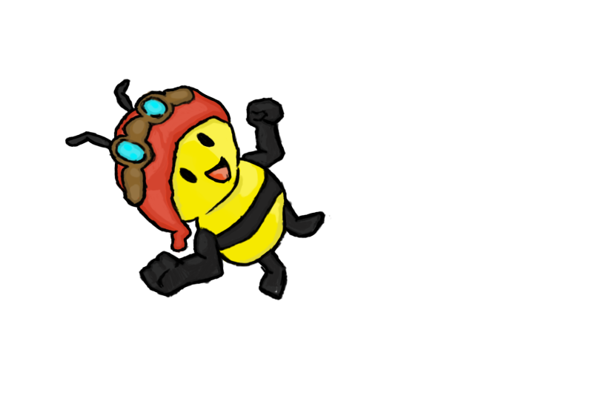
Introductions
Daniel Beales
Willoughby Axtell
Kyle Bodin
James Macleanan

Slide 2
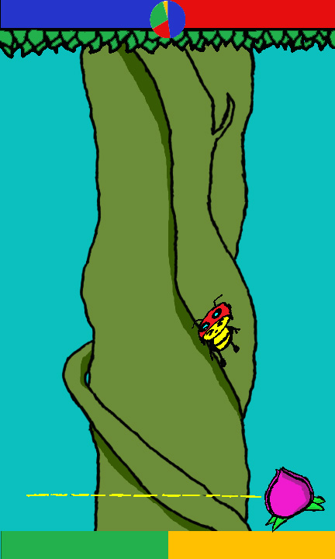



Buzz Blast Battle
3
1

Slide 3

Prototype

Slide 4
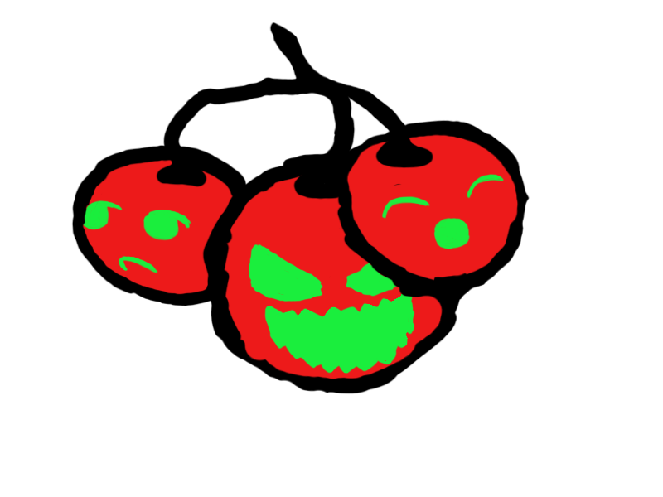
Known Bugs
Flower position
Player two score
Hazards
Scoring system
Aspect ratio

Slide 5

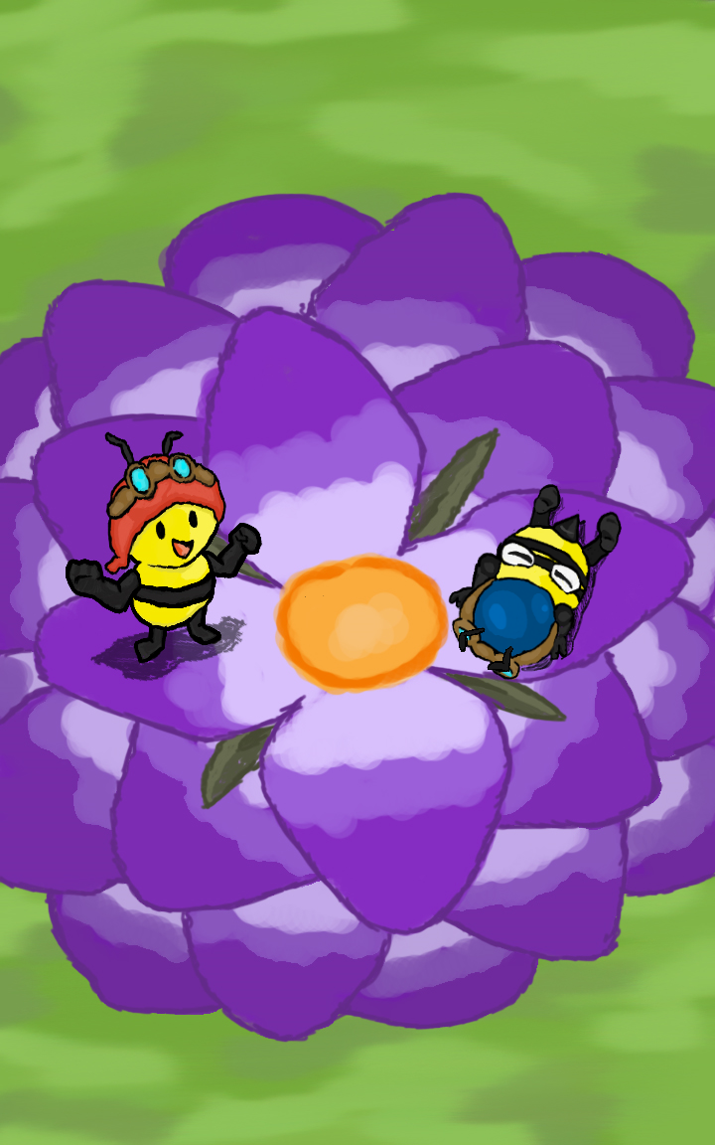
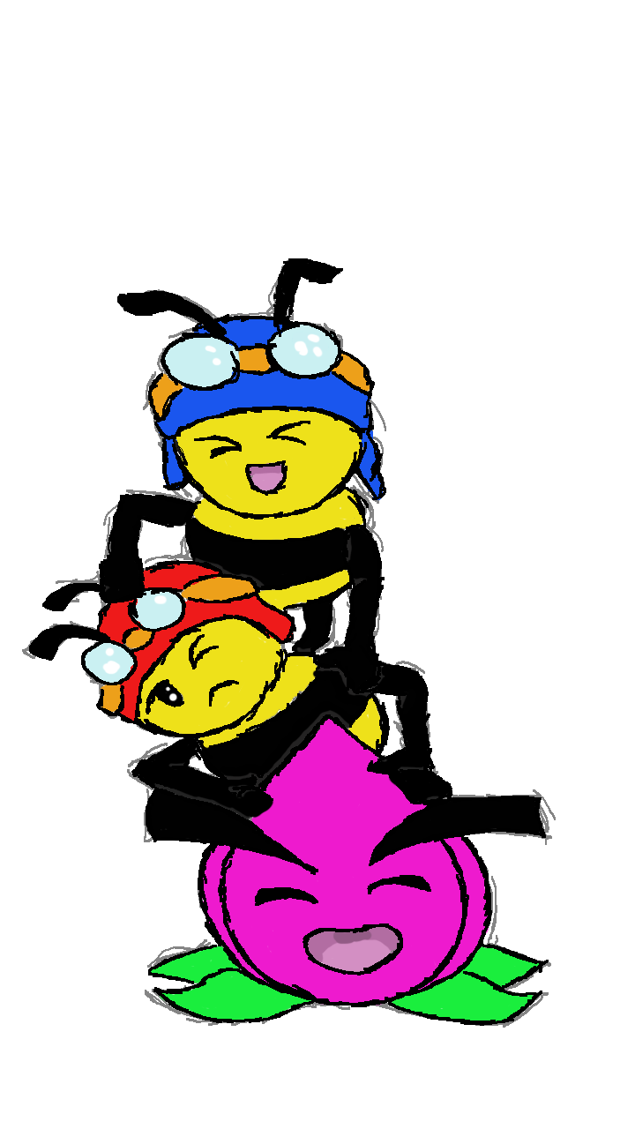
Design

Slide 6
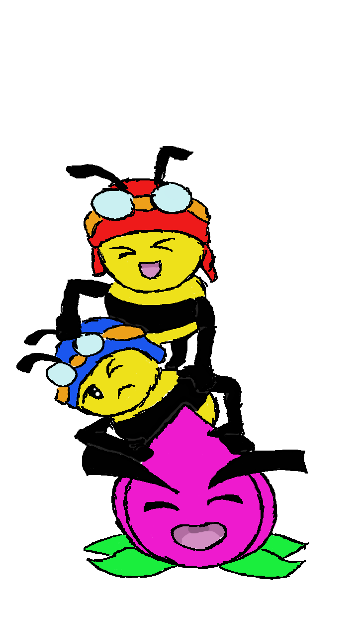
Our Plan
Sort through the key bugs
Playtesting
Polish
Add Animations
Update Design
More playtesting

Slide 7
Any Questions?

