Slide 1
MGP/GP Group 16
Initial Pitch
Matthew Cavignac (Project lead)
Jack Gilmour (Designer)
Jordan Godbold-Slater (Programmer)
Joshua Pearse (Designer)

Slide 2
Bandai Namco Brief
The brief asks us to make a 2D mobile game, below are the key points;
Playable on one device
Tap only input
Simple and intuitive ruleset
Keep the players focused and engaged
Multiplayer
Be polished
Symmetrical

Slide 3
Discussing Initial Ideas
Originally we started with nine concepts and used these to build three core ideas;
Tap Miner
Tap Jump
Tap Parachute

Slide 4
A Brief View of Our Other Ideas
Tap Jump
This game used an endless runner style, where the score was the distance ran. Players would then compete over who has the high score.
Tap Parachute
This game used a reaction time mechanic, where the closer the player opened their parachute to the ground the higher their score.
After working on these ideas and flushing them out, the team decided on our tap miner idea

Slide 5
Our Chosen Game
Tap Miner (Working Title)
Our game utilizes a reaction time mechanic to keep the player focused.
Score is gained when items are destroyed, the first player to reach 10 points wins.
Core game loop;
Hit Item
Gain Score
Break Item

Slide 6
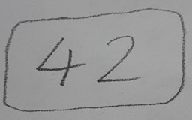
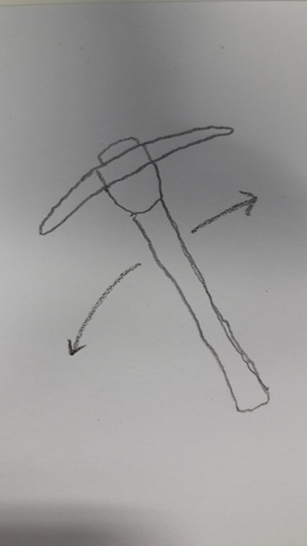
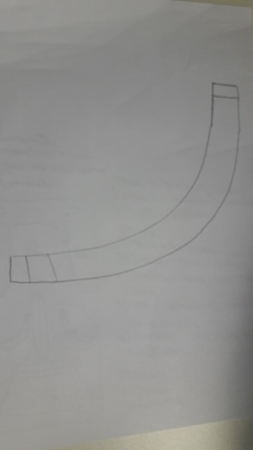
Mechanics
Reaction Time – (Core Mechanic)
Timer
Rhythm

Slide 7
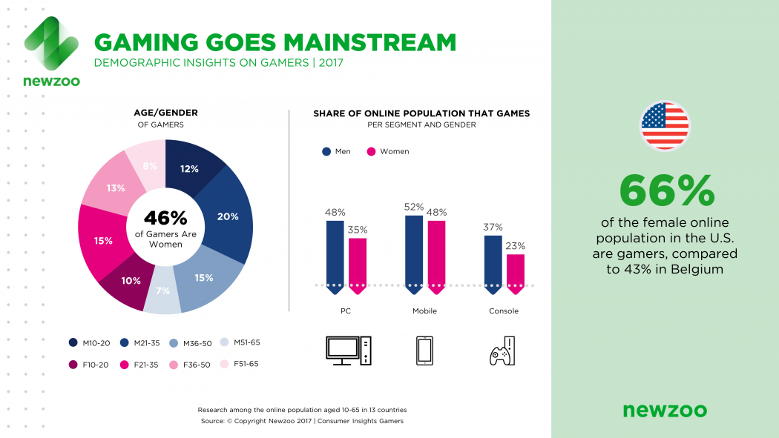
Target Demographic
Our target demographic is males & females aged 10-35, we chose this from the research we conducted.
Our game is able to master
Our target demographic makes up 57% of gamers in 13 countries in 2017.

Slide 8
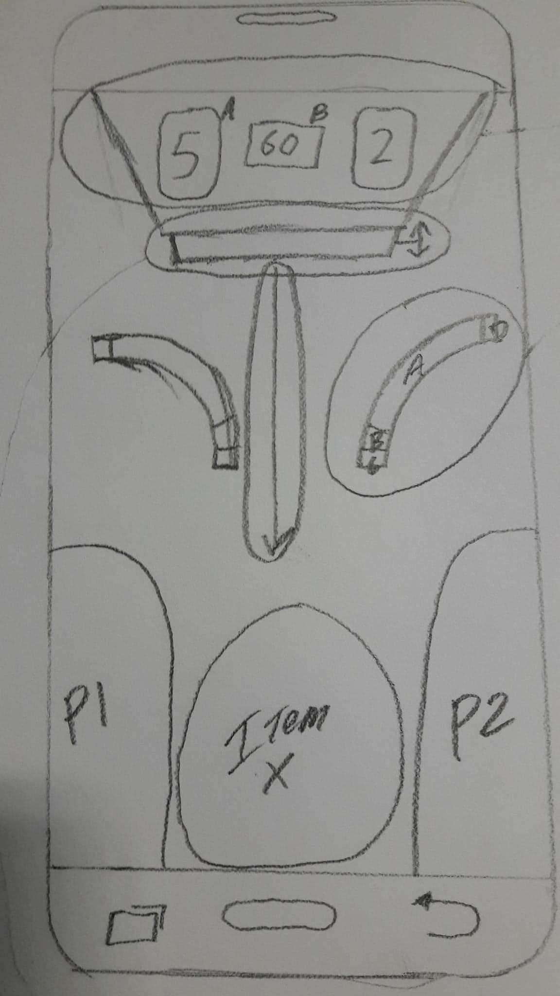
How the Game Will Look
The game will be vertically displayed on the phone, the players will be facing each other with an item in the middle for them to break.

Slide 9
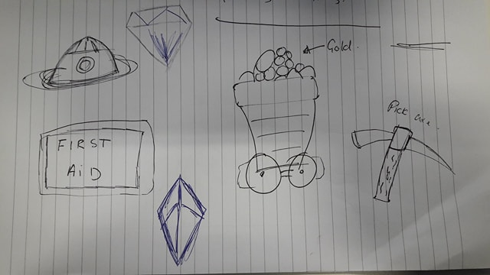
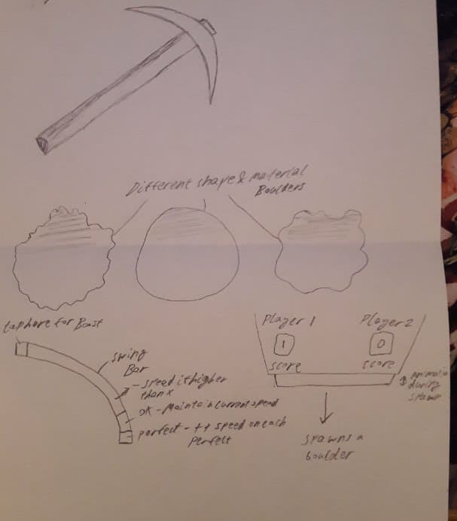
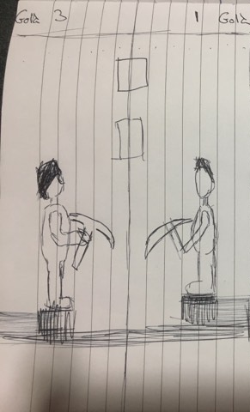
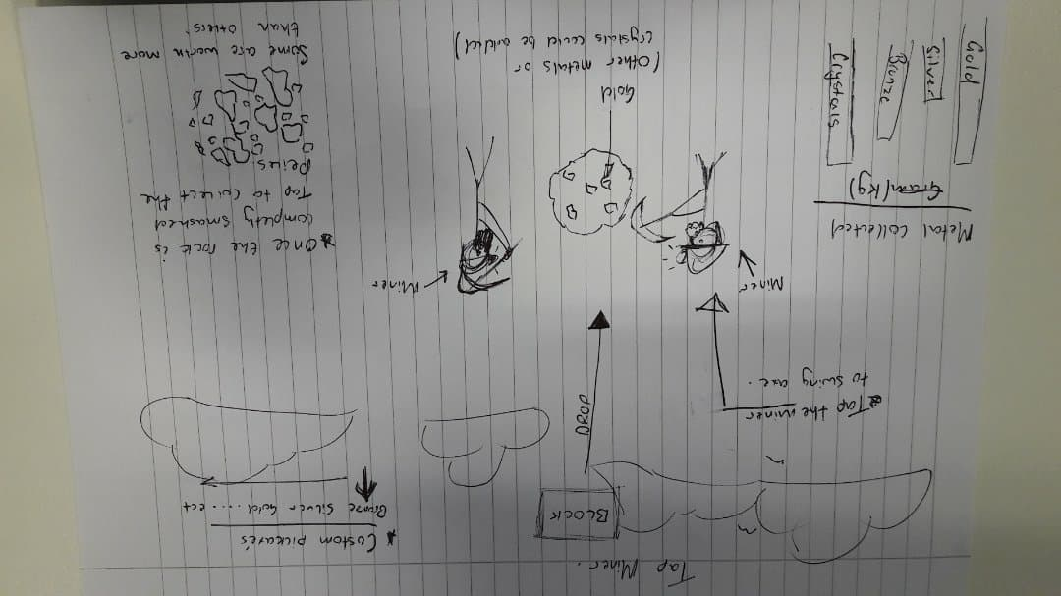
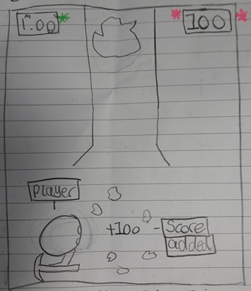
Concept Art

Slide 10
Questions?

