Slide 1

Group Project Pitch
Group Project Pitch
Notes:
Hello everyone
My name is Liviu Focsa and I’m here to present your assignment developed by the University of Suffolk in collaboration with the Bandai Namco Entertainment studio in Bucharest.

Slide 2
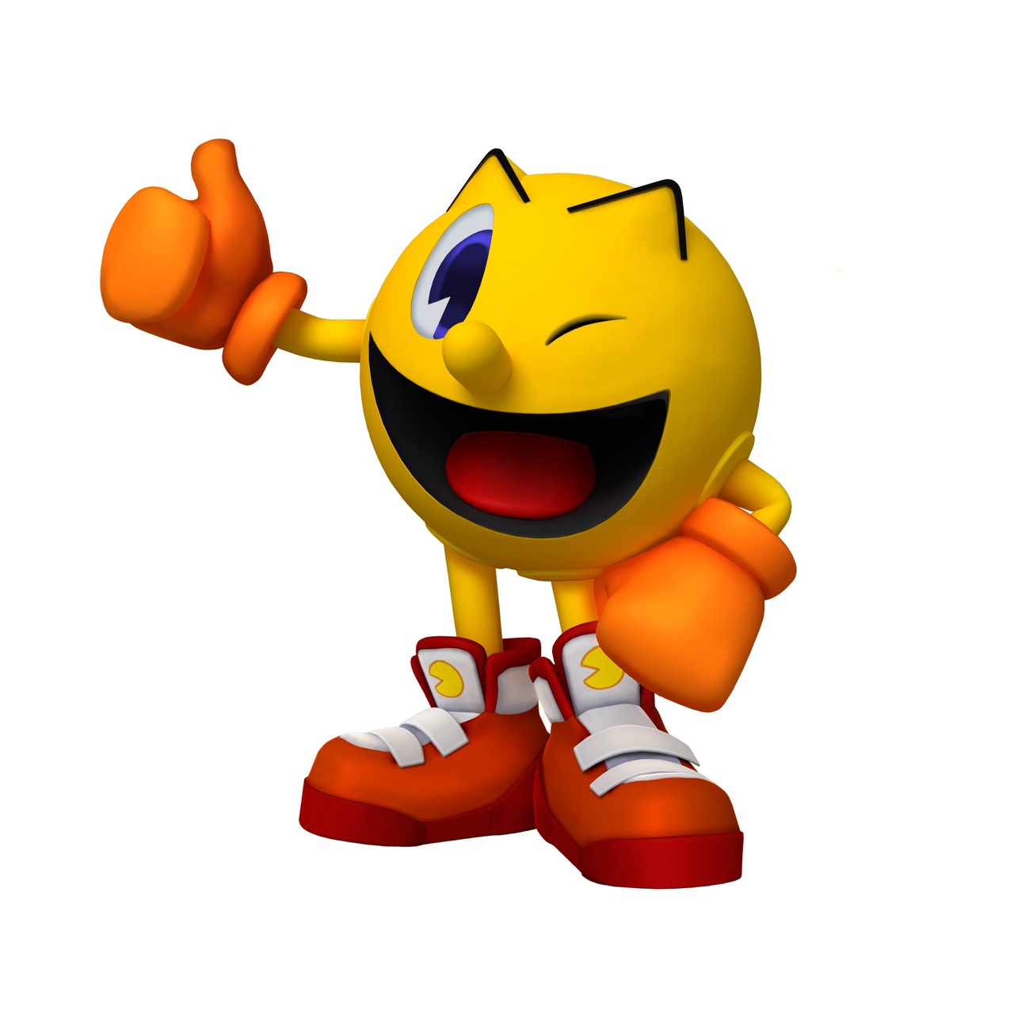

Introduction
Introduction
Liviu Focsa
Game Designer
Bandai Namco Entertainment
Notes:
I am a game designer at Bandai Namco Entertainment studio in Bucharest. I’ve been in the gaming industry for 6 years, starting as a Level Designer for console games, moving on as game designer for mobile and having a small period as a producer for web-games before returning to my one true love, game design.
Right now I take care of the PAC-MAN Mobile version leading a team of artists, analysts, programmers, QA and other designers.

Slide 3
The Assignment
The Assignment
The Assignment
2D Game
Main control mechanic is a simple tap
Multiplayer – by taking turns
On a single device
Symmetric
Simple and intuitive rules
Notes:
In order to better understand the assignment we prepared for you, I shall continue by explaining the requirements listed on this slide.

Slide 4
No Technical Showcases
No Technical Showcases
The Adversarial / Single Device / 2D requirements eliminate big technical challenges – 3D, AI, networking – which are not of interest to us.
We want you to focus on the main purpose of the exercise, the gameplay experience, which should be:
Engaging
Focused
Polished

Slide 5
Why Mobile?
Why Mobile?
The Mobile game market is growing at a phenomenal pace. In a few years it reached the Console and PC game sales and is predicted to surpass them.
Such a growth attracted the interest off all major gaming companies on the market and even created new giants of the industry, like SuperCell. Now everyone wants a piece of the cake. (Chances are one of your first jobs might be at a mobile games studio)
A market growing at such a speed also means a lot of new users of all ages and experiences. From kids to grandparents and from hardcore gamers to casual Solitaire players. Hey! Who knows? maybe even the future players of your game.

Slide 6
Why only 1 tap?
Why only 1 tap?
Because we have so many different users in the Mobile market, we consider most of them as Casual Users and there are a few differences between casual users and PC/Console Gamers:
Casual Users don’t have years of gaming experience
Casual Users don’t have the dexterity of gamers
Casual Users play on their phone to pass time
In order to engage and retain as many users, of all kinds, your game needs to be: Easy to control and understand but difficult to master!

Slide 7
Why Multiplayer?
Why Multiplayer?
The competitive nature of the game makes it easy for users to commit to it giving your game a higher retention than single player games.
It creates a feeling of urgency as both players progress through gameplay and approach the “finish line”.
Opponents are also a strong tool in making an experience that is always fresh.

Slide 8
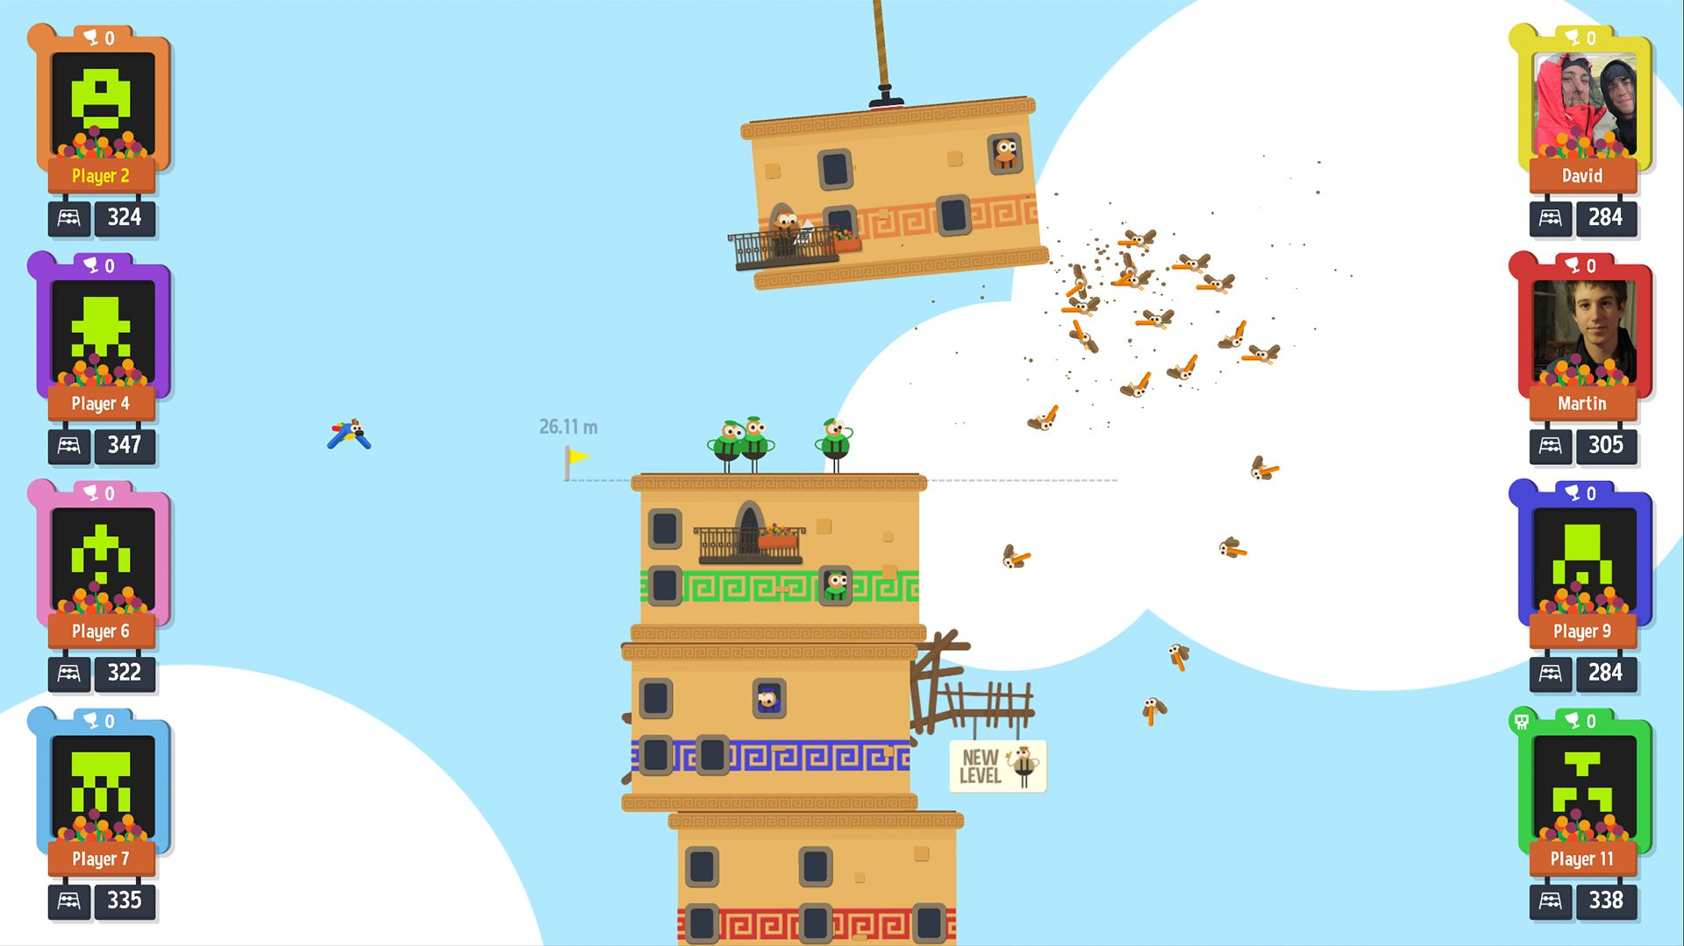
Example: Tower of babel
Example: Tower of babel
Simple structure :
Deploy tower blocks to build the highest tower!
Don’t let the tower block you deploy destroy the tower!
All players only use
a simple tap to deploy their tower block

Slide 9
But wind, ballance speed, other random events make the game different every time
Small Tower Of Babel video will be shown here

Slide 10
Other Games
Other Games
Here’s a list of other one tap mechanics you could check out:
Toon Blast
One More Line
Badland
Leap Day
One Tap Heroes

Slide 11
Advice: Prototyping
Advice: Prototyping
Start with quick prototypes maybe even pen and paper, dice, playing cards
Don’t be afraid to drop un-fun prototypes, you can have 3 or 30 ideas before you find the right one, you’ll know it
Test your work on other people, but not only your colleagues go to other students during breaks or try it on your family, this will help you find problems you never even thought about
Don’t start polishing until you find “the chosen one”

Slide 12
Programing Pointers
Programing Pointers
Use modular code: If you write code for a pop-up window, button or any other element, make sure that you can re-use it anywhere else in your game with minimum effort. This will keep your code clean and improve your programing speed
Careful about scaling: The mobile environment offers lots of devices with different screen resolutions. I recommend procentual scaling in order to avoid different problems like: text spills, assets overlapping or screen cropping
Code review: After each module of code you deploy, have someone you trust do a code review. Better to spot any issues as early as possible instead of searching for them in a complete project.

Slide 13
Playtesting
Playtesting
Playtest at every stage
Use new people each time
Don’t speak, listen
Don’t assume anything

Slide 14
Teaching the game
Teaching the game
Early versions can use external support
The final version should be built to be played with no problems by people who have no prior knowledge of the game
Your challenge: the game should feature no more than one introductory info page as a tutorial. Everything else should be learned from the signs & feedback of the game.

Slide 15
Signs & Feedback
Signs & Feedback
SIGNS
To drive player’s actions
FEEDBACK
> A response to a player’s action
> Provides information about the
consequences of these actions, and how to improve / do better next time

Slide 16
Signs & Feedback Golden Rules
Signs & Feedback Golden Rules
Signs
Self-explanatory
Understood by players
Non ambiguous
Perceptible (contrasted enough)
Feedback
For every interaction
Immediate
Clearly related to the action just done
Understood by players
Perceptible (contrasted enough)
Don’t forget that there are multiple tools to use, not just the interface: colors, sound, animations, visual effects etc.

Slide 17
Good Luck!
Good Luck!

