Slide 1

Group 17 – Let’s Joust
Alixander Roden (2nd Year Programmer)
Jack Gilmour (1st Year Designer)

Slide 2
INTRODUCTION
Due to problems with our previous groups we have had to start again, and create a game in 3 weeks
We have produced a prototype game design and assets
We can then iterate this and develop further

Slide 3
WHAT IS THE GAME?
Turn based mobile “battle” game
Each player plays on half of the screen
Players have a variety of abilities which they use to fight with the other player
Cooldowns apply for each player, and the attacks give random damage
Encourages competitiveness

Slide 4
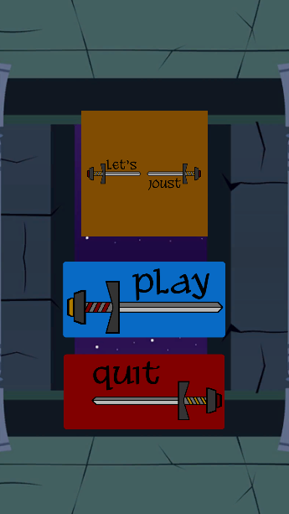
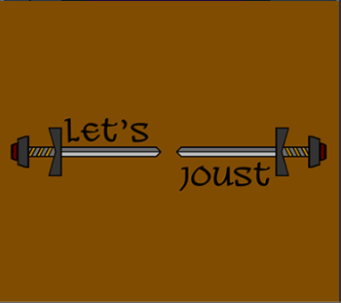
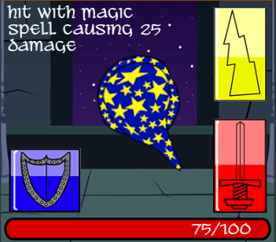
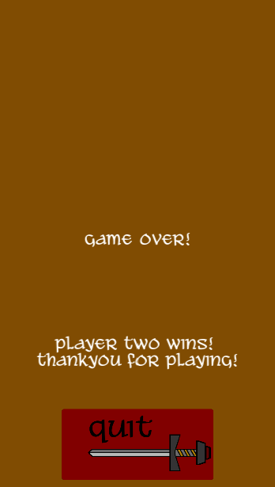
THE GAME

Slide 5
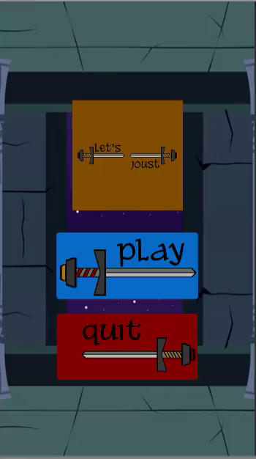
VIDEO OF GAME PLAY

Slide 6
WHAT NEXT?
Implement cooldowns
Testing
User Feedback
Polish the game
  Maybe introduce spell animations?
  Music?
  Sound effects?

