Slide 1

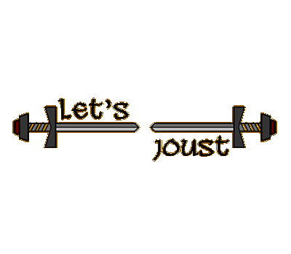
Group 17 – Let’s Joust
Alixander Roden (2nd Year Programmer)
Jack Gilmour (1st Year Designer)

Slide 2
Introduction to our game
Newly formed group, had to create a game in 3 weeks
Game is Let’s Joust, a turn based mobile spell casting game
Designed so that both players can play on the same device/screen

Slide 3
Game Design
Art style is a cartoon like aesthetic
Set in the medieval era where wizards exists
Thought using jousting but was too much

Slide 4
Game Functionality
Player selects move options presented
Own and Opponents health not visible
Opponent side covered
Plays out moves selected and shows results; hides health after

Slide 5
How To Play the Game
Each player selects one of three moves
Once both players selects, animations play accordingly
Health appears during this phase and disappear

Slide 6
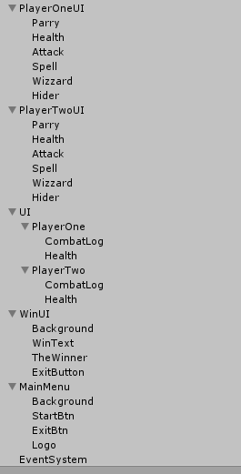
Programming
Game is developed in Unity using C#
Modular code structure
  InputController
  GameController
  PlayerController
  Separate scripts for each attack/player
UI is scalable for different screen resolutions
Game objects all structured and named correctly

Slide 7
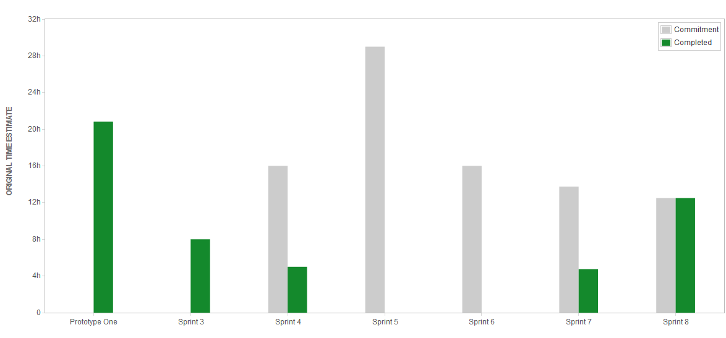
Management
3 sprints, all tasks were completed on time and none added to backlog
1 sprint still active due to ongoing tasks (cleaning up directories .etc)

Slide 8
Management
Github Commits
Total 51
20 of which from the new project
  Jack committed 8 times
  Alix committed 12 times

Slide 9
Management
Meetings
  Held 3 meetings
  Discussion was good in these meetings
Emails
  Not as many emails sent as would have liked, however an email was sent after each meeting and when planning a meeting
Escalation
  Previous group had to be escalated resulting in a meeting with remaining group members.
  Was then escalated again due to no difference and the new team created

Slide 10
Gameplay Video

Slide 11
Game Feedback
Too simple, boring after a short amount of time
Each player doesn’t know what is going to happen next, which is good
The basic mechanic of playing using each end of the phone is unique
Limited replayability, spells are very basic
Don’t understand why the game is called “let’s joust” when it features no jousting
Would be good to add sound or music to enhance the experience
Spell damage could be random, same everytime

Slide 12
What went well?
Produced a working game that fits the main elements of the brief in the short amount of time that was remaining and with the setbacks experienced
JIRA was used extensively in the new project, and all tasks set were completed
Jack had all the assets already completed, so all that was left was to program the game

Slide 13
What went wrong?
Lack of communication regarding meetings and emails. Meeting times were set and then not adhered to
Feedback not very positive, game wasn’t designed well
Game produced is very basic

Slide 14
Any questions?

