Slide 1
Presentation
Group 9
Thomas McCarthy
Jayden Murray
Cristian Hanganu

Slide 2
Genre/ Style

Slide 3
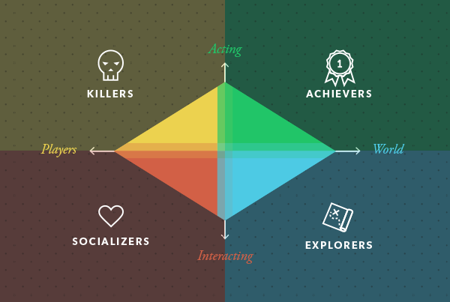
Target Demographic
Research
Gender
Age
Casual

Slide 4
Mechanics
Tap
Twitch
Relation to brief
1 image to show mechanic
Score mechanic 301
Dart moving mechanic
Dart board getting smaller

Slide 5
Game Flow
What does the player do? Controls
How to win?
Engagement
Turn taking
Win condition

Slide 6
Code
Multi-gating
Dart board getting smaller
Scoring
Random dart movement
Wind
Turn taking

Slide 7
Art
Art style
Colours
Optional art style

Slide 8
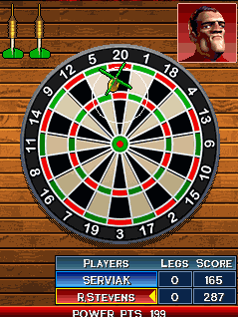
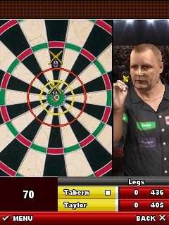
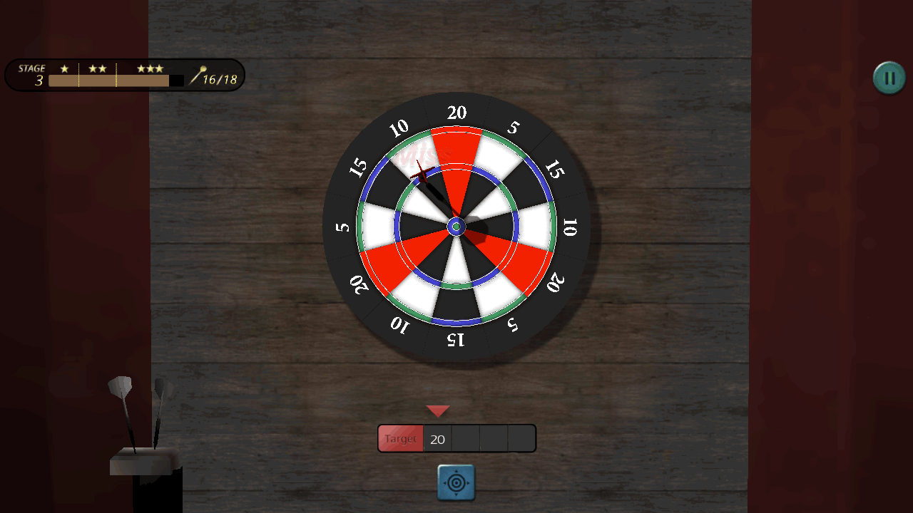
MoodBoards

Slide 9
Any Questions?

