Slide 1
Games idea(research)

Slide 2
Genre: Platformer
Typical Main Mechanic: Jumping
Replacement Mechanic: Falling
Gameplay: You fall from the top of the screen with the end goal being to fall for the longest duration or distance. Whilst dodging oncoming obstacles which damage you or hinder you from falling.

Slide 3
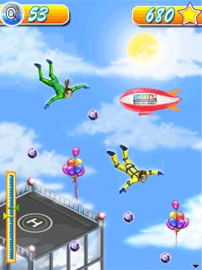
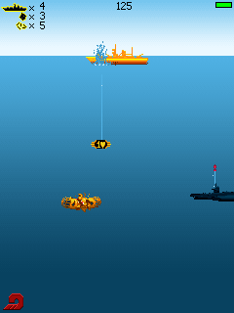
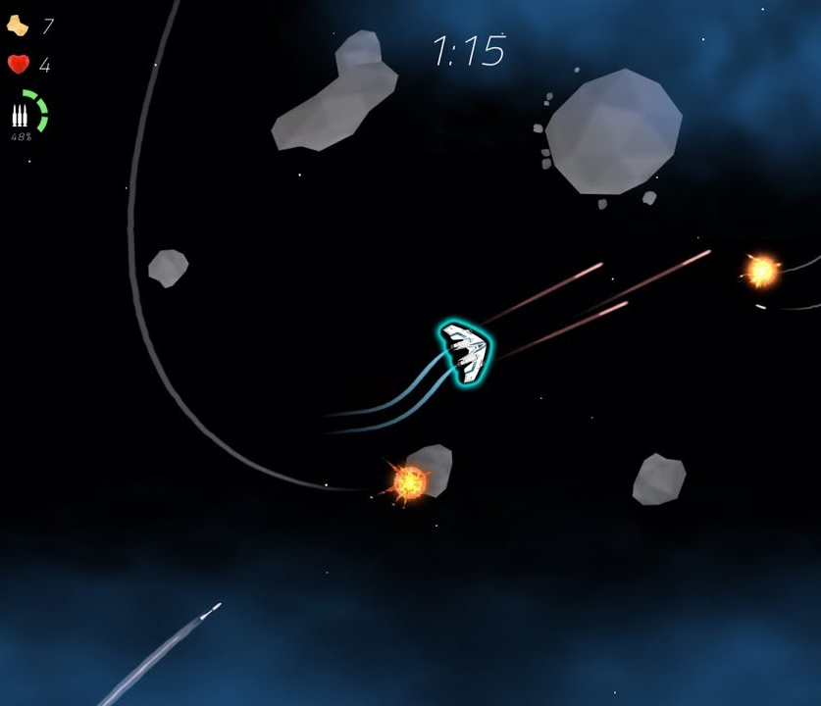
Themes

Slide 4
Genre: Racing
Typical Main Mechanic: Catch Up Mechanic
Replacement Mechanic: Slow Down
Gameplay: You have to try and lose the race by crashing into oncoming vehicles and obstacles. In order to claim the highest insurance payout to upgrade and buy a better car to cause more damage.

Slide 5
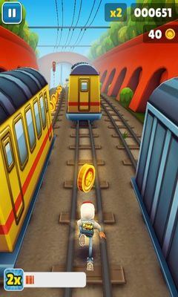
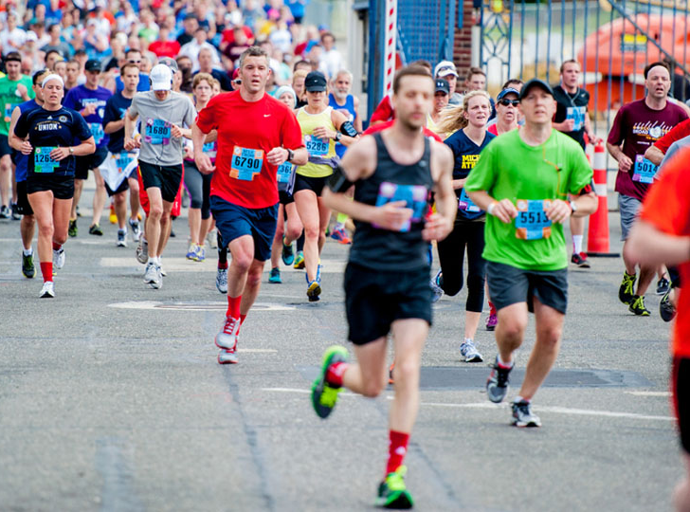
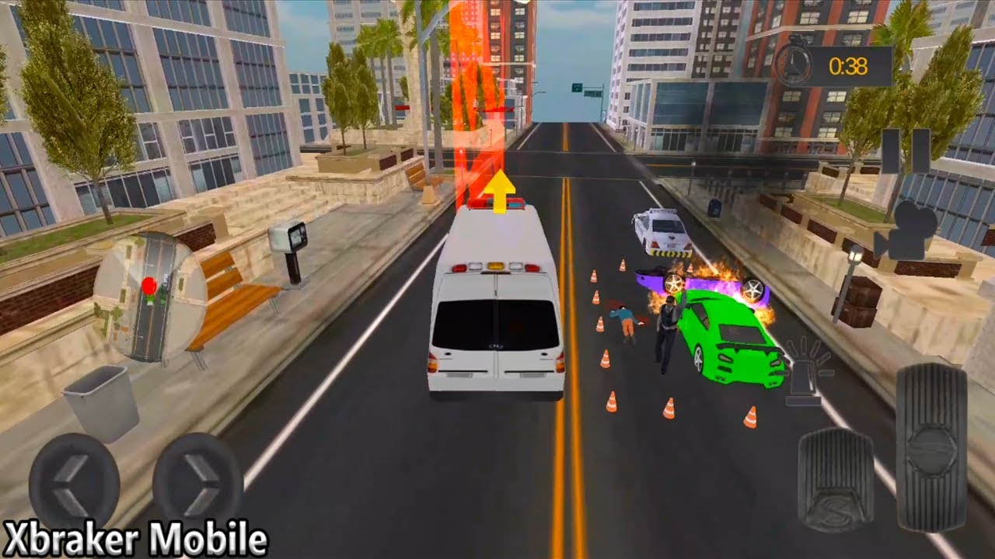
Themes

Slide 6
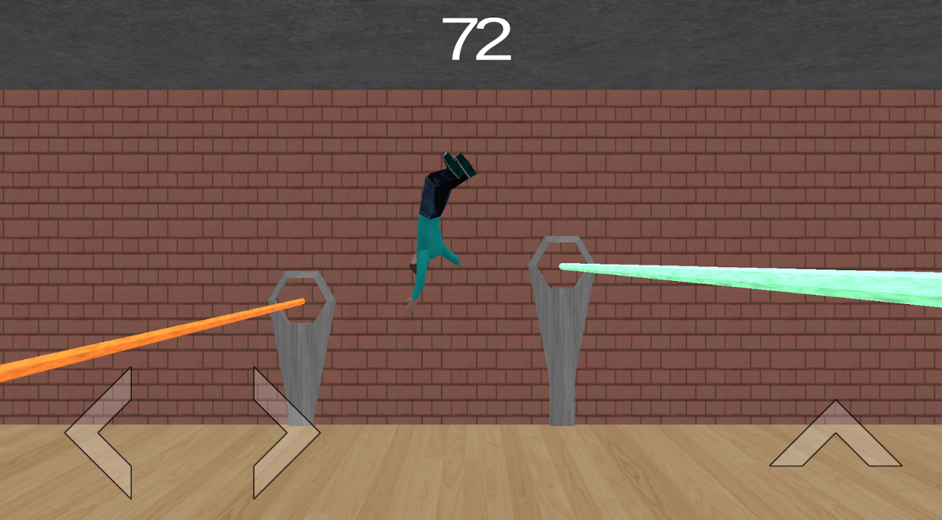
Genre: Fighting
Typical Main Mechanic: Attacking
Replacement Mechanic: Blocking
Gameplay: A fighting game in which you have to constantly block against a fighter and the first person to fail a block takes damage and loses.

Slide 7
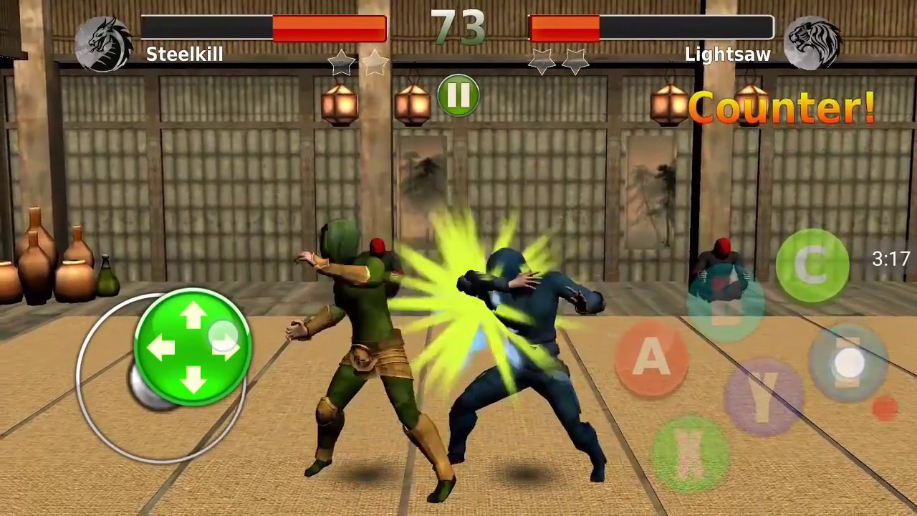
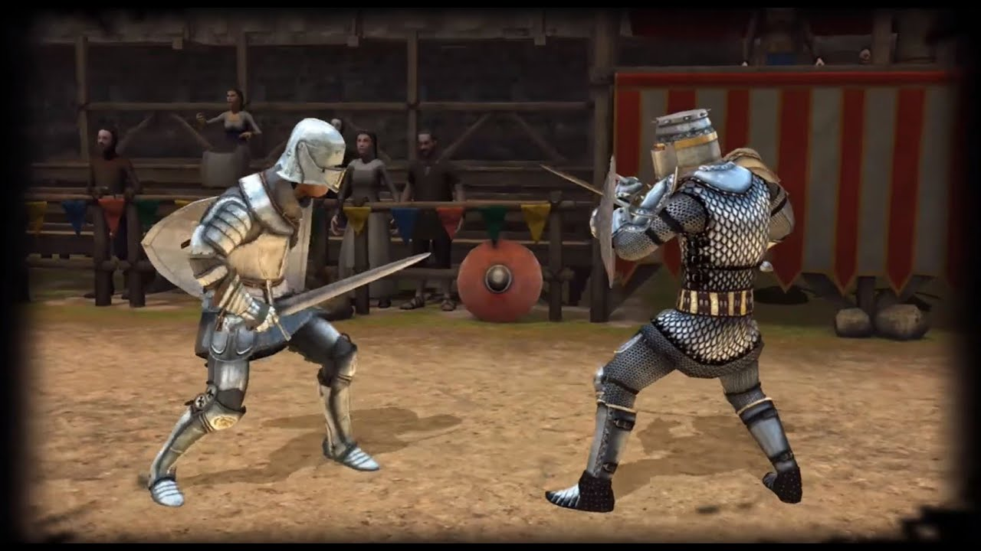
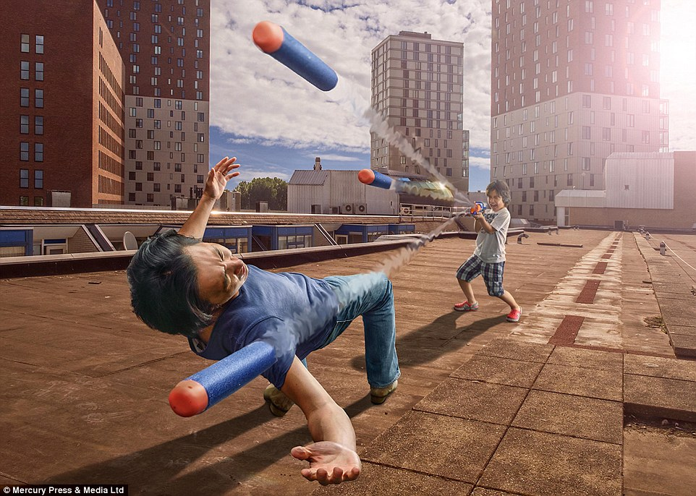
Themes

