Slide 1
Games with Mechanic Replacement (research)

Slide 2
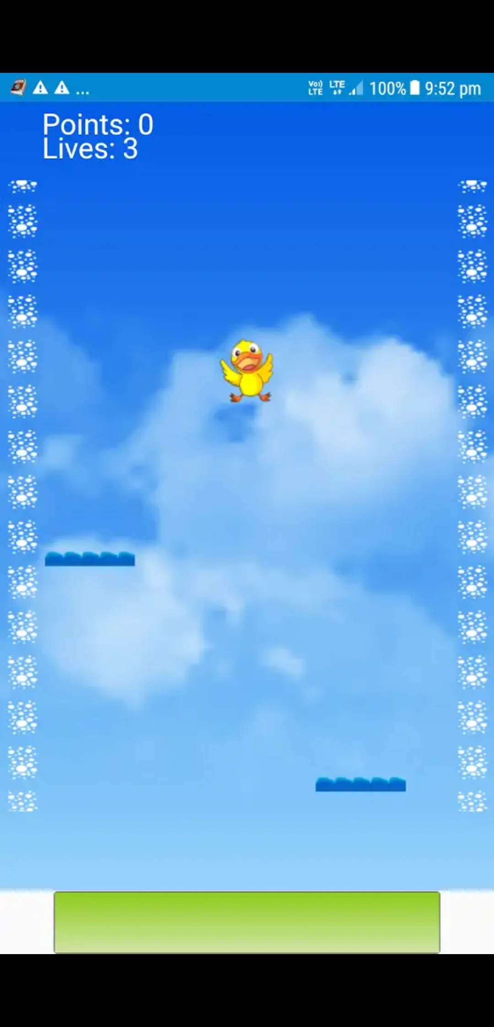
Baby Bird Fall Down
Genre: Platformer
Typical Main Mechanic: Jumping
Replacement Menchanic: Falling
Gameplay: You fall from the top of the screen making sure not to go off the bottom or top of the screen. You stay alive by landing on different platforms and jumping off them before going off screen.

Slide 3
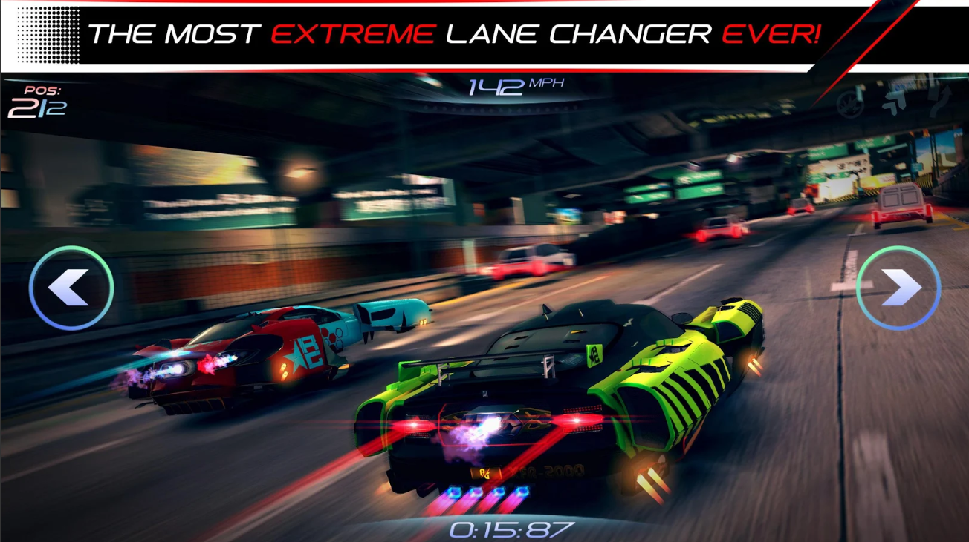
Rival Gears Racing
Genre: Racing
Typical Main Mechanic: Catch Up Mechanic
Replacement Mechanic: Dodging
Gameplay: You race against other players, however instead of accelerating your car it is already constantly accelerating. In order to beat your opponent you have to dodge oncoming vehicles in order to stay ahead of your opponent.

Slide 4
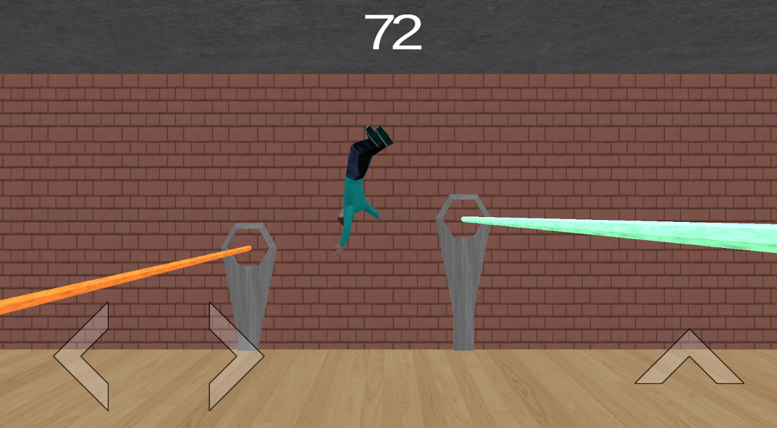
Floppy Dodge
Genre: Endless Runner
Typical Main Mechanic: Jumping/Sliding/Ducking
Replacement Mechanic: Reversing
Gameplay: You have a never ending map where you have to avoid lasers. However you can chose to go backward or forward or stay still in order to wait to avoid lasers.

