Slide 1

Game Goals

Slide 2
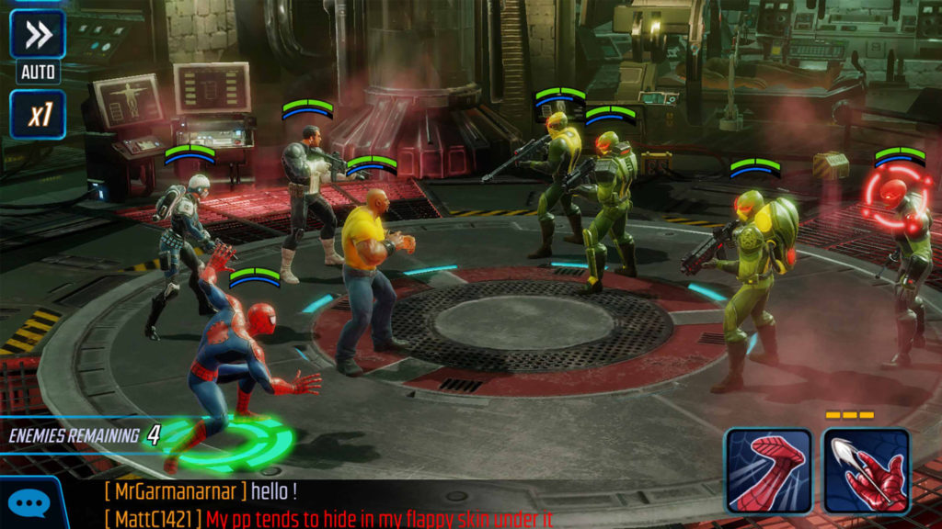
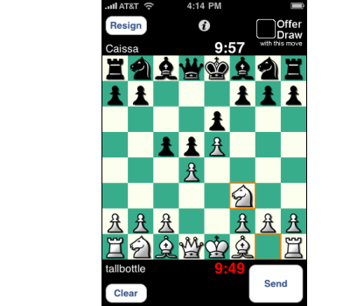
Capture/destroy
Eliminate all of your opponent’s pieces or players from the game.
Examples Marvel Strike Force, Chess
Our game- Capture different types of pets.

Slide 3
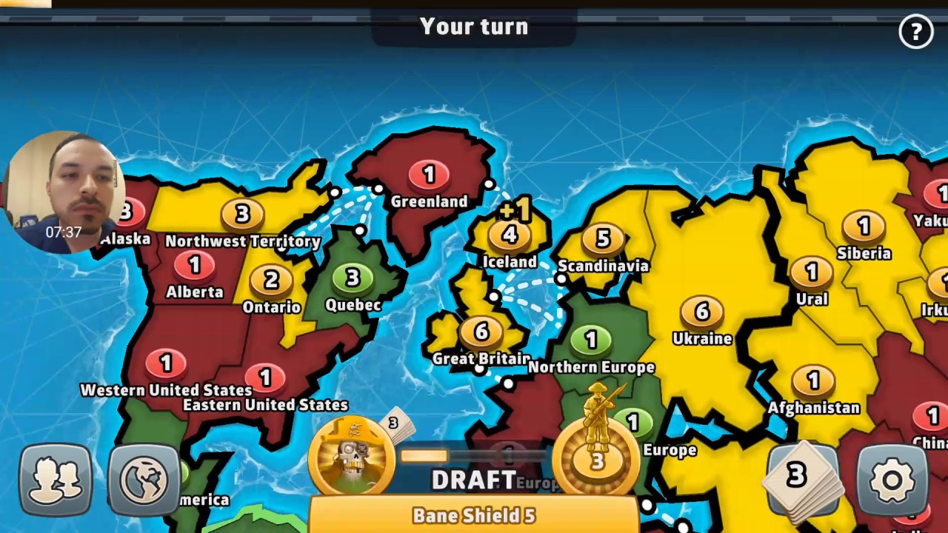
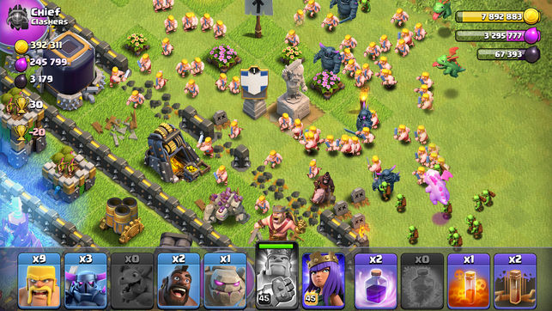
Territorial control
Focus is not on destroying the opponent, but taking control of certain areas
For example Clash of Clans, Risk
Our game- Capture all pets on one Island to unlock the next Island, which has new pets and tress.

Slide 4
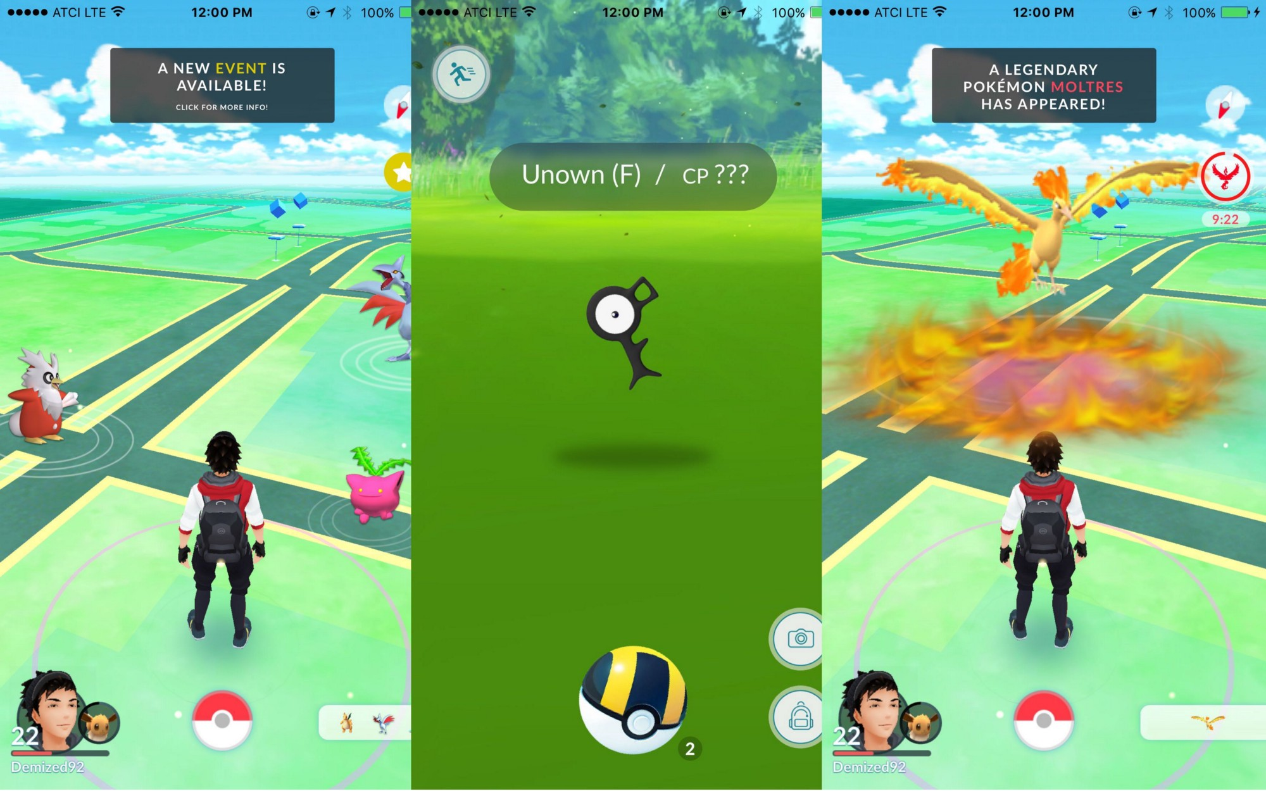
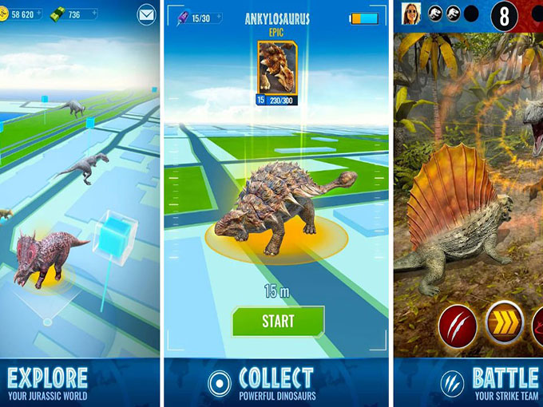
Collection
In order to win and progress to the next level, you need to collect all items
For example Pokémon Go, Jurassic World Alive
Our game- Capture different pets to collect all different types.

Slide 5
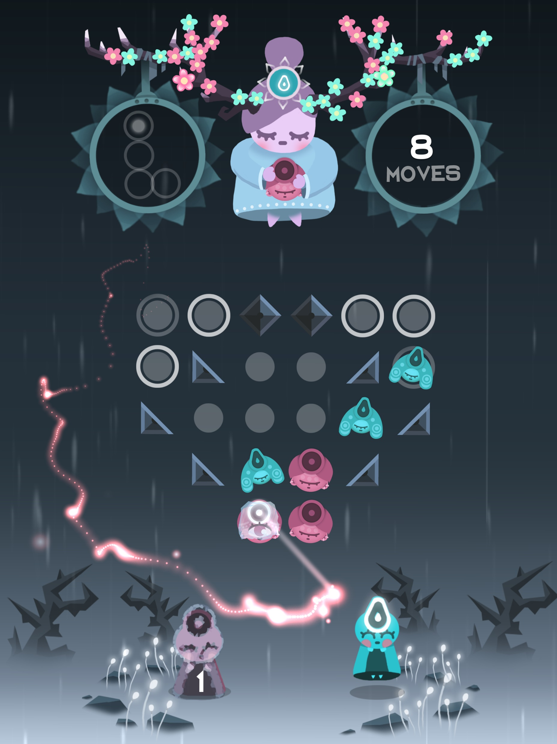
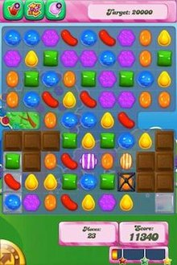
Solve
Game objective being to solve a puzzle to progress
For example Candy Crush, Ruya
Our game- Having to breed different pets to grow all types of pets for that Island, to unlock the next one.

Slide 6
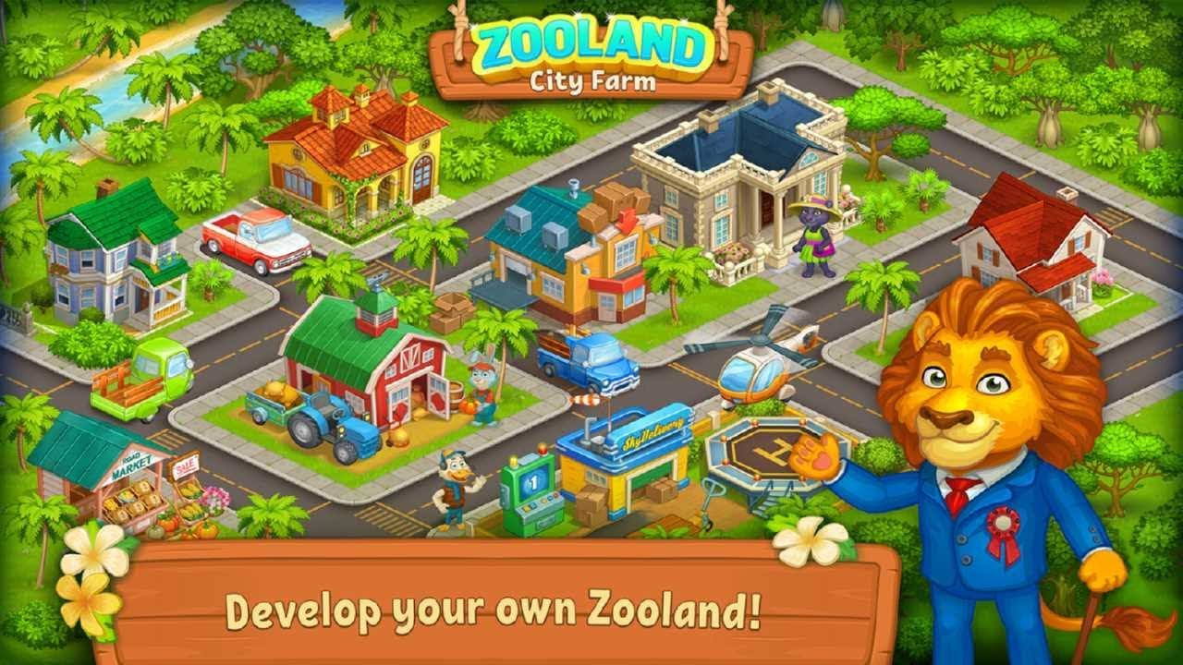
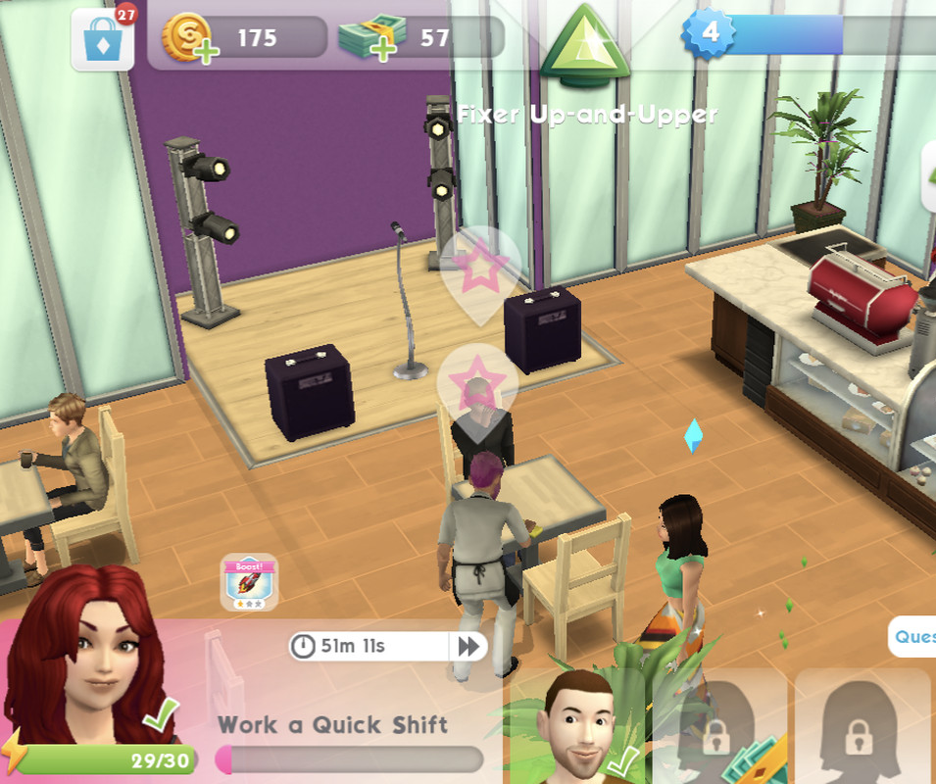
Build
Goal is to advance your character or build resources to a certain point
For example Sims, Farm Zoo
Our game- Compete in pageants to advance your pets skills. Also to breed higher cp pets, to unlock a higher potential creature.

Slide 7

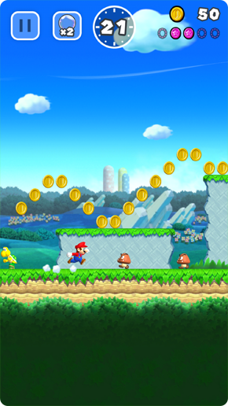
Chase/race/escape
The objective is to run towards or away from something
For example Super Mario Run, Temple Run
Our game- Race to feed and breed pets so they are strong enough and create a family so they can escape to the next Island before the current Island breaks.

