Slide 1
Level 6 Group 2
Elliot Chester, George Heath-Collins, Thomas McCarthy and Thomas McLaren

Slide 2
Gaia
Designed for mobile and tablet
Single Player with Network Connectivity
Pet simulation game
Easy fun with focus on relaxation and nurturing behaviour
Designed for children between 7 and 14

Slide 3
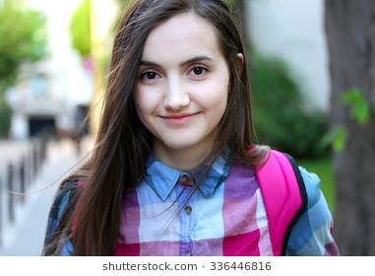
Psychographic
Sally
Aged 14
Female
Grade 2 in Clarinet
She lives with her Mum and two siblings

Slide 4
Sound and Colour choice
According to Yousuf Azeemi, S and Mohsin Raza, S (2005), Pink is used in Chromotherapy to relax (specifically used in Prison Populations) and Blue is used to induce calmness.
The music being produced uses mostly string instruments and soft air instruments.

Slide 5
Gaia
Here’s the previous version: https://www.youtube.com/watch?v=rhv1c4Z93j4&feature=youtu.be
Here’s the latest version: https://youtu.be/clCCnU6iQ5M

Slide 6
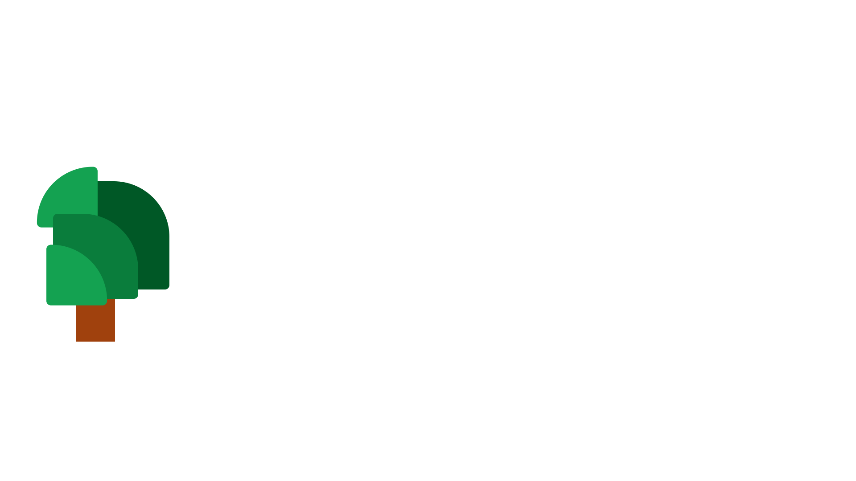
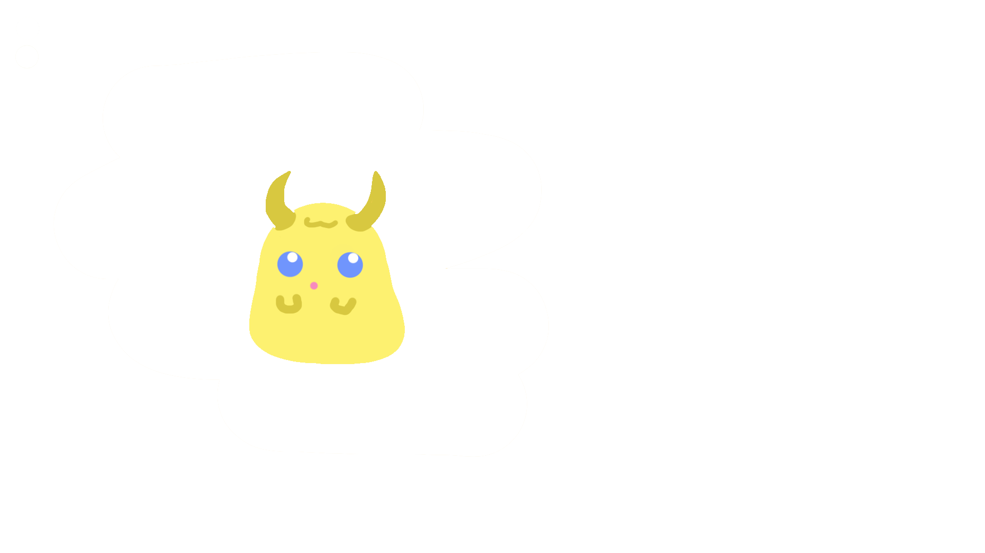
What does the player do?
Hatch Pets
Get Seeds
Breed Pets
Feed Pets
Plant Trees
Level up Pets
Grow Fruit

Slide 7
How do we encourage nurturing?
Attachment behaviour has the outcome of increasing proximity of the child to the attachment figure. Some attachment behaviours (smiling/vocalising) make mothers feel the need to nurture their child to ensure survival.
-Bowlby’s Evolutionary Attachment Theory, 1969

Slide 8
Caring for your pet
Each pet has a mood meter
Keeping pets happy will keep them engaging with you
Neglecting your pet will decrease it’s mood
If your pet is sad, it will avoid interaction

Slide 9
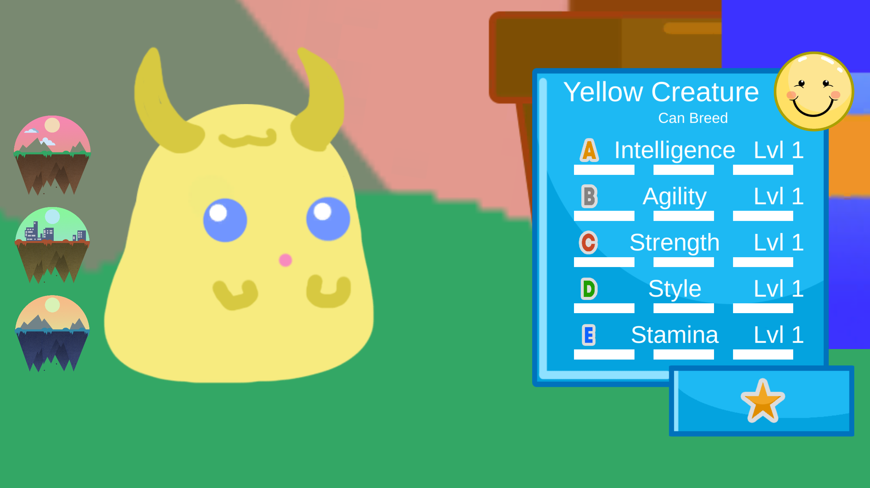
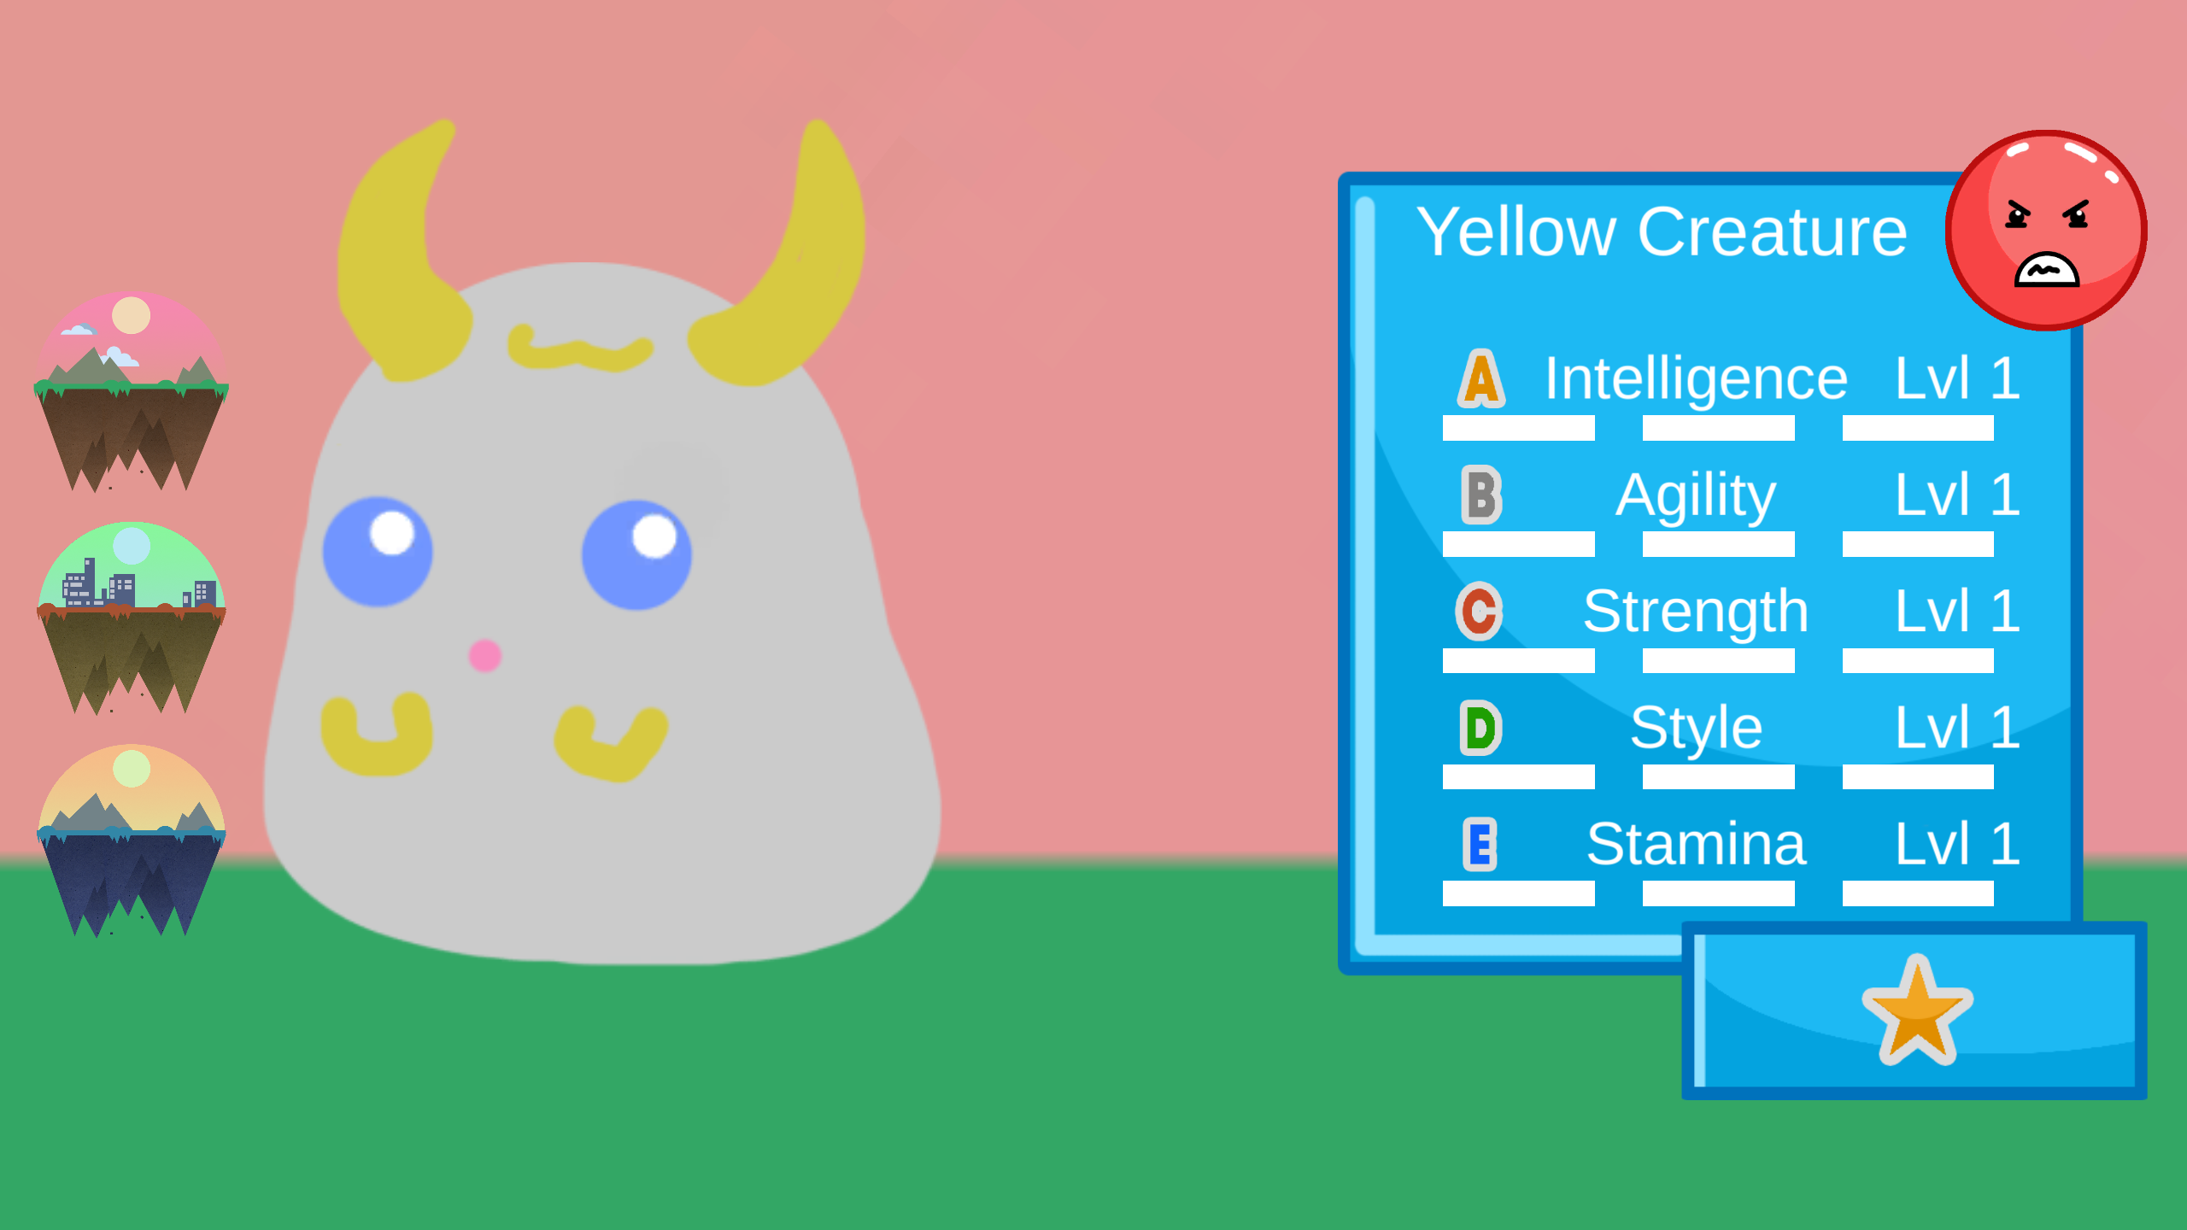
Representing mood in Gaia

Slide 10
Keeping your pet happy
Food will never decrease mood
Favourite Fruit Increases mood a lot
Non-Preference Fruit increases mood a little
Disliked Fruit will not increase the mood
Plan to add interaction such as petting/brushing/playing with them

Slide 11
STATs and Affinity
Pets have 5 upgradeable STATs
Each STAT has an ‘Affinity’
Each STAT has a Level
Each STAT has an Actual Value

Slide 12
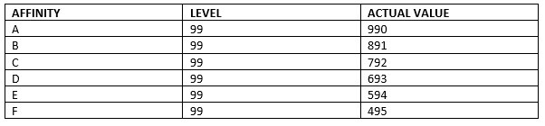
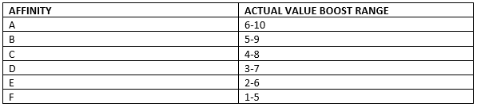
How Affinity Affects Potential

Slide 13
Meaningful Decisions
Each Fruit affects one STAT massively and another minorly
There 3 Tree Spaces
Players can rapidly increase 3 STATs at a time
If each Tree is different, all STATs can be raised

Slide 14
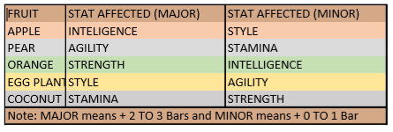
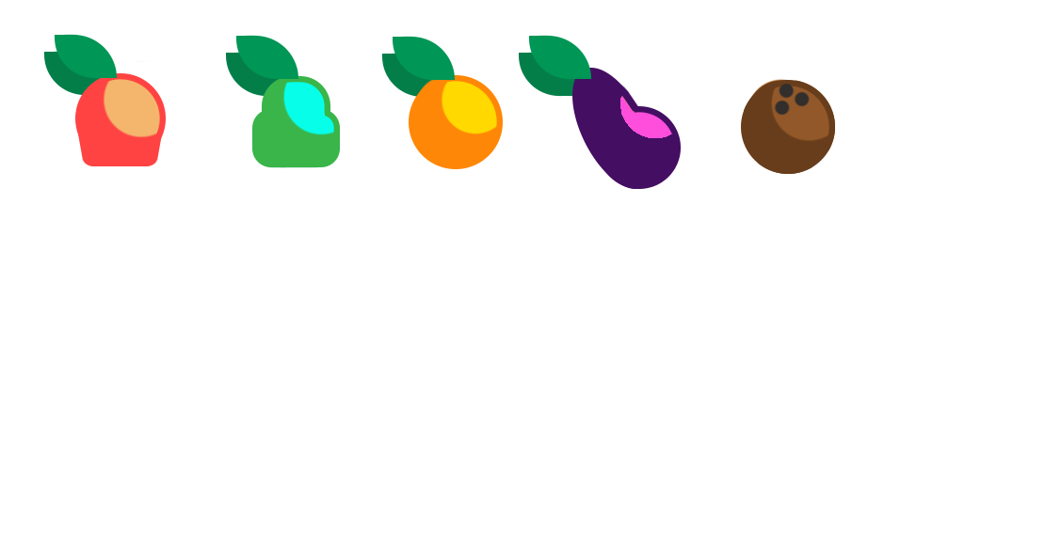
Fruitful Choice

Slide 15
Loss Aversion
Is used to encourage players to remain engaged with their pets and the game space
Fruit will rot on trees (to be implemented soon)
Pet mood decreases over time

Slide 16
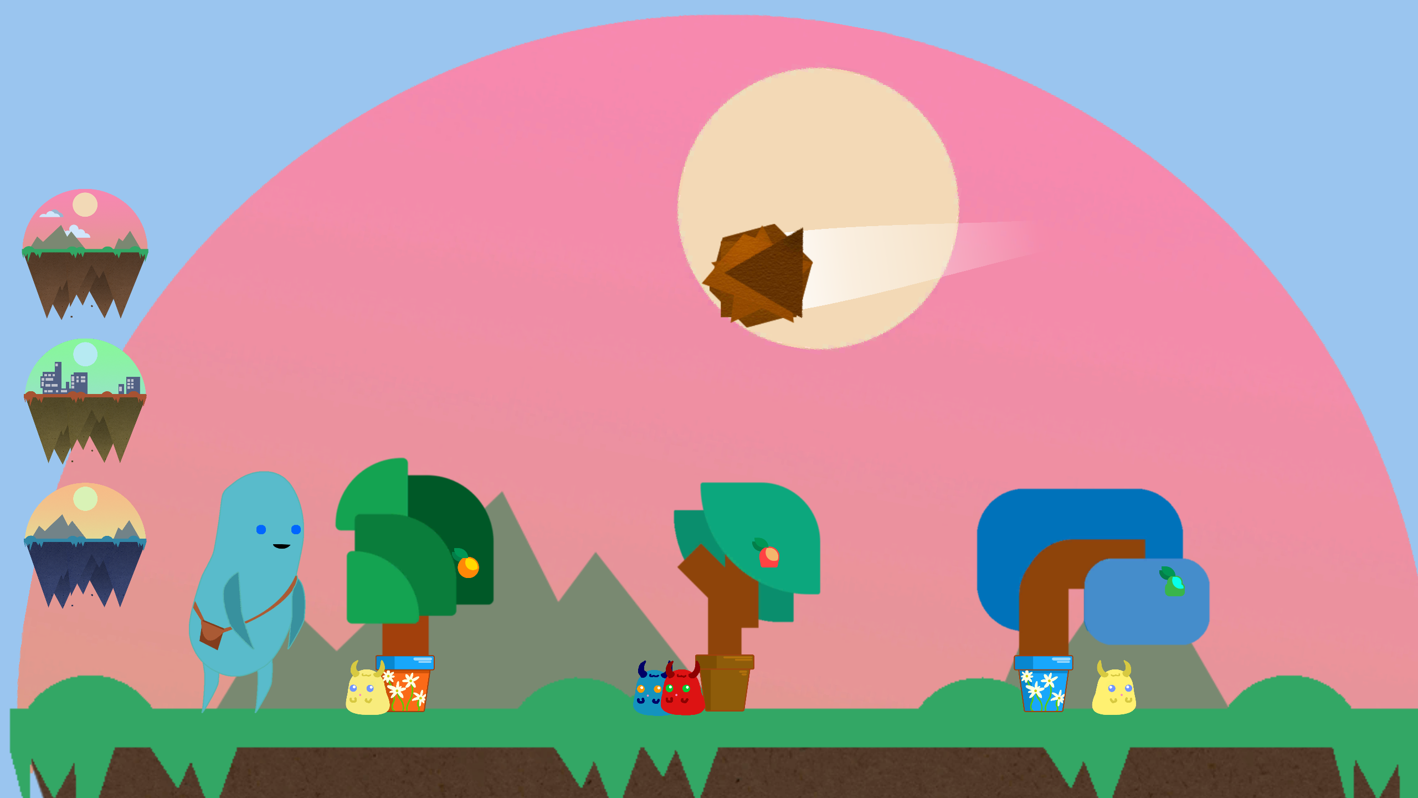
Variable Reward Schedule
1 in 5 chance of receiving a gift from a pet upon levelling up
Random chance of Meteor Event occurring between 4-8 mins
1 in 10 chance of a STAT increasing when pets are bred

Slide 17
Positive Feedback
The art style
Relaxing game loop consisting of picking berries
Animations for Tree growth
Virtual pets and their levelling mechanic
Egg hatching animation
Pets were cute

Slide 18
Criticism
A visual feedback for when the pet is eating Fruit + showing which stat increased
More pets
Pinching to zoom from pet stat window
Customizing the Giant and pets
UI improvements
More interaction between the Giant and the pets

Slide 19
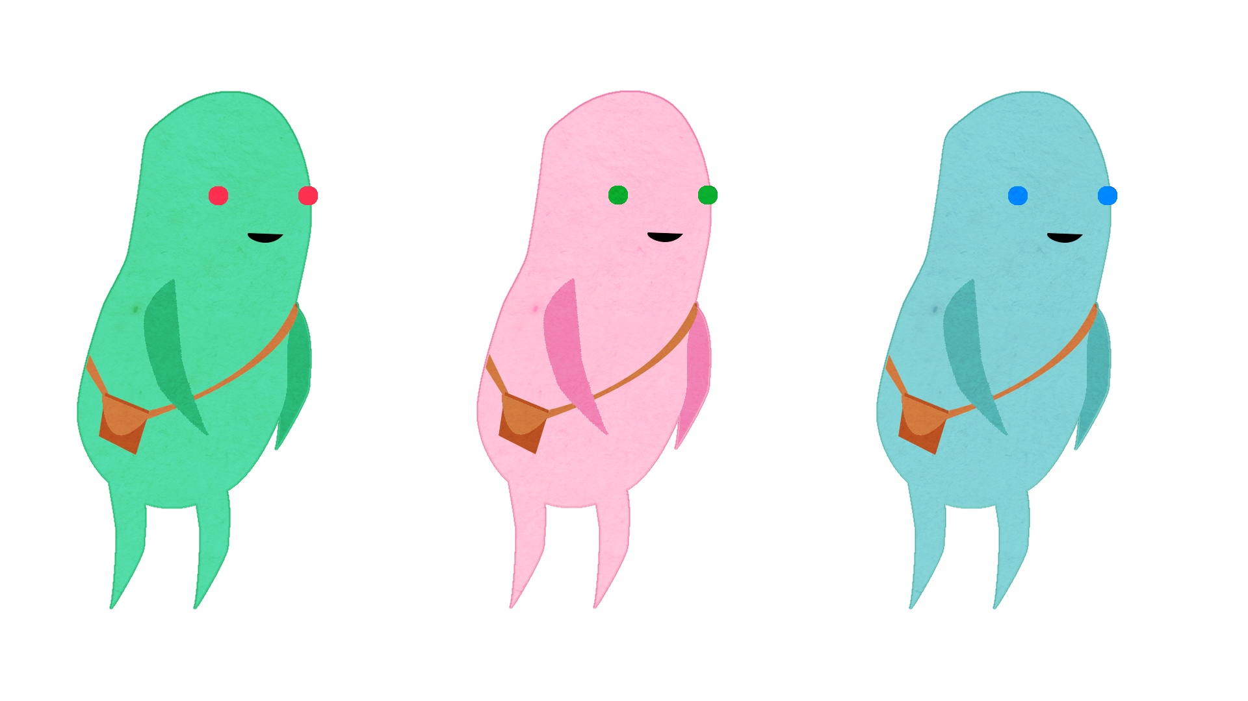
Thank You
Any Questions?

