Slide 1
Level 6 Group 2
Elliot Chester, George Heath-Collins, Thomas McCarthy and Thomas McLaren

Slide 2
Boat Concept
Intended for mobile and tablet devices
Endless Runner style of game featuring a co-operative mode
Procedurally generated levels
Twitch based mechanics

Slide 3
What does the Player do?
ANALYSE – Incoming obstacles
AVOID – Pass the obstacle
COMMUNICATE – Coordinate with your partner
REACT – Steer your boat away from danger

Slide 4
What is the goal?
The players goal is to reach a new high score
Avoid obstacles and collect pickups
In multiplayer mode, players must synchronise their actions to perform ducking or jumping actions.

Slide 5
Target Demographic
Males
Aged 10-30
For people who have free time during commutes
Socializers and Achievers

Slide 6
Prototype
Old movement system: https://www.youtube.com/watch?v=WS2YNvm84kE&feature=youtu.be
New movement system: https://www.youtube.com/watch?v=eF8hN_IJLKQ&feature=youtu.be

Slide 7
Market Plan
Shortcut packs
Alternative boat skins
Power ups
Continue option after death

Slide 8
Crown Campaign
Intended for mobile and tablet devices
Two player adversarial
Turn based
Hidden bidding
Limited resources
Diegetic scoring system

Slide 9
What does the Player do?
ANALYSE – Card for sale
REWARD – Gain influence
DECIDE – What is the card worth to you?
REACT – Bid on the card

Slide 10
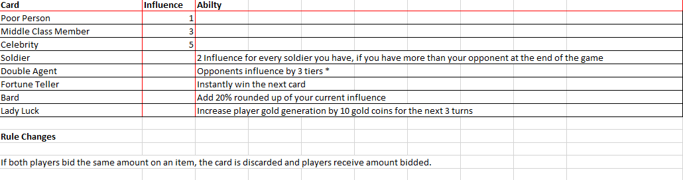
Prototype

Slide 11
What is the goal?
Purchase influential cards
Have more influence than your opponent

Slide 12
Target Demographic
Male
15-25
Socializer
Experientialist

Slide 13

Gaia
Designed for mobile, tablet and PC/MAC
Single player
Resource management/Pet simulation game
Easy fun with focus on curiosity
Sandbox

Slide 14
What does the player do?
ANALYSE – Get seed
REWARD – Attract creatures
INTERACT – Plant seed
REACT – Grow tree

Slide 15


Target Demographic
Females
Aged 7+
Completionist
Explorer

Slide 16
Prototype
Seed demonstration: https://www.youtube.com/watch?v=rhv1c4Z93j4&feature=youtu.be

Slide 17
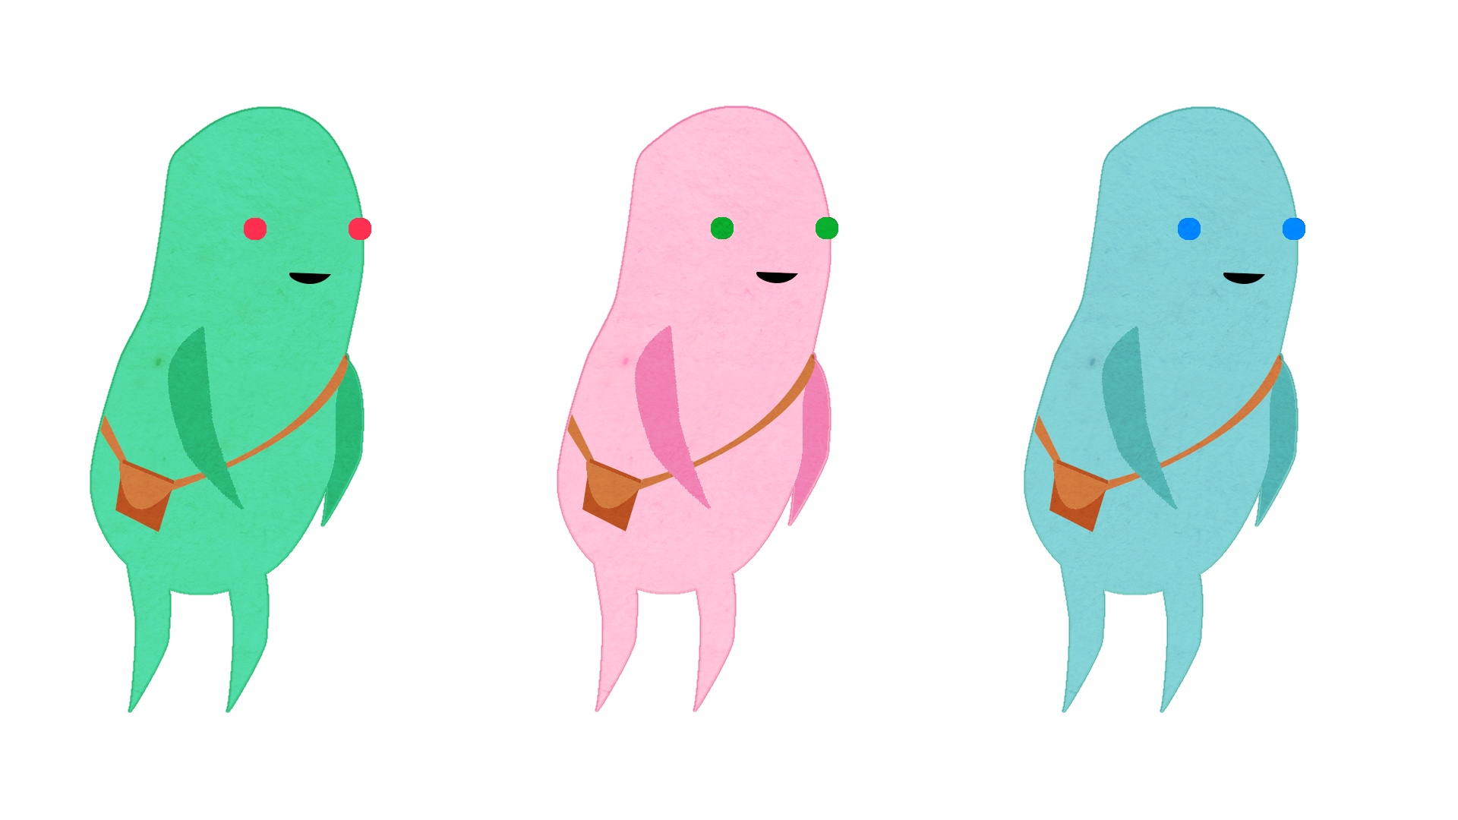
Market Plan
Different character skins
Instant access for Islands
Texture packs

