Slide 1
Monetization Ideas

Slide 2
In Game Currency
Can be obtained through achievements, ad viewings and purchasing.
Can be used for many purchases within game

Slide 3
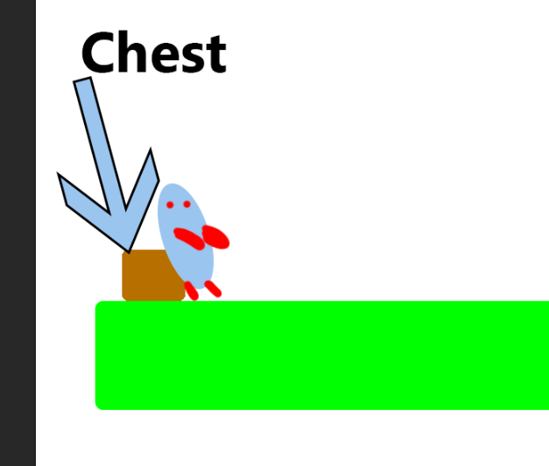
Customizing Giant Resting Spot
During our group meeting we spoke about having an area for the Giant to sit/be placed when it is not performing actions
We also spoke about having a chest which contains all the fruit collected for that specific island
This chest can be customized cosmetically and mechanically through the use of payments/ad viewings

Slide 4
Customizing Creatures
Purely cosmetic apparel which pets are able to wear to change the appearance of themselves
This involves; hats, gloves, scarfs and etc

Slide 5
Planting Trees
We can allow the player the chance to be able to upgrade their island by being able to plant more than 3 trees, other game offer similar things to this such as Clash of Clans, they use builder huts which allow to you work on different structures at the same time. This speeds up the process of upgrading your base giving an advantage.

Slide 6
Day Boosters
Once purchased or earned through ad viewing. Once used the time taken for fruits is reduced by half for 24 hours real time.

Slide 7
Different Islands
Having unique and locked Island which the player can preview.
This also allows for the player to have more pets in total
This can be purchased or obtained with in game currency.

