Slide 1
The Sims Mobile

Slide 2
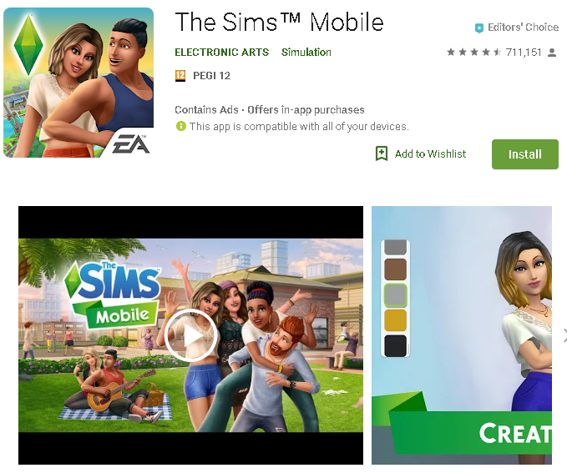
What does the player do?
Similar to Tycoon type games such as Zoo Tycoon. You create your own customizable character and build a house for them. Live your characters life by getting a job, having a partner and develop relationships to improve your Sims lifestyle.

Slide 3
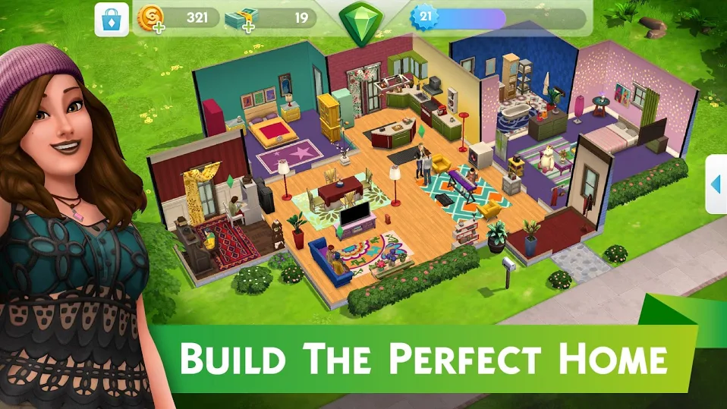
Colours
Vibrant and bright colors are used within this game.
Similar to our game which also uses the same technique in order to keep players engaged and give them a clean aesthetic .

Slide 4
Characters
In the forums I found that players loved the high amount of customisation features. In which they could customize and dress up their own character, as well as the house they live in.
They also loved that actions within the game affect gameplay. For example choosing to have your character do one job will limit what social events you will go too.

Slide 5
Their Community Forum
https://forums.thesims.com/en_US/categories/tsm-social-corner

Slide 6
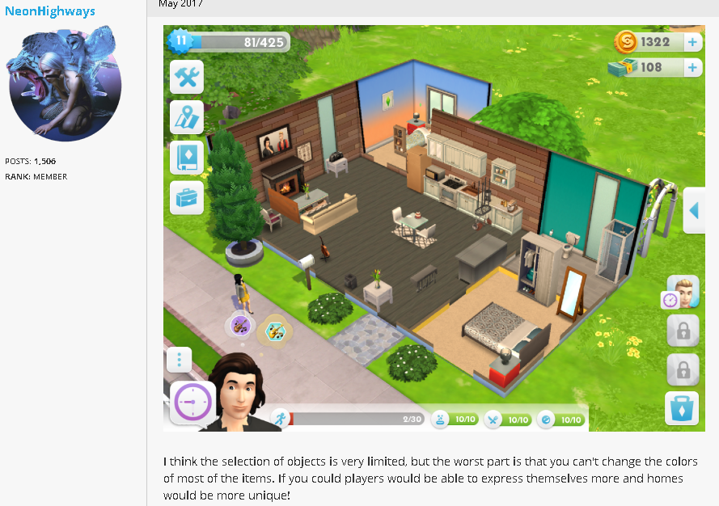
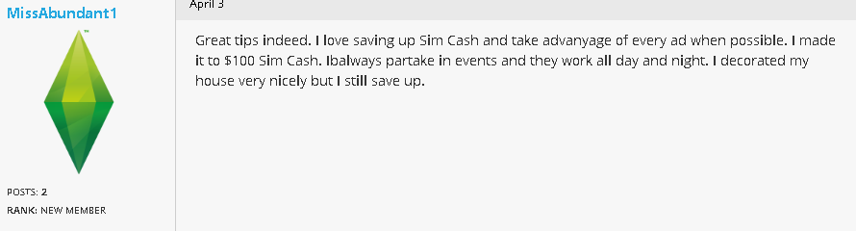
Some Comments From the Forum

