Slide 1
Level 6 Group 2
Elliot Chester, George Heath-Collins, Thomas McCarthy and Thomas McLaren

Slide 2
Gaia
Designed for mobile and tablet
Single Player with Network Connectivity
Pet simulation game
Easy fun with focus on relaxation and nurturing behaviour
Designed for children between 7 and 14

Slide 3

Psychographic
Sally
Aged 14
Female
Grade 2 in Clarinet
She lives with her Mum and two siblings

Slide 4
Gaia
Here’s the previous version:
https://youtu.be/clCCnU6iQ5M
Here’s the latest version:

Slide 5

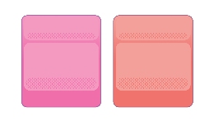
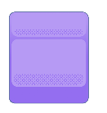
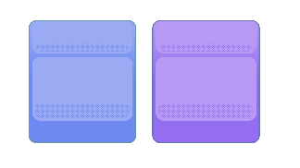


Features To Come
Quests
Daily Rewards
Combinational Content
Interacting with Slimes
Cosmetic Rewards
Unlocking Islands

Slide 6


What does the player do?
Hatch Pets
Get Seeds
Mixing Slimes
Feed Slimes
Plant Trees
Level up Slimes
Grow Fruit

Slide 7
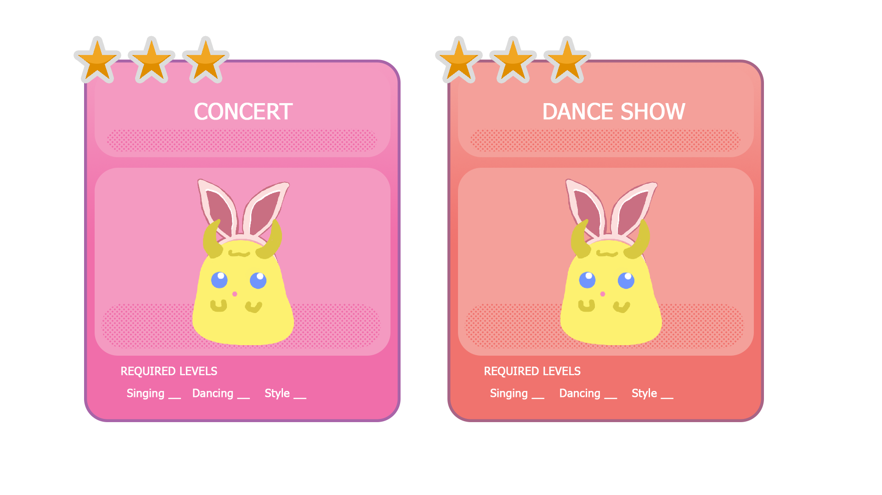
What does the player do?
Complete Quests
Different lengths of time
Different requirements
Found on the Quest board

Slide 8
Combinatorial Assets
Recycles assets to provide more content
Better trees require more seeds
Can mix different rarities of seeds
Upgraded trees offer better fruits
Better fruits lead to better slimes

Slide 9
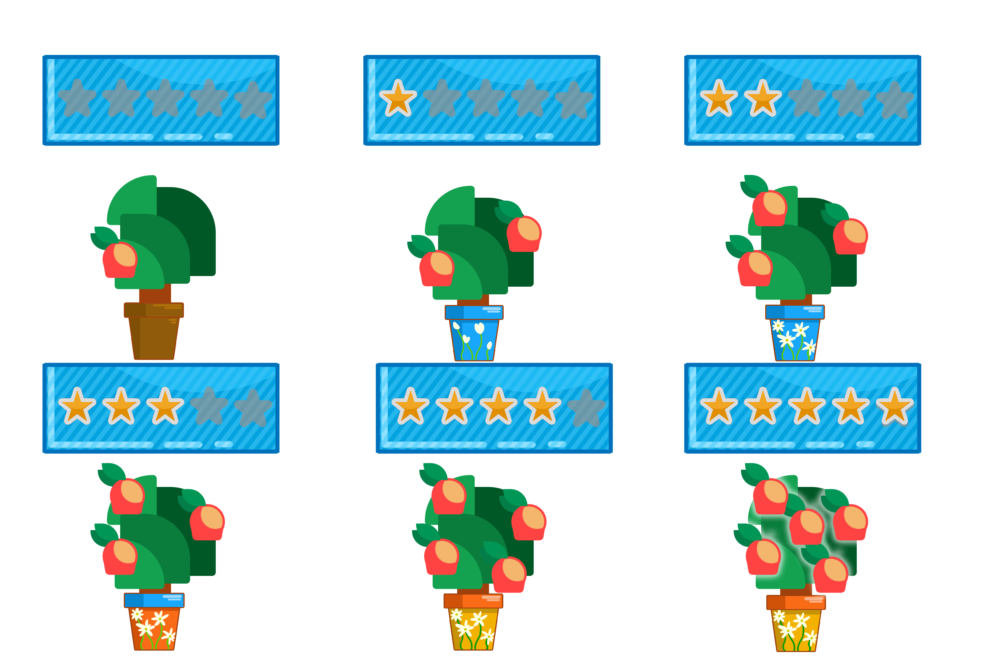
Upgrading Trees
Players can use seeds to plant or upgrade trees
Higher levels give more fruit
If Players want to replace a tree with another, it resets the level

Slide 10
Caring for your slime
Each slime has a mood meter
Keeping creatures happy will keep them engaging with you
Neglecting your slime will decrease it’s mood
If your slime is sad, it will avoid interaction
Sad slimes have less chance of completing quests

Slide 11
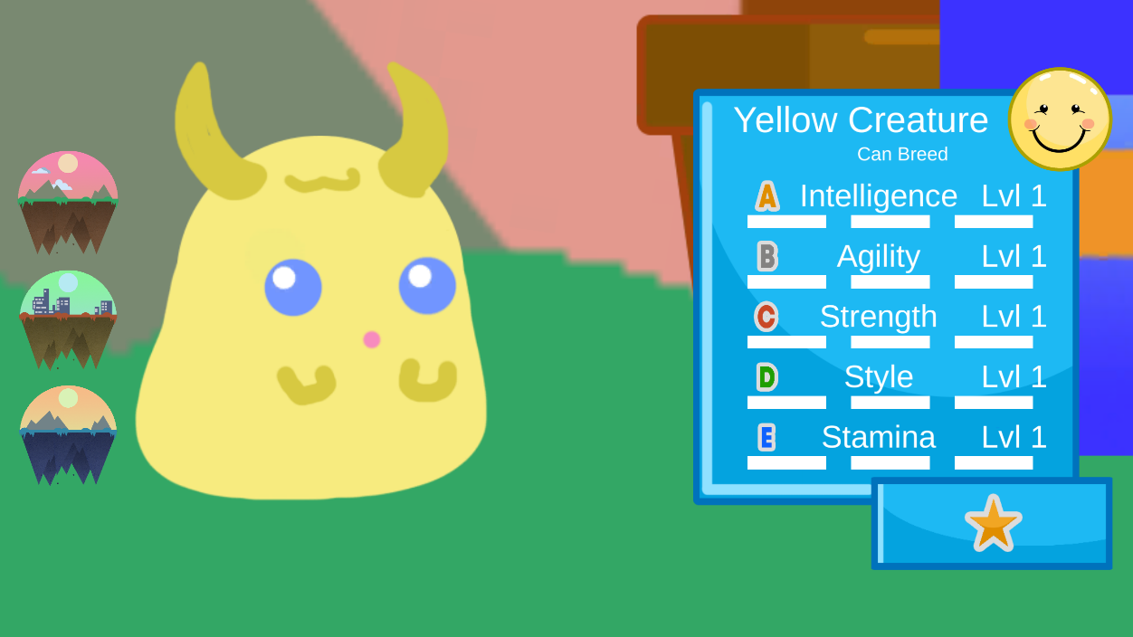
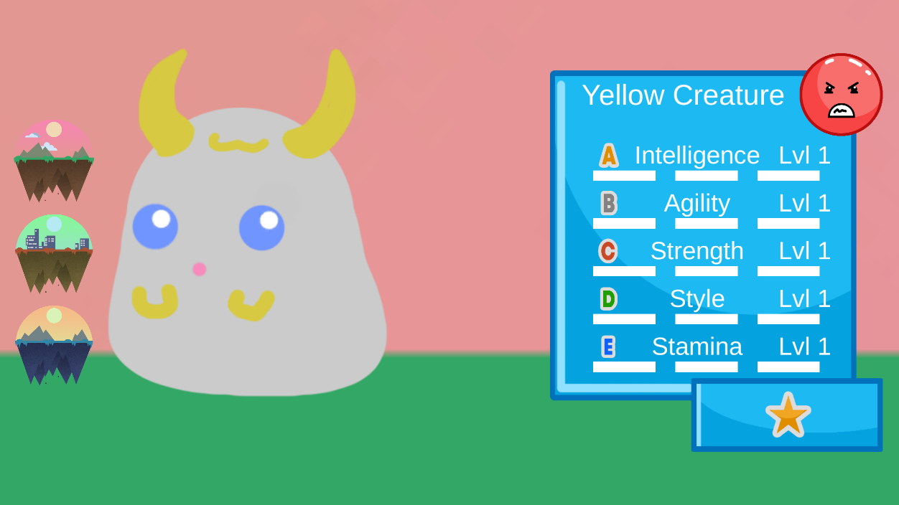
Representing mood in Gaia

Slide 12
Keeping your slime happy
Food will never decrease mood
Favourite fruit Increases mood a lot
Non-Preference fruit increases mood a little
Disliked fruit will not increase the mood
Plan to add interaction such as petting/brushing/playing with them

Slide 13
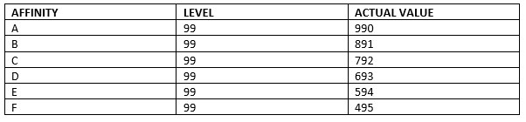
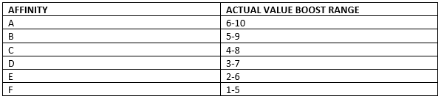
How Affinity Affects Potential

Slide 14
Meaningful Decisions
Each Fruit affects one STAT massively and another minorly
There 3 Tree Spaces
Players can rapidly increase 3 STATS at a time
If each tree is different, all STATs can be raised

Slide 15
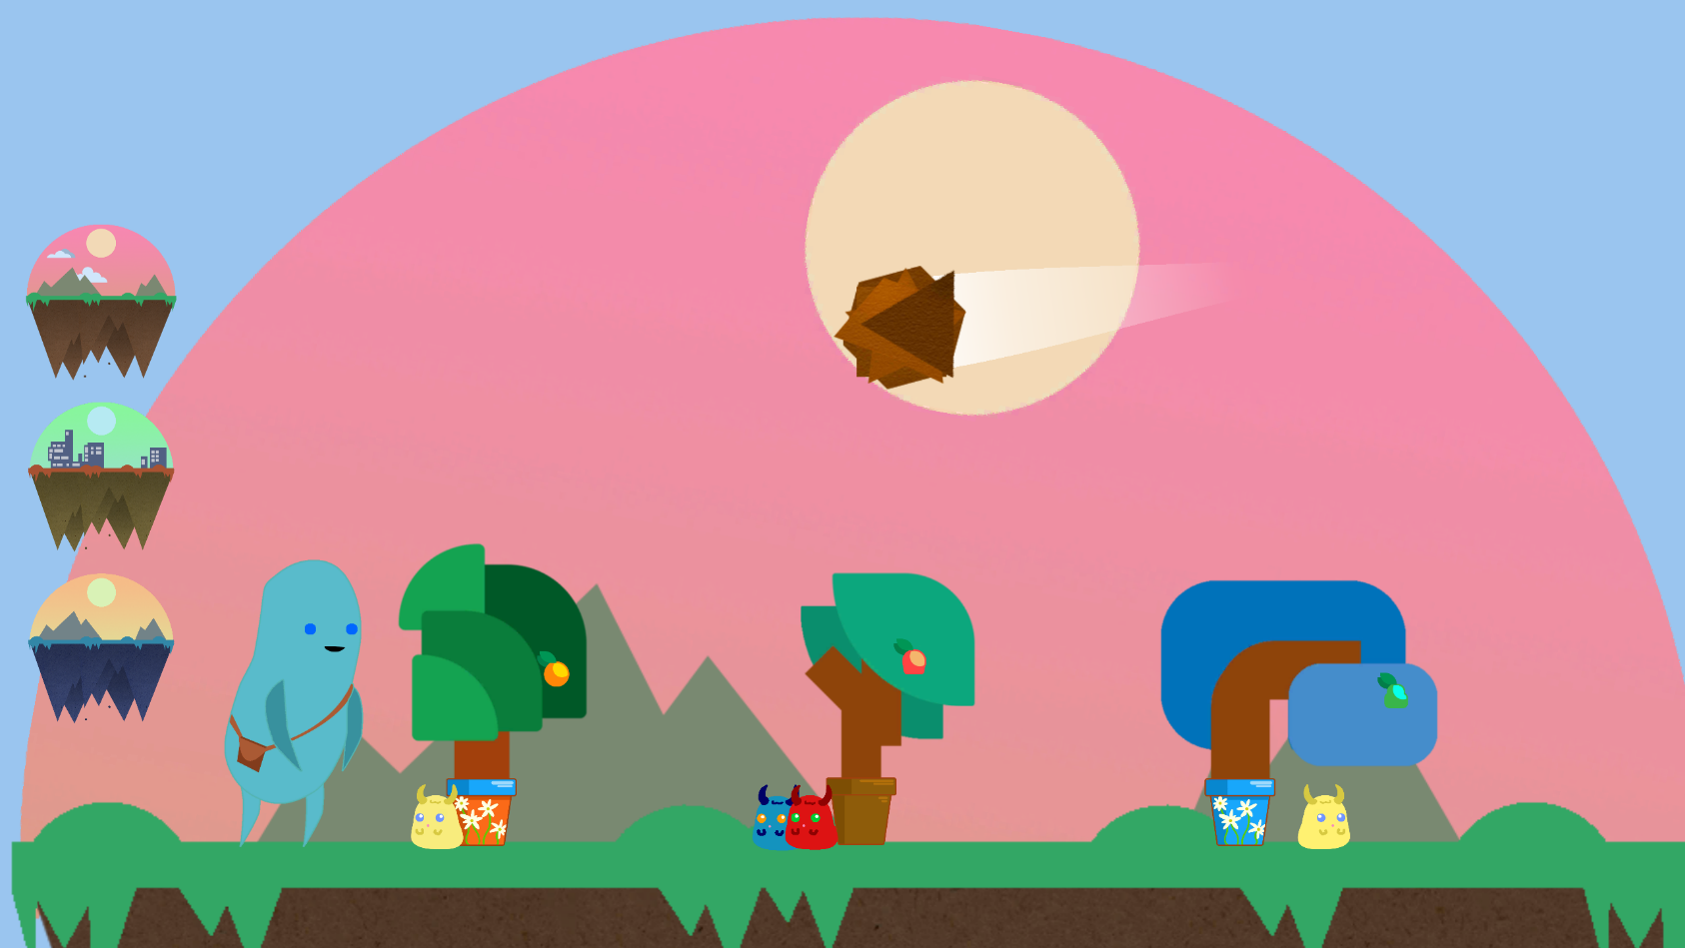
Variable Reward Schedule
1 in 5 chance of receiving a gift from a slime upon levelling up
Random chance of Meteor Event occurring between 4-8 mins
1 in 10 chance of a STAT increasing when slimes are mixed

Slide 16
Deliverables
Our game will include 10 minutes of gameplay (including a tutorial) with a feature and art complete starting island.
Our game will be play tested to maximize Easy Fun, Intrinsic Motivation and Nurturing Behaviour.

Slide 17
Timeline
04/03 – Quests
Creating Quests so that players can send off specific slimes to claim rewards
11/03 – Rewards and Tutorial
Daily rewards and teaching players how to play
18/03 – Interaction
Allow players to customize and play with their slimes
25/03 – Playtesting
Playtesting to tweak reward schedules and balance the game
01/04 – Bug Fixing and Final Assets
Ensure bugs are fixed and create final art assets

Slide 18
Any Questions?

