Slide 1

Games with Social integration Research

Slide 2
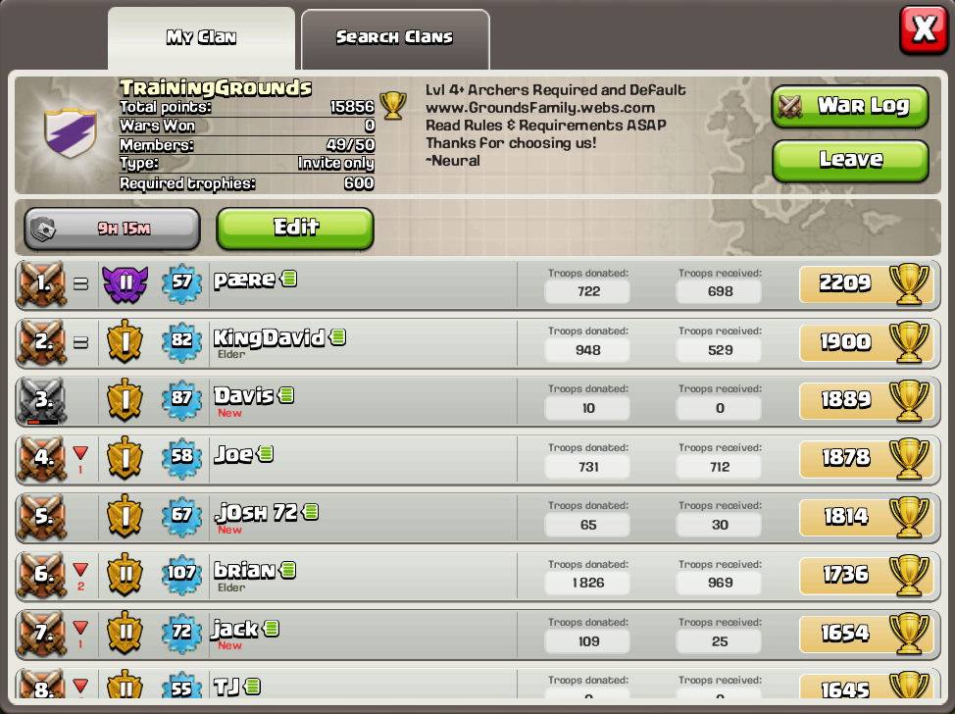
Clash of Clans
You can join a Clan which allows you to complete in team clean battles against other clans.
Your able to gift troops you have to other clan members and request to receive some
Able to message other clan members

Slide 3
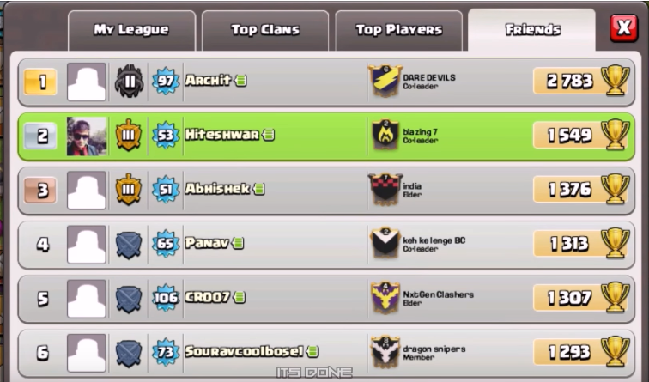
Clash of Clans (Social media)
You can also log into Facebook on the app, receiving a bonus for doing so.
Also you are now able to view any Facebook friends account, which shows their level, allows you to view their village and send gifts.

Slide 4
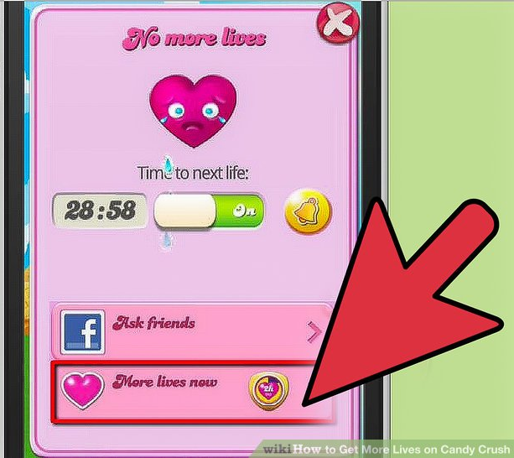
Candy Crush
Playing Candy Crush through Facebook allows the user to save their progress to the Facebook network, so progress can never be lost.
Also your able to post your current progress on Facebook to share it with your friends.
Your able to request help off other Facebook friends, in order to aid you in completing a level.

Slide 5
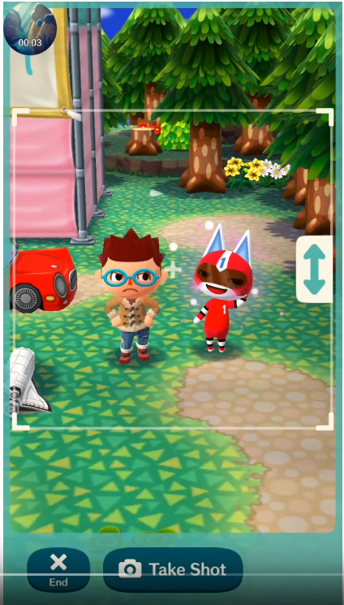
Animal Crossing Pocket Camp
There is a screenshot mode, in which you can send and share your campsite layout to your friends.
They have made it easier to add friends. You can now share a link instead of having to use a codes system which was a lot more complicated.

Slide 6
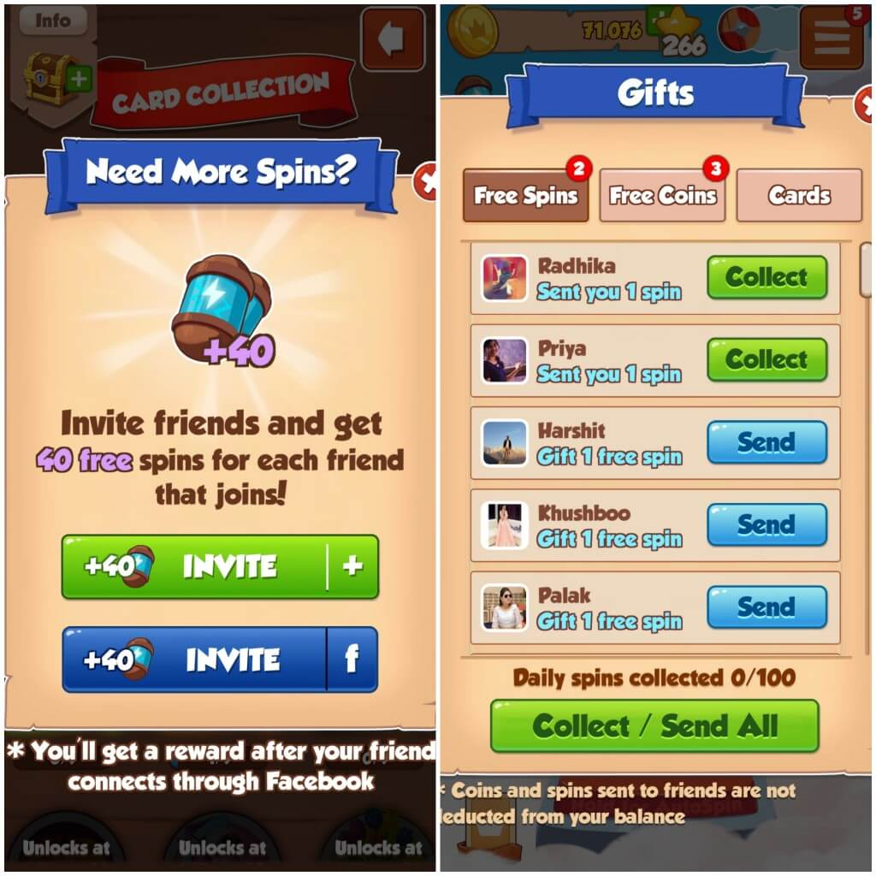
Coin Master
You can send and receive gifts from Facebook friends
If you invite a Facebook friend and they install the game you receive a large bonus
You can battle Facebook friends and view their stats on the leader board.

