Slide 1

Group 5
Alice Baker and Beth Cowle

Slide 2
Overview
Non-digtial – Card Game
Voting
Bluffing/Deceiving
Hidden Information
3 – 6 Players
Simultaneous

Slide 3
Game Idea
A player is selected at random to be the liar at start of each round.
Players have to figure out the liar by asking questions.
Players score points for guessing correctly, or decieving players if you’re the liar.

Slide 4
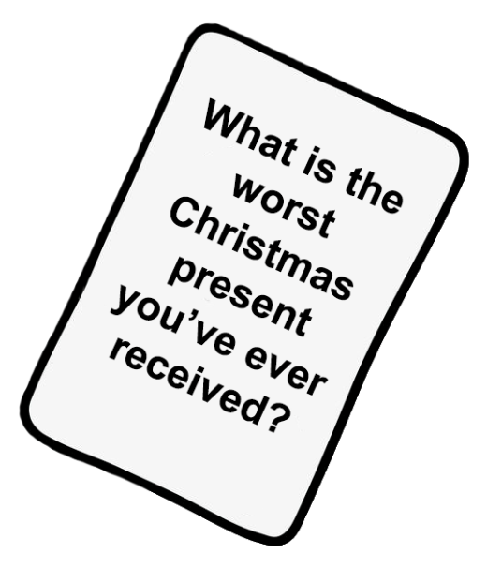


Answer the question card
Questioning players
Vote in secret
Reveal votes
Liar is revealed
Points collected

Slide 5
Mechanics, Dynamics and Aesthetics
Mechanics | Dynamics | Aesthetics
3 – 6 players Voting Bluffing/deceiving Hidden Information Simultaneous game play | Communication Accusation Arguing Quick thinking Story telling Alliances | Laughter Tension Fiero Amusement Anticipation

Slide 6
Target Audience
Male and Female
Ages 16 +
Casual Gamers
Social Players

Slide 7
Project goals
Iteration & Bug Fixing – Play Testing Cycle
Artwork for each question card

Slide 8
Design
Rising tension
Meaningful choices
Resource Management
Replayability – different players and cards
} Limited questioning

Slide 9
Thanks for listening! Any Questions?

