Slide 1
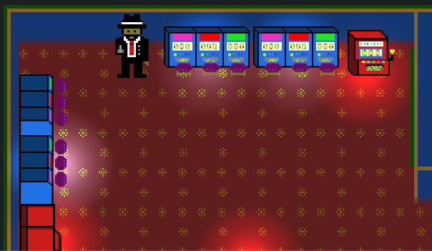

Group 21
Jordan, Ash, Macaulay, Len

Slide 2
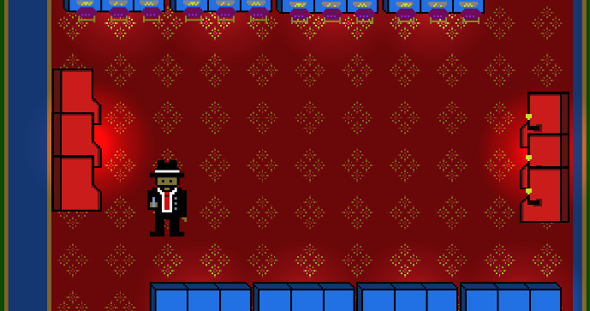
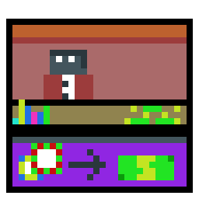
The Key Elements of the Brief
Take a game with an existing mechanic
Develop a game without that integral mechanic
Substitute the mechanic with a refined new solution
Notes:
Len

Slide 3

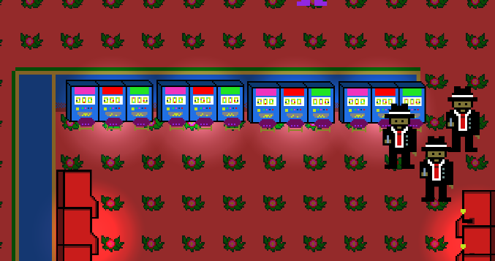
OUR Solution to the brief
A twitch shooting game without a shooting
Auto fire
Auto weapon switching
Notes:
Jordan
Twitch Action Shooter Game Talk about – what mechanic we have chosen to remove and our solution

Slide 4
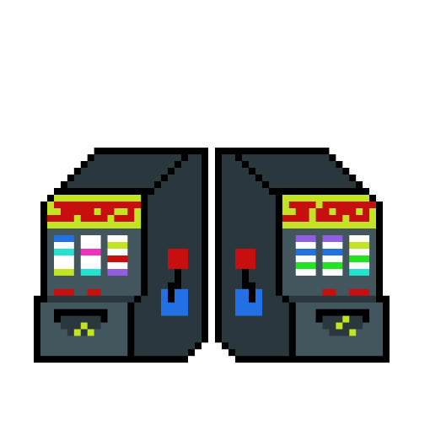
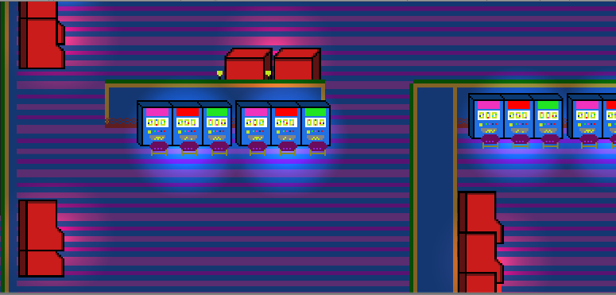
A video walkthrough of the game
Notes:
Ash

Slide 5
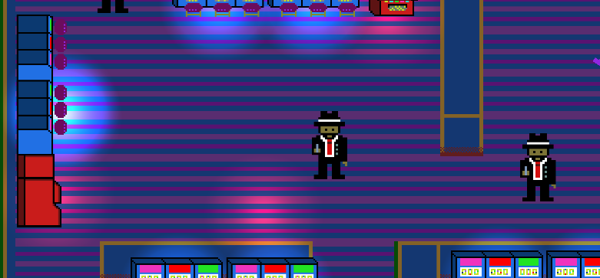

List of the deliverables for week 12
- Asset complete
Notes:
Macaulay

Slide 6
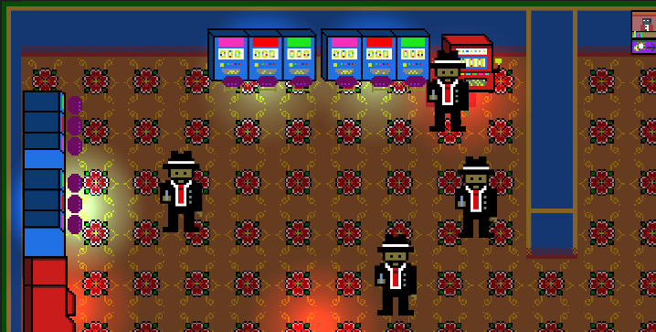
Any Questions?
Thank you!

