Slide 1

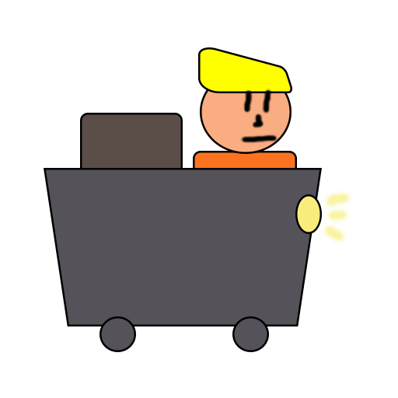
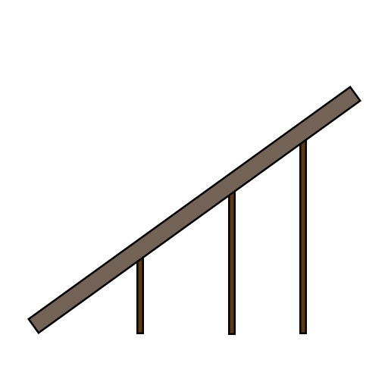
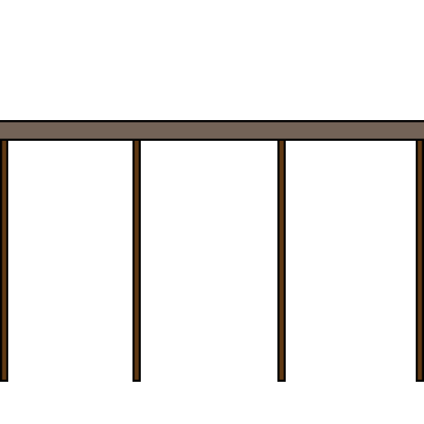
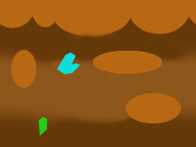
Minecart
Andrei Dumbravescu
Alpeche Pancha
Matthew Fisher

Slide 2

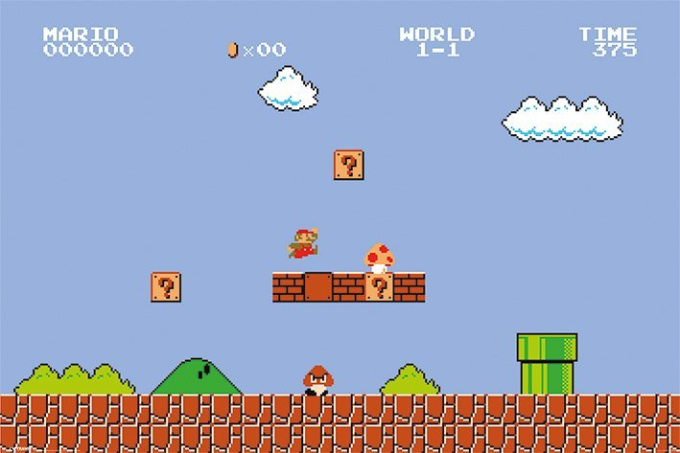
Project Brief/Solution
Single player.
2D Platformer game
Replacing the Jump Mechanic with a Drag and Drop Mechanic
Player needs to have quick reactions and fast decision making
Notes:
So the brief asks us to make a single-player game, pick a genre, select a mechanic and change it. So we made a Single-player 2D platformer game but instead of the player pressing Space to jump, the player will use the mouse to drag and drop tracks. The player will need to have quick reactions and fast decision-making when playing the game.

Slide 3
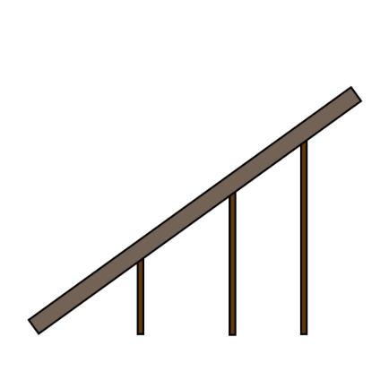
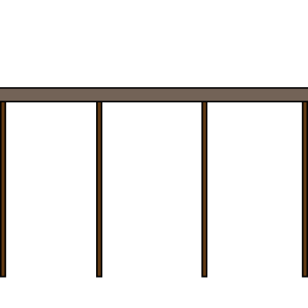
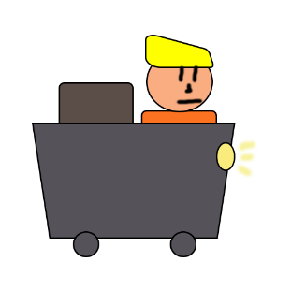
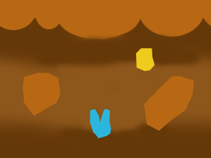
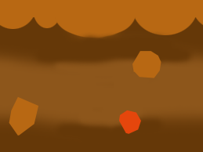

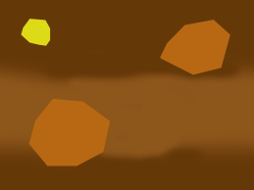
Game Loop
Minecart moves at a constant speed in a random generated level
Player places tracks on the level to avoid obstacles
The game is endless until the minecart hits an obstacle

Slide 4
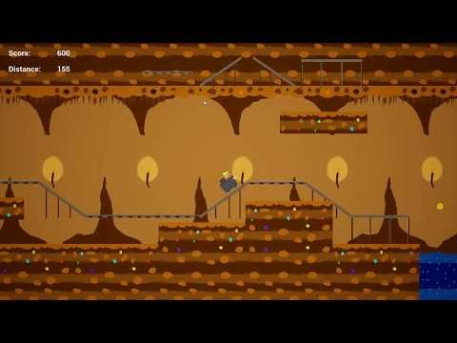
Demo
https://youtu.be/otWon8BLhx8

Slide 5

Emotions
Fiero!
Building tension through constant need of fast reactions and upcoming obstacles
Relief through the inevitable player death
Notes:
We want the player to experience Fiero, a sense of triumph when a player either reaches a certain distance or score while collecting gold. Also create stress for the player, build tension through the constant need of fast reactions and relief through the inevitable player death.

Slide 6

Delieverables
Random generated assets in the level
Distance tracker
Currency and distance marker assets
UI assets that improve the user experience
Menu screen, pause screen and end screen
Audio
Animations
Visual effects

Slide 7

Questions?

