Slide 1
Level design
Level_01

Slide 2

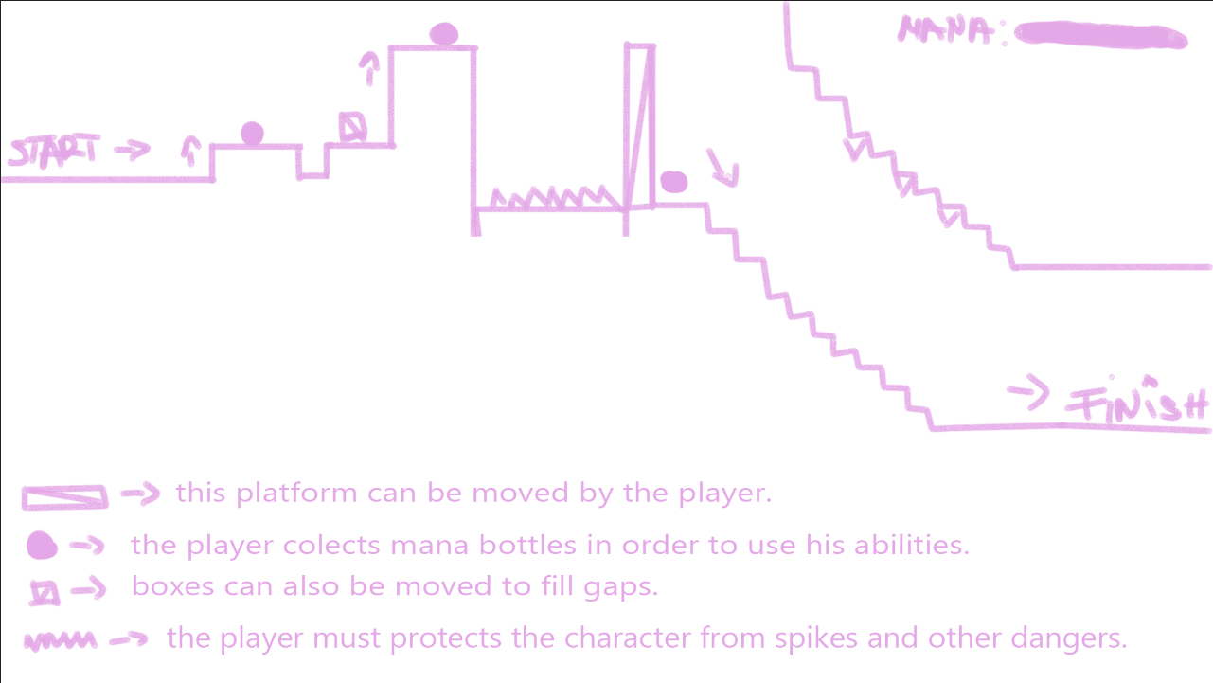
Level_01/ Tutorial
The first level is built in such manner so the player can learn the controls and how the game works.
The difficulty slowly rises as the player runs for the finish line.

Slide 3
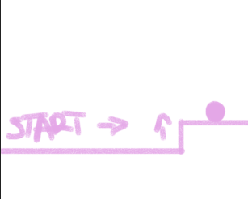
The first thing the player has to learn is how to jump.
The game does not have a jump mechanic.
The moment the player learns how to move, he also understands the game theme.
The player, which is a hand, has to take care of the main character.

Slide 4
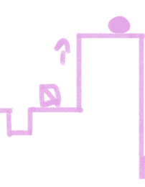
After learning how to jump, the player will learn how to use the environment in order to cover gaps or potential dangers for the main character.
The first level will also bring the power to grab the main character from time to time.

Slide 5
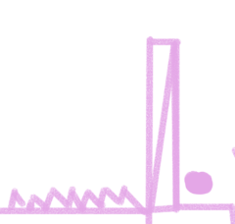
The first level will also cover the potential hazards the main character could encounter.
Spikes, for example can be avoided by simply covering them with a platform that can be moved.

Slide 6
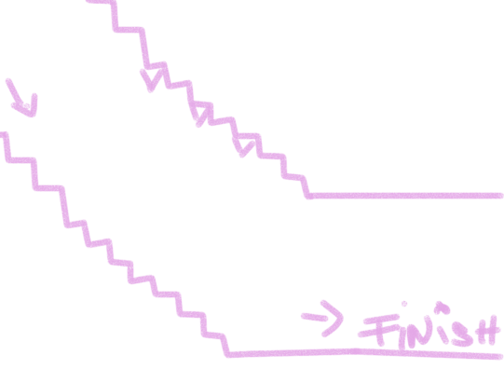
The first level ends with the hardest obstacle so far.
The player has to be quick and use his hand to cover the character while spikes drop from above.

