Slide 1
L4/5 Group Project Team Two Project Zombie
A zombie survival game with distraction mechanics.
Developed by Michael Davis, Bogdan Dumitrascu, Jack Gilmour
Notes:
All
Hello everyone, and welcome to our MVP pitch presentation (introduce ourselves).

Slide 2
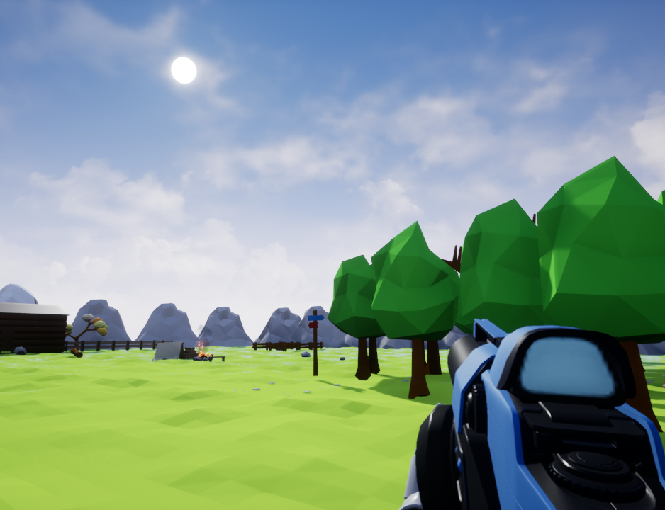
What is Project Zombie?
A first person zombie survival game where the traditional shooting mechanics have been replaced with distraction mechanics.
Traditional shooting mechanics are firing invisible projectiles, weapon reloading, recoil, ammo depletion, etc.
Distraction mechanics are utilised via noise generating actors from the game world.
The player can pickup these noise generating objects via a physics gun and launch them to create noise when they collide with actors in the world.
Notes:
Michael
What is project zombie and what is our answer to the brief. Our answer to the brief is a zombie survival game where we have replaced the traditional shooting mechanics with puzzle distraction mechanics. We use noise making objects to distract zombies, you can even use these objects to lure them into traps.

Slide 3

Gameplay Video
Notes:
Michael
If video does not play use this link.
https://www.youtube.com/watch?v=bJrFpjK7Ud0

Slide 4





Our Current Design
A cartoon, stylized art style with low-poly 3D models.
Very popular art style due to Fortnite, Overwatch, etc.
We want our players to feel these emotions.
Notes:
Jack
We want to create a fun experience for our player, that involves not only creating feelings of excitement, but also frustration.

Slide 5
Our Current Project State
We have a fully working prototype game.
We have a small prototype game world.
We’ve had feedback on our prototype game.
“I really like the way it handles. Feels like old Unreal games. I like the art style a lot, the colors !”
Notes:
Bogdan
We’ve had some player feedback. People liked the concept (potential). Crosshair. More features ( preview of throw, crouch, more types of zombies, upgrade system, item drops).

Slide 6
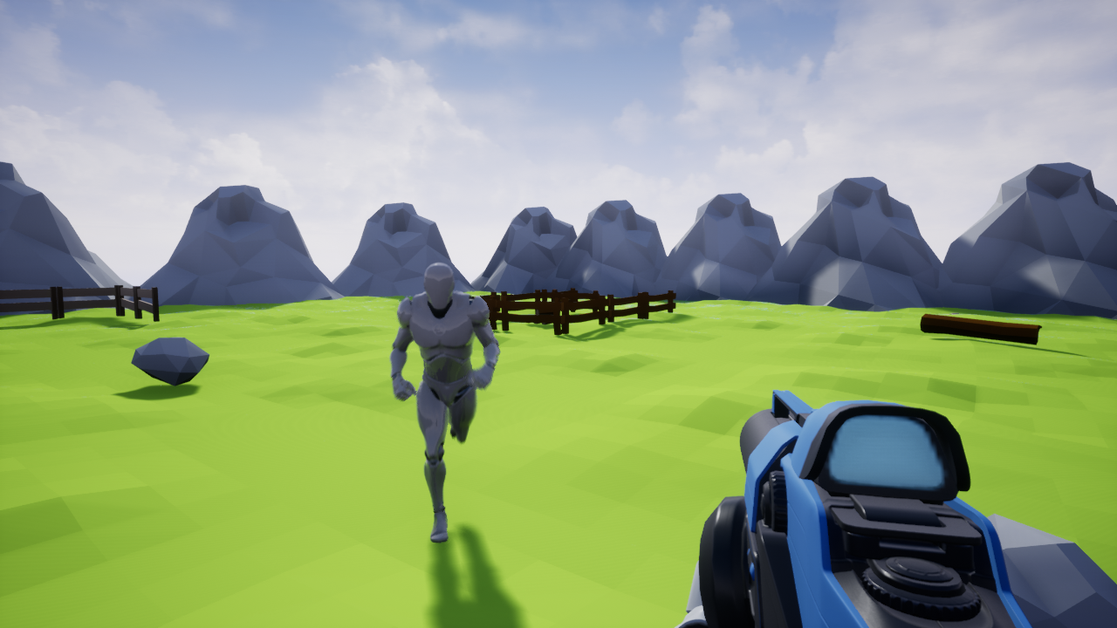
Problems
Project scope, it is a very large and a very ambitious game.
3D art took longer than we expected.
Open world level design is hard.
AI Programming is hard.
Notes:
Bogdan
Development hasn't been smooth, these are some of the problems we’ve had making this game.

Slide 7
Deliverables
Essential
Survival Mechanics (Hunger, Thirst, etc)
Interactivity
Zombie Wave Spawning
Day/Night Cycle
HUD
Non-essential
Inventory System
Crafting Mechanics
Building Mechanics
Puzzle Crafting
Notes:
Michael and Jack
This is a list of what we would like in our game some of these can be achieved with the skill set we have others will take a lot of time to develop.

Slide 8
Questions?
We would like to answer them for you!
Notes:
Everyone
Are there any questions

