Slide 1
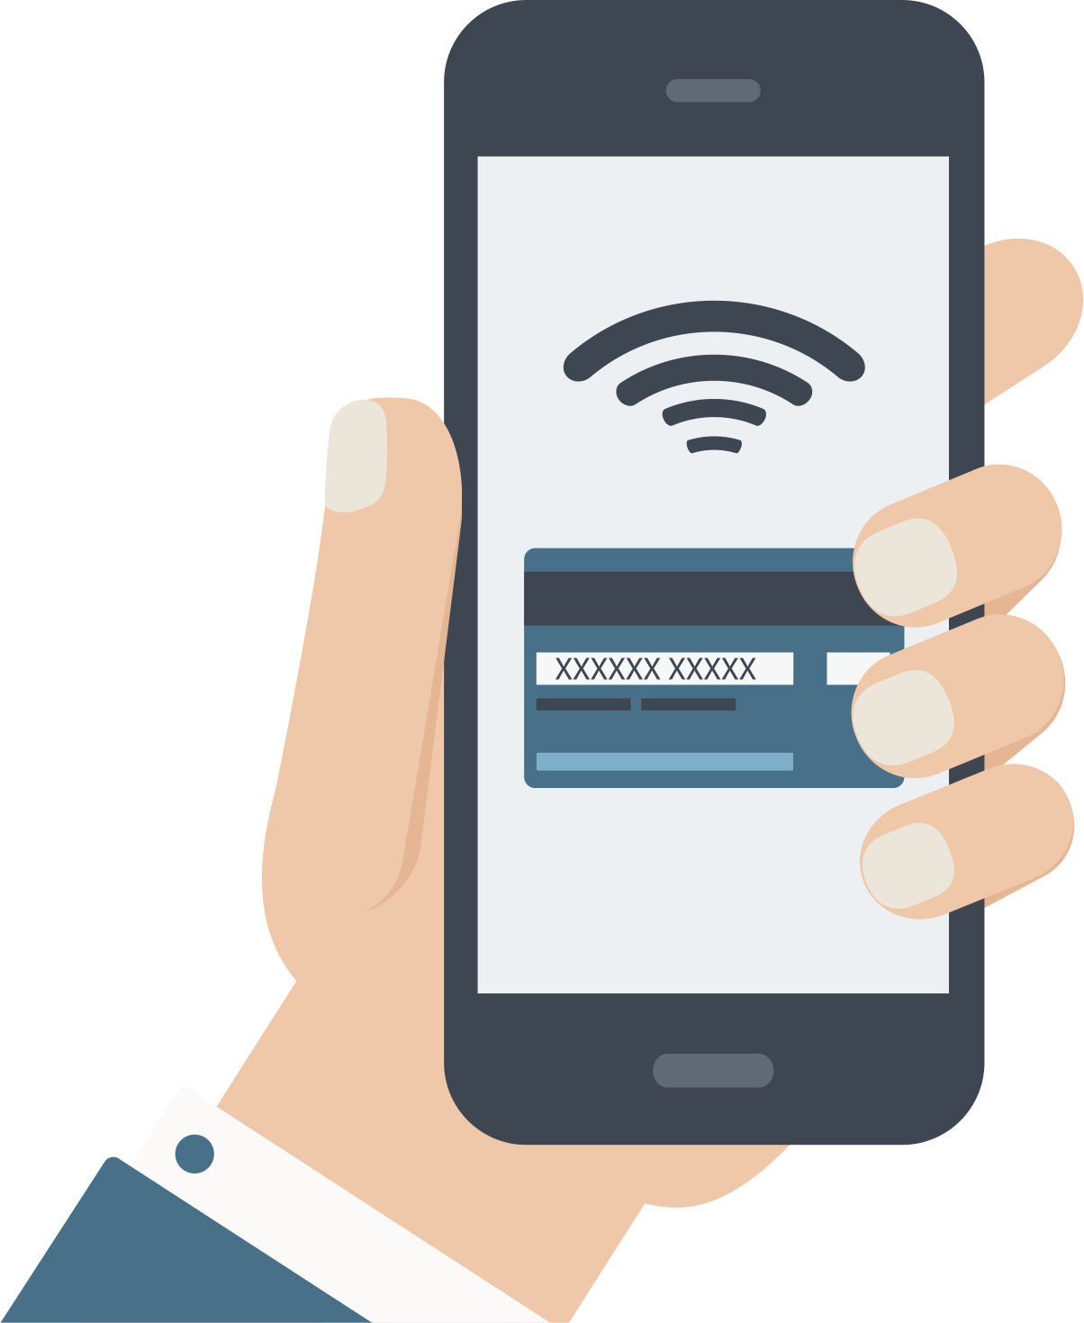
Payment methods?
Made by
Karina Karushkova
Notes:
There are different payment methods that exist nowadays - from online payments to cards and cash.
For this week I had to do a research about online payment methods, that can be alternatives of the ones that our Uni shop is using - credit/debit cards. For my document, I searched the web, as I found very interesting information about many of the payment services that we are going to look at in a bit. Those payment services that are modern and growing with every single day going. Smartphone developers made apps (also called digital wallets) that can make their users’ lives easier. No need of bringing cards or even cash – if you have your phone in your pocket, you can do everything with one click. Currently, the three most established systems are from Apple, Samsung and Google.

Slide 2
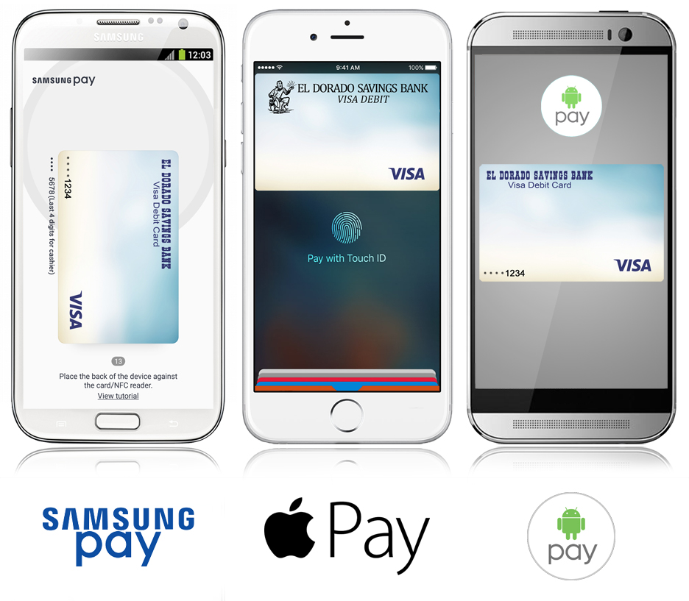


Different Payment Services
Notes:
The payment services that I searched the web more detailed for are the three most famous electronic wallets on the market at the moment ( Samsung Pay, Apple Pay and Google pay, which is a merged service between Android pay and Google Wallet). There are similar with each other, but still, they have some differences. The three of them are doing the job, they are easy, secure, private. You can add credit, debit or gift cards to the applications.
But let’s look at the differences :
•Apple pay has the bigger range of places that can be used as payment method – 27 countries worldwide, Google pay can be used in 18 countries and Samsung Pay in 24 countries.
•Samsung is way more limited than the other two. This electronic wallet is compatible with select Samsung Android mobile devices.
•Fingerprint, iris, PIN code are the security options for the user to keep their bank details private and to proceed with a payment.
Of course, there are also PayPal and Stripe, which are other payment platforms/ processors. They allow merchants to accept payment from their customers. Both of the platforms are secure and easy to use.
PayPal’s core offering has always been its payment processing: allowing anyone to make a payment to a merchant using their own PayPal balance or a credit or debit card. But these days, merchants who use PayPal get access to a variety of supplemental services that allow you to go beyond selling on eBay. There are three service plans of PayPal -
•Express Checkout: Add PayPal as a supplemental checkout option in addition to your standard payment processor for standard PayPal rates.
•Payments Standard: Get online payment processing and invoicing for standard rates.
•Payments Pro: Get your standard PayPal features PLUS a Virtual Terminal and hosted checkout page for a monthly fee plus processing fee.
Stripe’s primary function is online payments. The company offers merchants a boatload of features to complement its core offering, but unlike PayPal, they’re more of supplements than additional features beyond payment processing. Here are Stripe’s main features (Payment processing; subscriptions; coupons; free trials; marketplace tools; buy buttons in mobile apps and so on...
PayPal has a monthly fee and Stripe doesn’t. There are other differences such as Stripe have as a payment method PayPal and PayPal doesn’t have other payment methods rather than itself. PayPal is more popular than Stripe as its range of countries is 220+ and Stripe is availiable only in 20+ countries.

Slide 3
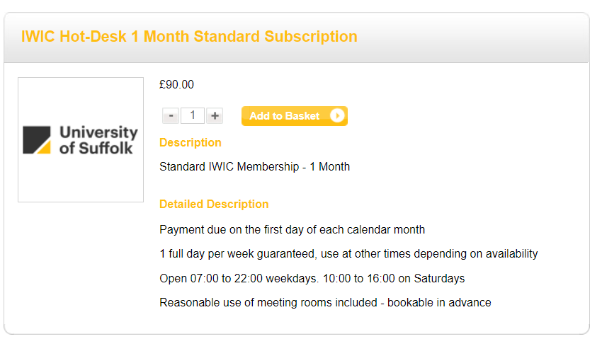
What do we have now?
Notes:
Now we can look at Our Uni shop and what services does it provide. I made myself an account as if I am a guest and I want to become a member in IWIC and subscribe to you for one month. It was easy to use the website and the payment methods are credit/debit cards. The system is secure and easy to use as I was going further with the payment process.

Slide 4
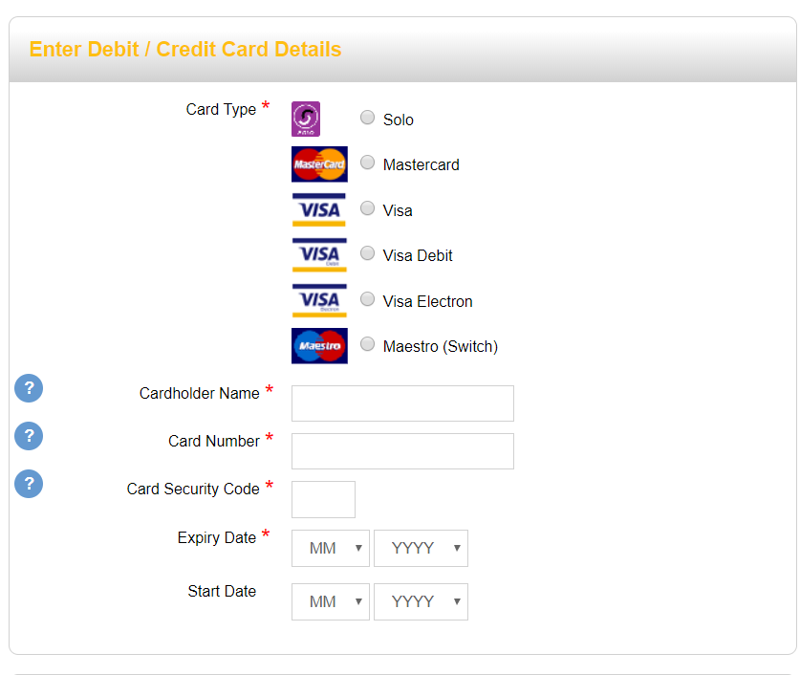
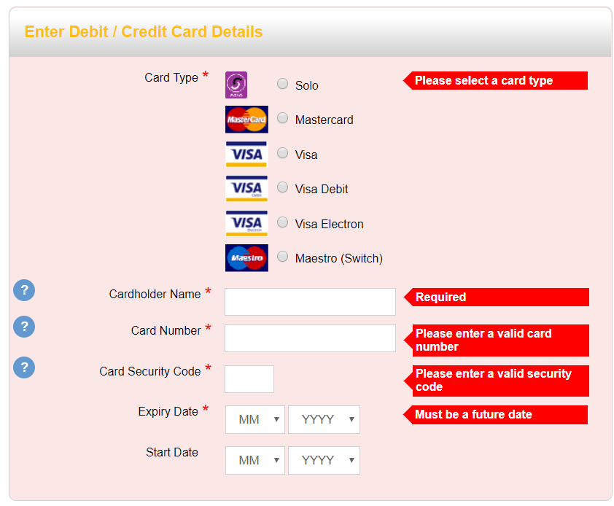
Notes:
Requested spaces.

Slide 5

Tracking the memberships?
Monthly report of payments?
Notes:
For next week's research I am going to include :
How can we implement tracking memberships and subscribtions
How can we make a monthly report to appear for the admin.

