Slide 1

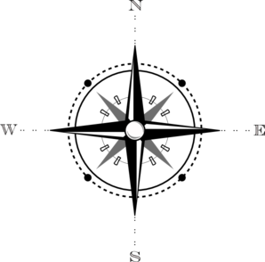
Virtual House Target Window Clue Chart
4
U
T
S
6
I
H
G
5
3
V
J
F
R
Top
W
K
E
Q
X
L
D
P
2
7
8
A
B
C
1
M
N
O
Starting Point

