Slide 1
Lesson 1:
Working in Parallel
Branches and Pull Requests
Reference:
Research Software Engineering with Python by Damien Irving, Kate Hertweck, Luke Johnston, Joel Ostblom, Charlotte Wickham, and Greg Wilson
https://merely-useful.tech/py-rse/git-advanced.html

Slide 2
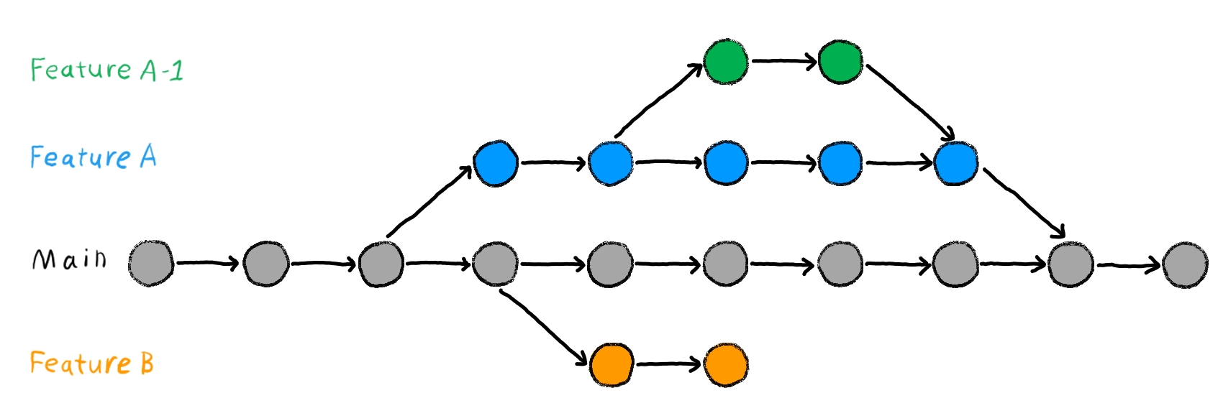
Working in Parallel: Branches

Slide 3



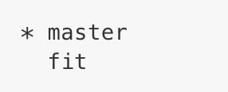
Creating new branches
Check what branches exist in the repository
main
The asterisk indicates which branch is currently active
Create a new branch called “fit”
fit
Check what branches exist in the repo
main

Slide 4
Creating new branches
Check what branches exist in the repository
The asterisk indicates which branch is currently active
Create a new branch called “fit”
Check what branches exist in the repo
In mid-2020, GitHub changed the name of the default branch from “master” to “main”. Owners of repositories can also change the name of the branch.

Slide 5
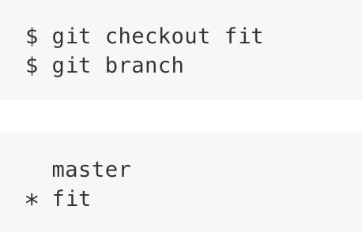
Checking out a new branch
fit
main

Slide 6
Checking out a new branch
fit
main

Slide 7
Checking out a new branch: Tutorial
$ git branch
$ git branch [name]
$ git branch
$ git checkout name
Notes:
Live-coding: Have students set up git in their IDES. They should make a repository.

Slide 8
Committing Changes: Tutorial
$ git add . OR $ git add filename.py
$ git commit -m “your commit message here”
$ git push origin yourbranchname

Slide 9
Committing Changes: Tutorial
YOU ARE HERE
fit
main

Slide 10
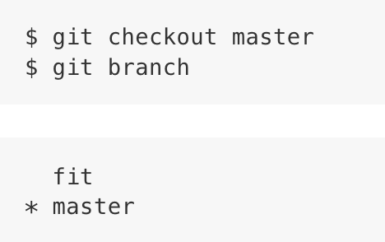

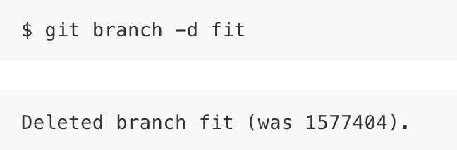
Merging
fit
main

Slide 11
Handling Conflicts: Merge or Rebase
$ git status
[Resolve the conflict]
$ git add <filename>
$ git merge –- continue
OR
$ git rebase –- continue
$ git commit -m “resolved merge conflicts”
$ git push origin yourbranchname

Slide 12
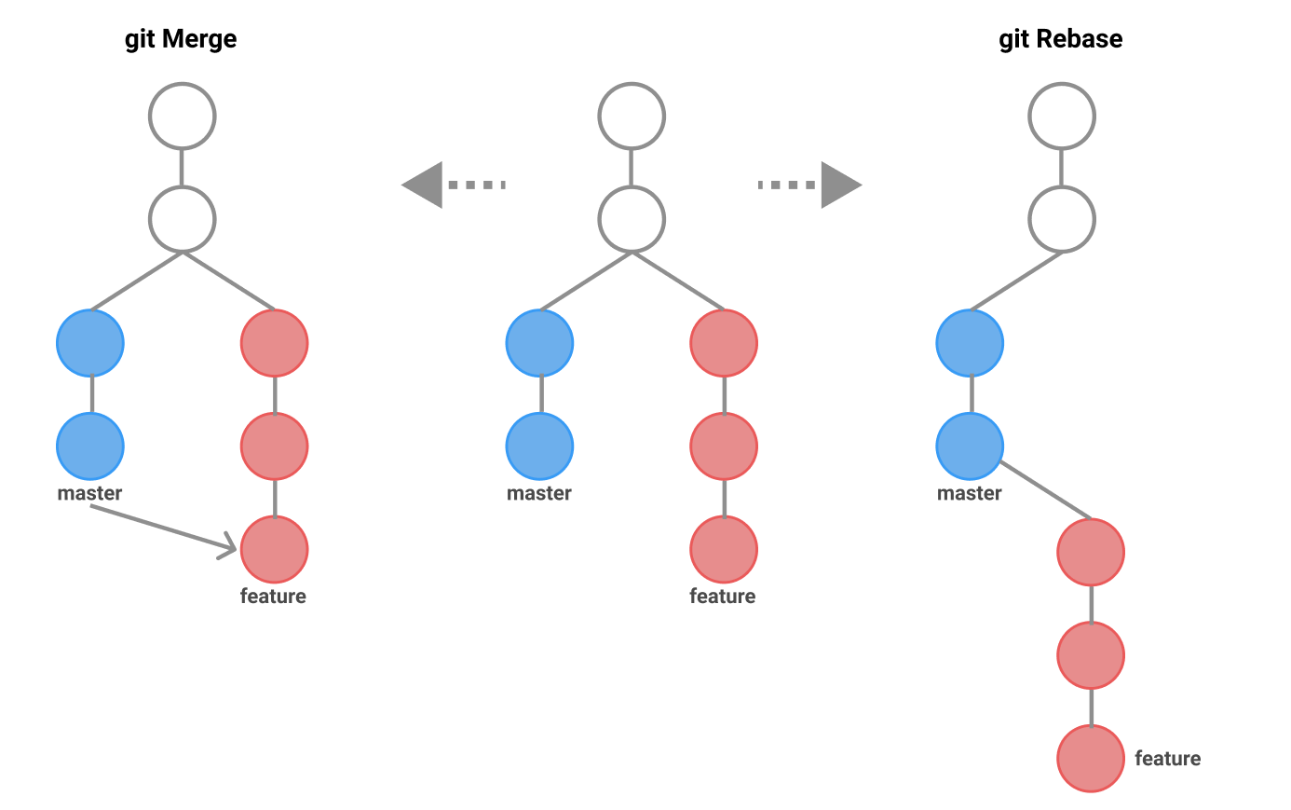
Handling Conflicts: Merge or Rebase
$ git status
[Resolve the conflict]
$ git add <filename>
$ git merge –- continue
OR
$ git rebase –- continue
$ git commit -m “resolved merge conflicts”
$ git push origin yourbranchname
Notes:
At this point, checkout a branch in your repo, and edit a py file so that there would be a conflict. Resolve it in real time.

Slide 13
Handling Conflicts: Merge or Rebase
$ git merge –- continue
$ git rebase –- continue
Integrates changes from one branch to another
Result is a non-linear, bifurcating history
Ideal for cases where you want to main a complete, chronological history
Rewrites commit history to apply changes from one branch to the tip of another
Result is linear. All changes looks like they were made in a single series of steps, even though they were made in parallel
Ideal for cleaning up commit history before merging into a main branch. Streamlines a sequence of commits before sharing with team
Notes:
At this point, checkout a branch in your repo, and edit a py file so that there would be a conflict. Resolve it in real time.

Slide 14
Handling Conflicts: Merge or Rebase
$ git status
[Resolve the conflict]
$ git add <filename>
$ git merge –- continue
OR
$ git rebase –- continue
$ git commit -m “resolved merge conflicts”
$ git push origin yourbranchname
Notes:
At this point, checkout a branch in your repo, and edit a py file so that there would be a conflict. Resolve it in real time.

Slide 15
Branch Based Workflow Best Practices
git checkout main
Make sure we’re in the main branch
git checkout fit
Make a new branch from the main branch
Always create a branch when making changes
Make changes
git merge main fit
Test that the merge fits WITHIN THE BRANCH
Resolve any conflicts WITHIN THE BRANCH
git checkout master
git merge fit main
We should not have any conflicts, tests should pass

Slide 16
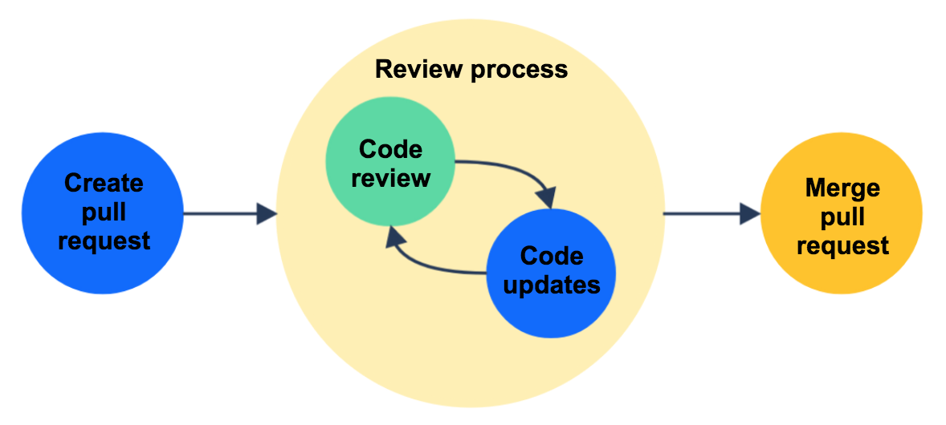
Working in Parallel: Pull Requests
Notes:
Explain that as teams grow, it can get more disorganized if everyone has read and write access to the same repository.

Slide 17
Making a branch:
Forking:
Collaborating within a repository
Branches are used when multiple people are working within the same repo. Every person or feature gets its own branch
Fixing Bugs
Making a branch to fix bugs or develop features keeps the main branch free from unstable code until you’re finished
Isolating Work
Branches are great for isolating different parts of a project and staying organized
Working on a Separate Project
Fork when you want to create a separate project that you can take in a completely new direction
Contributing to Open Source Projects
In open source projects, you typically don’t have write access. Fork, make changes, and then submit a pull request from your fork.
Maintaining a Personal Copy
if you want a version of a project for personal use or experimentation, forking is the way to go

Slide 18
Pull Requests: Forking
$ git clone [repository URL]
$ cd [repository name]
$ ls
$ git remote add upstream [original repo url]
$ git remote -v
$ git pull upstream master
Notes:
At this point, have students for your repository. Before the $ git pull upsteam master command, change the readme in your repo so that students can pull and inspect the changes. Write an introduction to the read me, like : This is the course repository. Contributors:

Slide 19
Pull Requests: Tutorial
$ git clone [repository URL]
$ cd [repository name]
$ ls
$ git remote add upstream [original repo url]
$ git remote -v
$ git pull upstream master
Notes:
Have students fork the repository, and add their names and email addresses under “Contributor:”, and make pull requests on github. Accept the pull requests and navigate any conflicts.

