Slide 1
Lesson 3:
Automating Analyses with Make
How to deal with multiple files and dependencies in a project
Reference:
Research Software Engineering with Python by Damien Irving, Kate Hertweck, Luke Johnston, Joel Ostblom, Charlotte Wickham, and Greg Wilson
https://merely-useful.tech/py-rse/automate.html

Slide 2
Make and Build Management
Make is a build management tool used to automate the process of compiling and linking software projects.
Helps manage and automate tasks in a workflow, especially when dealing with multiple files and dependencies.
Make uses a file called 'Makefile' to define how to compile and link a program.

Slide 3
Key Concepts in Make
Build rule: A specification for a build manager that describes how some files depend on others and what to do if those files are out-of-date. A build rule has targets, prerequisites, and a recipe.
Build targets: The file(s) that a build rule will update if they are out-of-date compared to their dependencies.
Default target: The build target that is used when none is specified explicitly.
Prerequisite: Something that a build target depends on.
Recipe: The part of a build rule that describes how to update something that has fallen out-of-date.

Slide 4
How Make Works:
Every time the operating system creates, reads, or changes a file, it updates a timestamp on the file to show when the operation took place. Make can compare these timestamps to figure out whether files are newer or older than one another.
A user can describe which files depend on each other by writing rules in a Makefile.
For example, one rule could say that results/moby_dick.csv depends on data/moby_dick.txt, while another could say that the plot results/comparison.png depends on all of the CSV files in the results directory.
Each rule also tells Make how to update an out-of-date file.
For example, the rule for Moby Dick could tell Make to run bin/countwords.py if the result file is older than either the raw data file or the program.
When the user runs Make, the program checks all of the rules in the Makefile and runs the commands needed to update any that are out of date.
If there are transitive dependencies—i.e., if A depends on B and B depends on C—then Make will trace them through and run all of the commands it needs to in the right order.

Slide 5
Installation: https://www.gnu.org/software/make/
Clone Repo: [instructor repo]

Slide 6
Testing it out
Run this command in the shell: $ make
Make automatically looks for a file called Makefile, follows the rules it contains, and prints the commands that were executed
Make indents a rule with spaces rather than tabs!

Slide 7
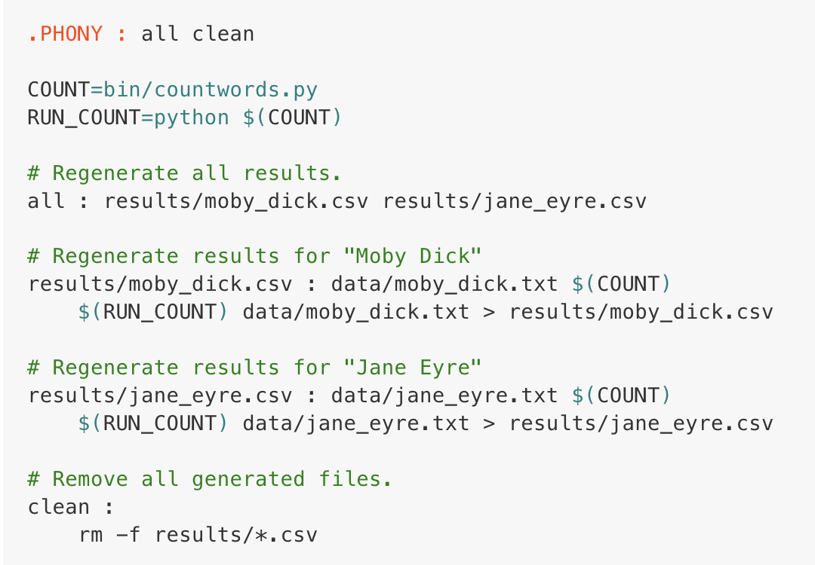
Using variables to avoid repetition
Reduces cognitive load
Easier to edit the Makefile if a filename changes
Notes:
Explain that the image is an example of a program that counts the words in text files.

Slide 8
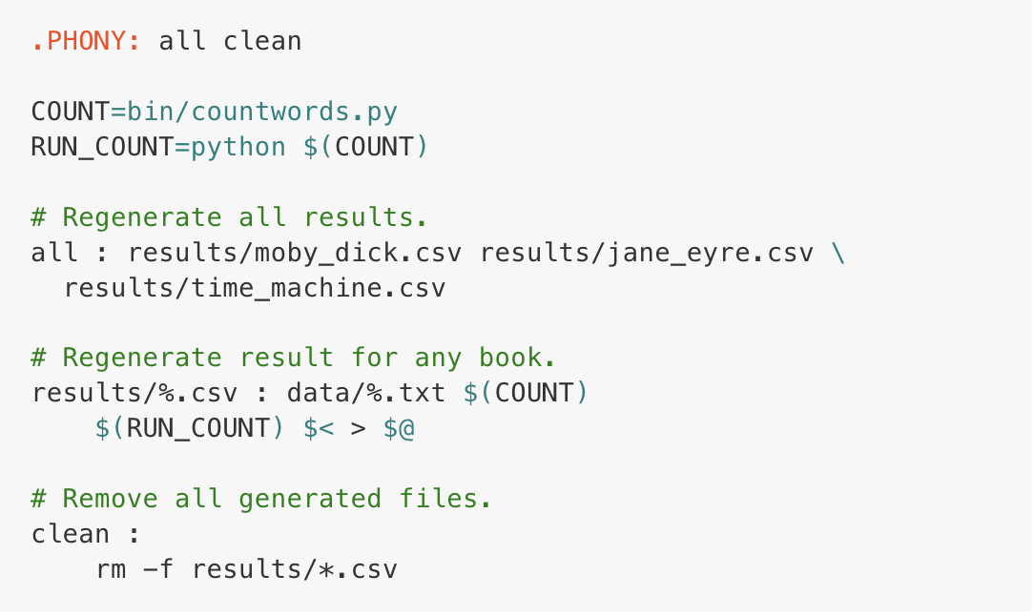
Automatic Variables: Simplifying even further
Notes:
Point out that the second version of the makefile has even more textfiles and files to accommodate, but less code.

Slide 9
Automatic Variables: Simplifying even further
%: Also called wildcard, is a placeholder for pattern matching in rules
% cannot be used in recipes, which is why $< and $@ are needed.
$@: Represents the target of the rule.
In this case, it will be replaced with results/%.csv where % matches the stem of the target file.
$<: Represents the first prerequisite.
In this rule, it will be replaced with data/%.txt, corresponding to the source data file for each book.
Notes:
Point out that the second version of the makefile has even more textfiles and files to accommodate, but less code.

Slide 10
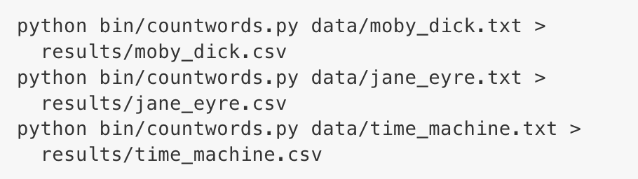
Automatic Variables

Slide 11

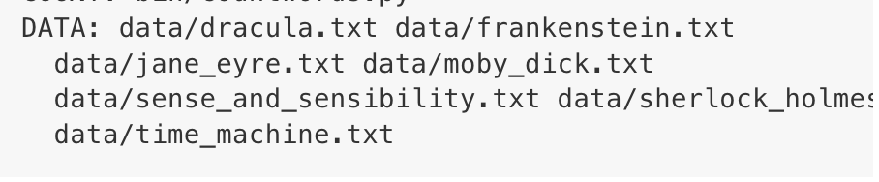
Automating even further: Defining sets of files
But what if we add another book to the data folder?
Here, we are creating a list of all the text files in the data directory.

Slide 12
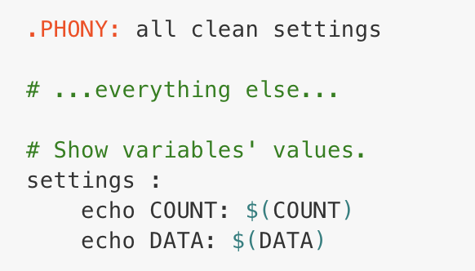

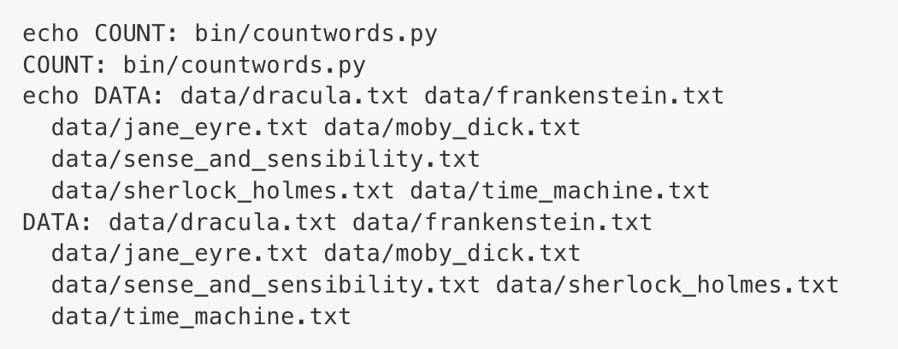
Automating even further: Defining sets of files
Making a phony target called settings that uses the shell command echo allows us to print the names and values of our variables:

Slide 13
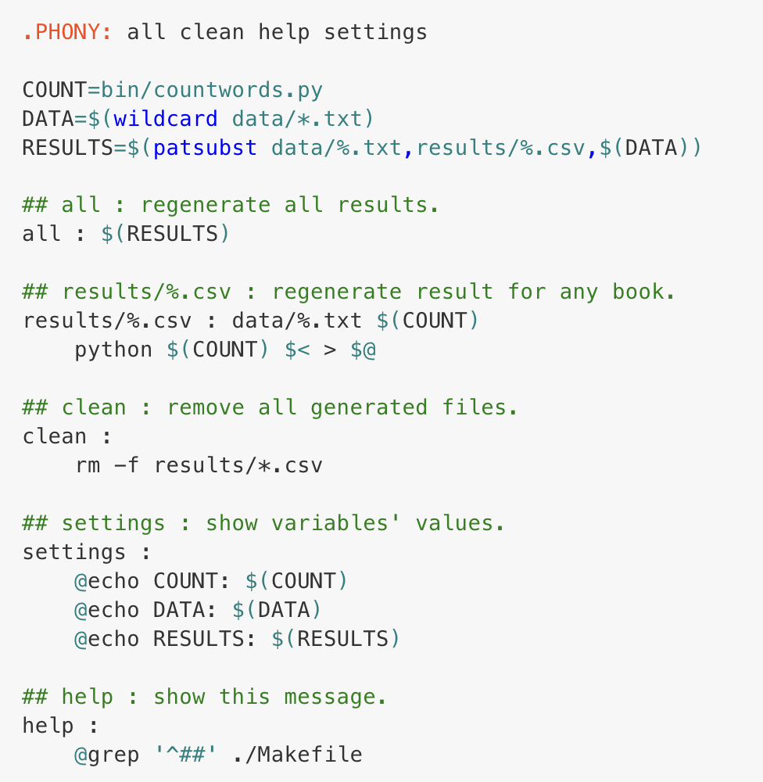

Automating even further: Documenting Makefiles
Now that we’ve defined each set of files, our code shrinks even more
$ make help will display all the comments, to clarify targets and explain the workflow
making comments as you go will keep the help function continually updated

